Slide 1
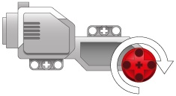
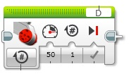
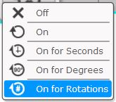
Large Motor Block
Used to run ONE large motor only.
1. MODE SELECT.
Choose how motor will operate.
For positioning:
On for degrees
On for rotations
is recommended.
When “ON” mode is selected, motor will keep running until another block tells them to turn “OFF”!
5. SELECT MOTOR PORT
Selects which brick port the motor is connected to
A, B, C or D
Turns motor OFF
Motor keeps running
4. BRAKES
Tick = ON
On is recommended
2. SET MOTOR SPEED.
Enter any number from
-100 to 100 using slider or keyboard.
(keyboard is easier)
“0” = stopped
“100” = full speed forward
“-100” = full speed reverse
3. SET the number of rotations, degrees or time period (secs) for the motor to run.
This setting is dependent on the MODE selected.
Use keyboard to enter data.
Decimals can be used here.

