Slide 1
Modern Home Cinema By Tomasz Zajda
Art of Projection
Session Three: Map the Edge
Dr Waldemar Jenek
10.03.2024

Slide 2
Acknowledgement of Country
We acknowledge Aboriginal and Torres Strait Islander peoples and their continuing connection to land and as custodians of stories for millennia. We respectfully acknowledge the land on which we all meet today, and pay our respects to elders past, present and emerging.

Slide 3
Session Overview
Welcome
Check in and get set up on a computer
Brief recap of Session Two
Overview of workshop
Today’s Goals and Timeline
Image by Viktor Kosilov from Pixabay

Slide 4
Equipment
Computer with Premiere Pro and TouchDesigner
SLQ collection items for mapping content,
Projectors
Portable projection surfaces (cardboard cubes).

Slide 5
Health & Safety
For all workshops at The Edge we like to familiarise participants with:
Exit points
Lab Risk Assessments
Safe operating procedures (SOP)

Slide 6
Objectives
Basic understanding of projection mapping.
Ability to use SLQ collection items creatively in digital art.
Skills in video editing and using TouchDesigner for projection mapping.
Experience in setting up and executing a projection mapping display

Slide 7
What is Projection Mapping?
Technology that turns objects into display surfaces for video projection.
Often used on irregularly shaped surfaces like buildings, stages, or indoor objects.
Adds extra dimensions, optical illusions, and notions of movement.

Slide 8
What is Projection Mapping?
Utilizes specialized software to fit images onto the surface of objects.
Can warp and align projected images to fit perfectly on irregular shapes.
Employs projectors to display light onto 3D objects, turning them into interactive displays.

Slide 9
What is Projection Mapping?
Used in advertising, public art, entertainment, and live concerts.
Transforms static objects into dynamic visual displays.
Engages audiences with immersive and artistic experiences.

Slide 10
Video Editing for Mapping
Repeat: Basic Editing Techniques: Cutting, Splicing, and Layering
Preparing Videos for Projection Mapping

Slide 11
Break Time
15-30 Minutes Break
Interactive Q&A Segment

Slide 12
Introduction to TouchDesigner
TouchDesigner Interface and Features
Mouse Navigation
Networks/ Network area
Path
Operators
Short cut (I Inside Operator and U outside operator)
H Home to find networks

Slide 13
Introduction to TouchDesigner
Data Travels from left to right
Connect and disconnected operators
Dynamic wires
Different operators
Top= Textures, Images, videos
Chop: Nummeric Data Channels Operators
DAT: Data Operators for Tables, API,
SOP: Surface Operators 3d Geometry
COMP: Component Operators
Mats: Materials operators

Slide 14
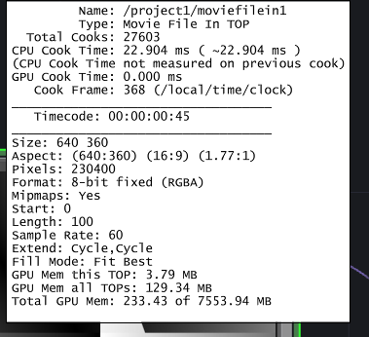
Parameters
Numbers
P-key Parameter Window
Video example and Parameters Speed/Play
Info Window, right click/info

Slide 15
User Interface
Timeline
FPS: Frames per Second
Pane Layout Alt z or Alt [
Find Help
Help/Snippets

Slide 16
Example Networks
Help/Snippets
Smaller packages
constant

Slide 17
Hands-On: Practice and Experimentation
Creating Your Projection Mapping Content
Step-by-Step Guidance
Tips for Refining Designs

Slide 18
Setting Up the Projection
Projector Setup Techniques
Aligning Projectors with Surfaces
Using Cardboard Cubes as Projection Surfaces

Slide 19
Showcase and Feedback
Presentation of Participant Works
Group Discussion and constructive Feedback

Slide 20
Wrap-Up
Recap of Key Learnings from Session three
How to Further Explore Projection Mapping
Feedback Collection and Closing Remarks

Slide 21
Q&A Session
additional resources

Slide 22
Images

Slide 23
THANKS FOR ATTENDING
Please complete our survey that will be sent out via Eventbrite.
Tag us on socials @statelibraryqld
Contact us on appliedcreativity@slq.qld.gov.au

