Slide 1
Laser cut covers and hand sewn spines Session 3
Notes:
Tee up time for tour of preservations
Ensure inductions ipads are charged and sso page logged in
Set up bucket of water with washer for hands.
Set up glue spots (disposable plates?)
Set up water bucket for glue brushes
Cut strips of wax paper x2 per person each longer than the books are tall, and wider than the strips of wood.
Gather masking tape 1 per person
Gather strips of wood (1 per person)
Gather clamps (2 per person)
Make files to cut. Cutting templates for book cloth?
List of who has and hasn’t sent me their covers
Files for cutting (spacers, trim lines, trim shapes)

Slide 2
Today
Decorate our covers
Trim the ends
Add end papers
Making our covers
Putting book into cover
Next steps

Slide 3
Tip on end papers
Grain line
Fold papers
Glue

Slide 4
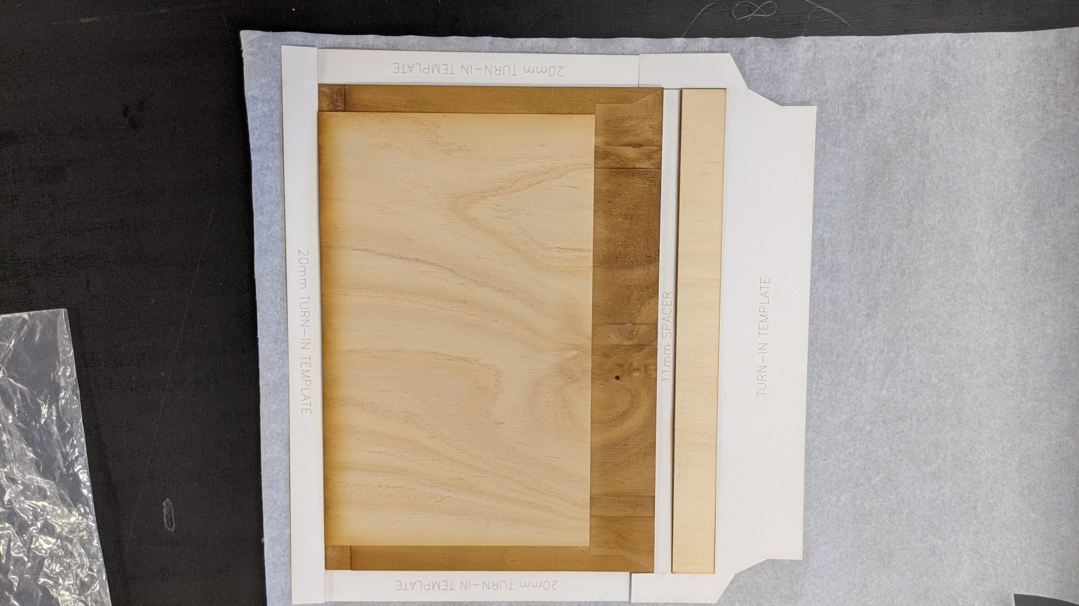
Layout
Check you have enough book cloth by laying out the template and cover like so:

Slide 5
Glue up cover
glue big back piece (plain) down first
Use spacer to place spine
Use spacer to place front cover (glue to inside of cover)
Turn-ins head, tail
Turn in foredge

Slide 6
Cutting end papers to size
Grain line importance
Cut around
Fold in half

Slide 7
Glue book into cover
Use baking paper to protect pages
Glue tapes to scrim on back glue on cover
Place in cover, close cover to ensure still fits. Note, boarder
Glue up top scrim/tapes/cover
press

Slide 8
Inserting end papers
Glue all one side, and 3mm over edge
Place atop pages
Close cover

Slide 9
Lots of ways to make a book
Types
Laser edges
Laser cut wood blocks for indenting
Laser cut stamps

Slide 10
Where to go from here
QLD Bookbinders Guild
Youtube channels:
Deep dives into various construction methods: DAS Bookbinding (Brissy guy!)
Fun/ lighthearted: Sea Lemon
iBookbinding: Tutorials, guest speakers (also have website)
Open Lab & Hack the Evening

