Slide 1
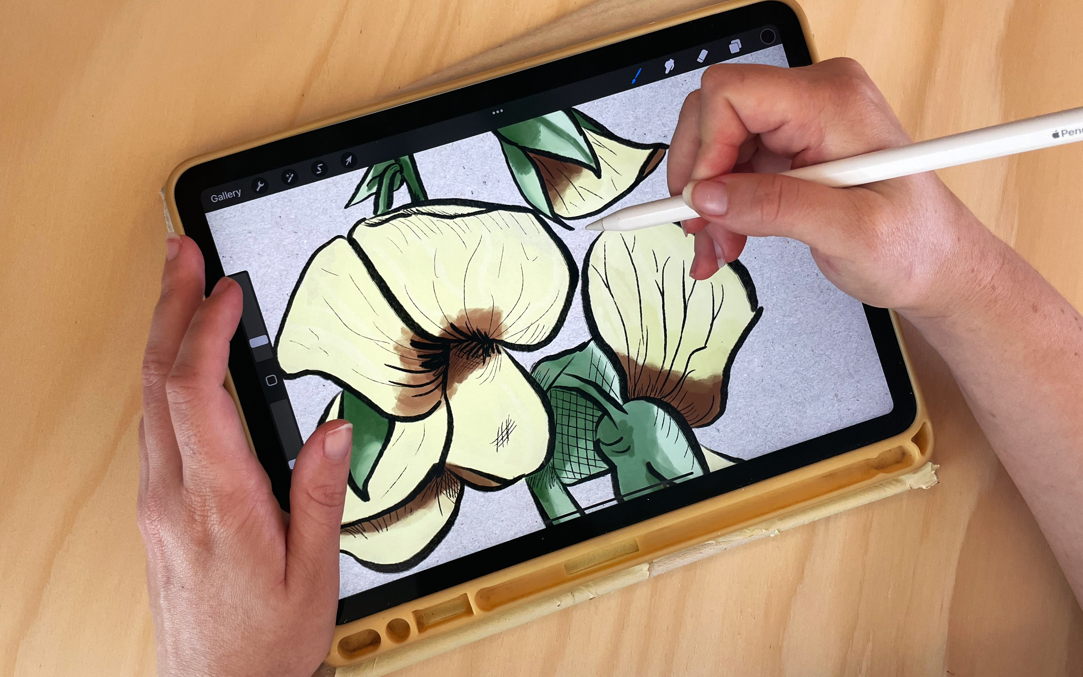
Procreate 101 Workshop
Ellie Dumigan, Month 2023

Slide 2
Acknowledgement of Country
We acknowledge Aboriginal and Torres Strait Islander peoples and their continuing connection to land and as custodians of stories for millennia. We respectfully acknowledge the land on which we all meet today, and pay our respects to elders past, present and emerging.

Slide 3
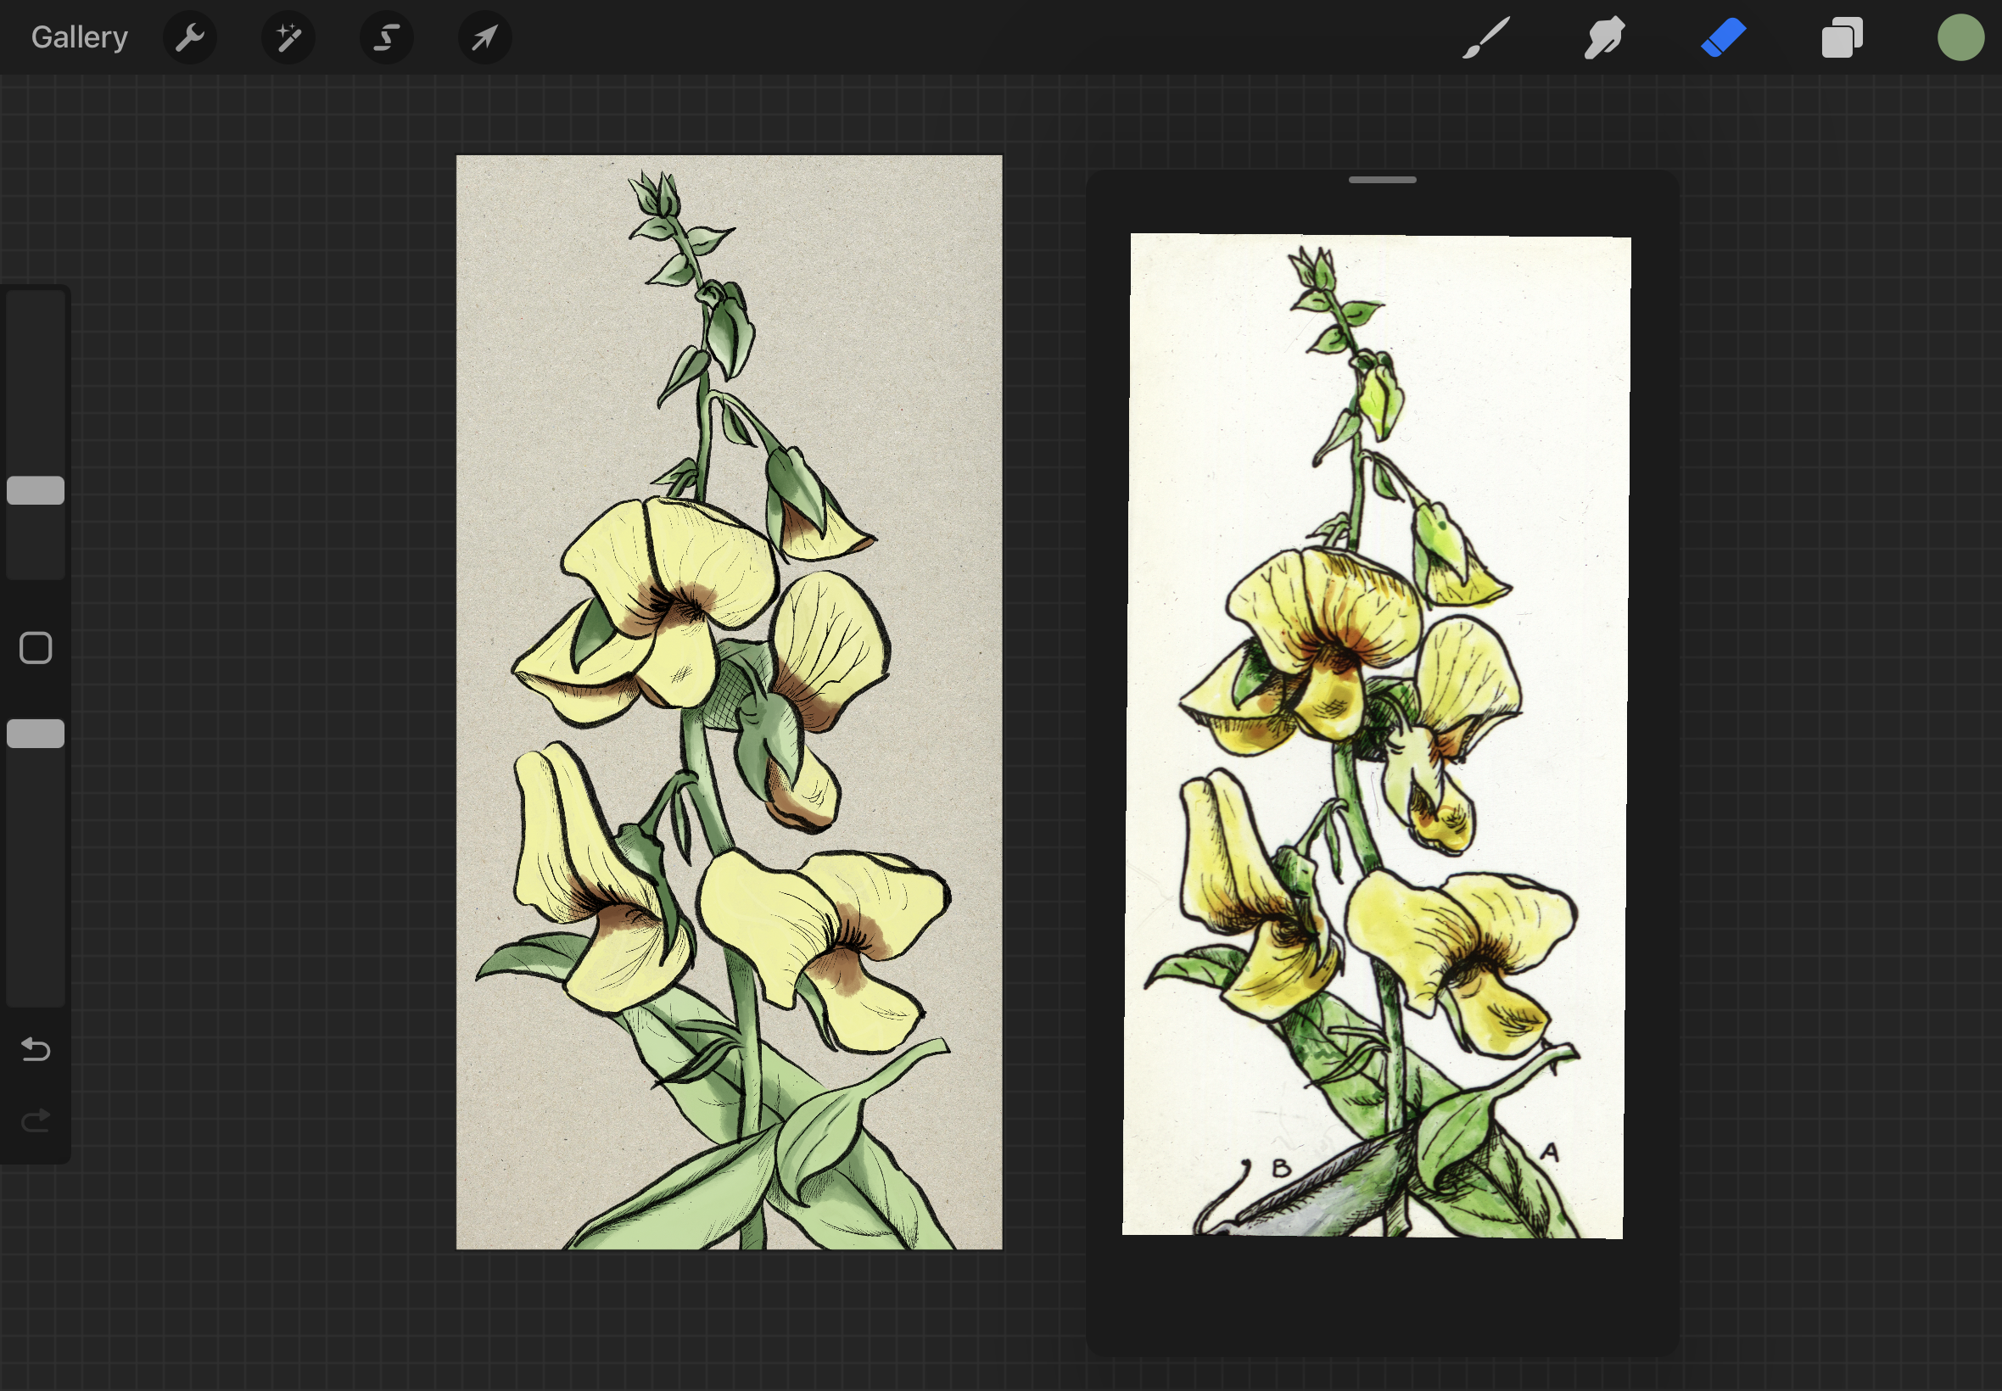
WORKSHOP SUMMARY
Summary:
Learn the basics of using Procreate to create sketches, paintings, illustrations and even animations.
Skills Introduced:
Procreate Gallery Overview /basics
Interface Overview + Hand gestures
Creating a Canvas
Brush options
Brush Studio
Introduction to Layers
Saving and Files + Exporting capabilities

Slide 4
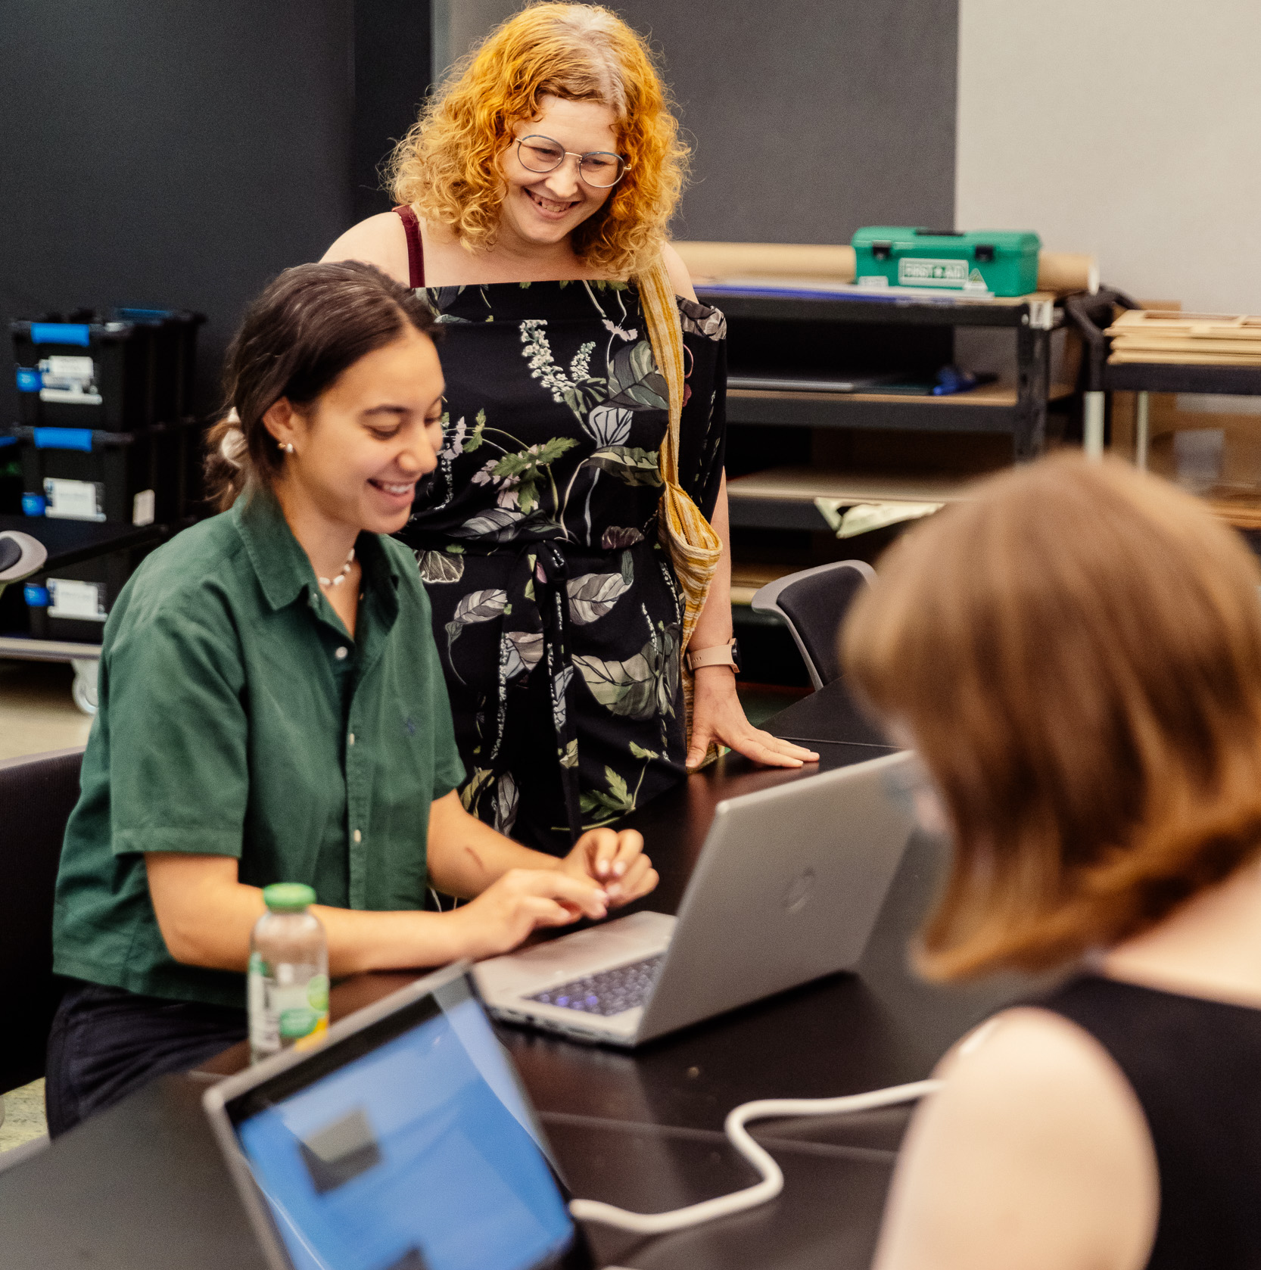
INTRODUCTIONS
Welcome
Check in and get set up on IPad
Why did you sign up for the workshop?
What are you keen to learn?
SLQ account logins
End goals
We will give an overview of the Procreate software and share all the tips and tricks for creating artwork within the app.
Build your confidence in Procreate to create your own artworks at the end of the session and beyond.

Slide 5
IPad
Apple/Drawing pen
Procreate App
TOOLS

Slide 6
LET'S GET
STARTED
Procreate Overview

Slide 7
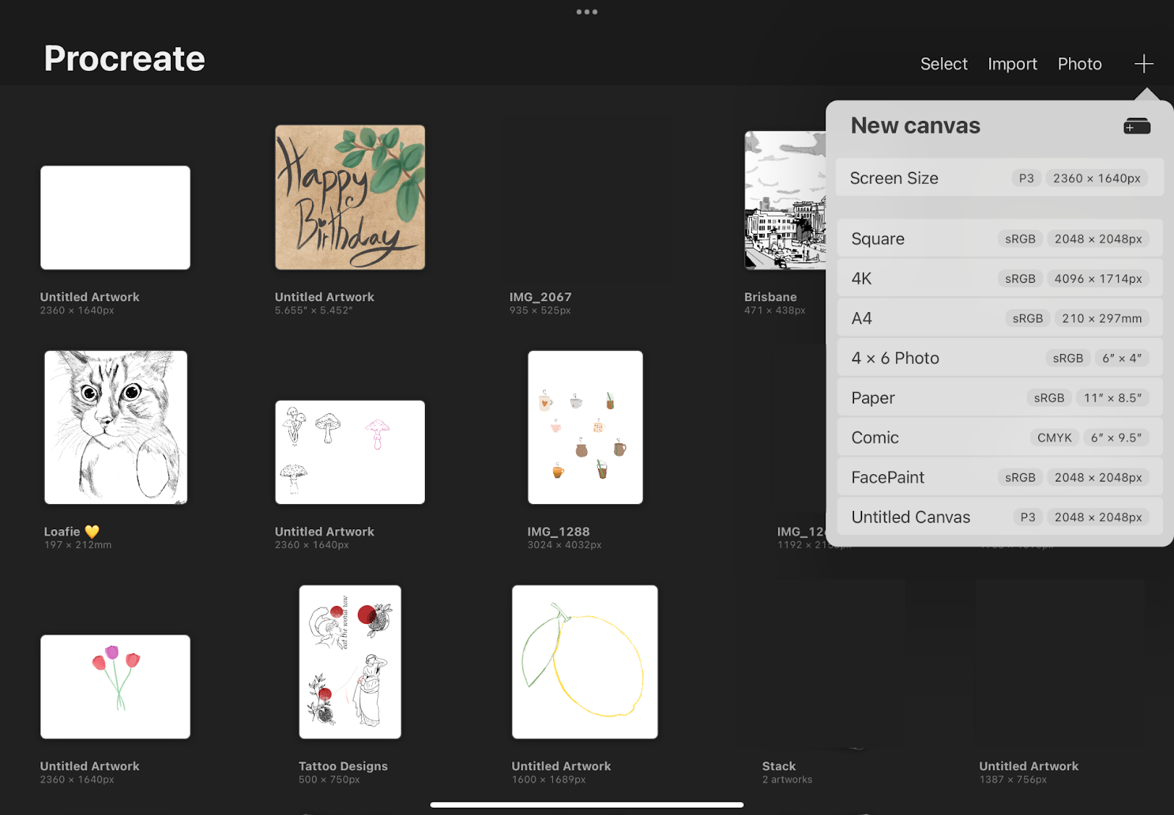
Procreate Gallery & Basics
Notes:
Overview of procreate gallery info

Slide 8
There are three sections of the Procreate interface.
These three sections can be broken down into;
Painting Tools (Top right)
Sidebar (left side)
Editing Tools (top left)
Interface Overview + Hand gestures
Notes:
Interface overview and then talk/explain Hand Gestures - demonstrate

Slide 9
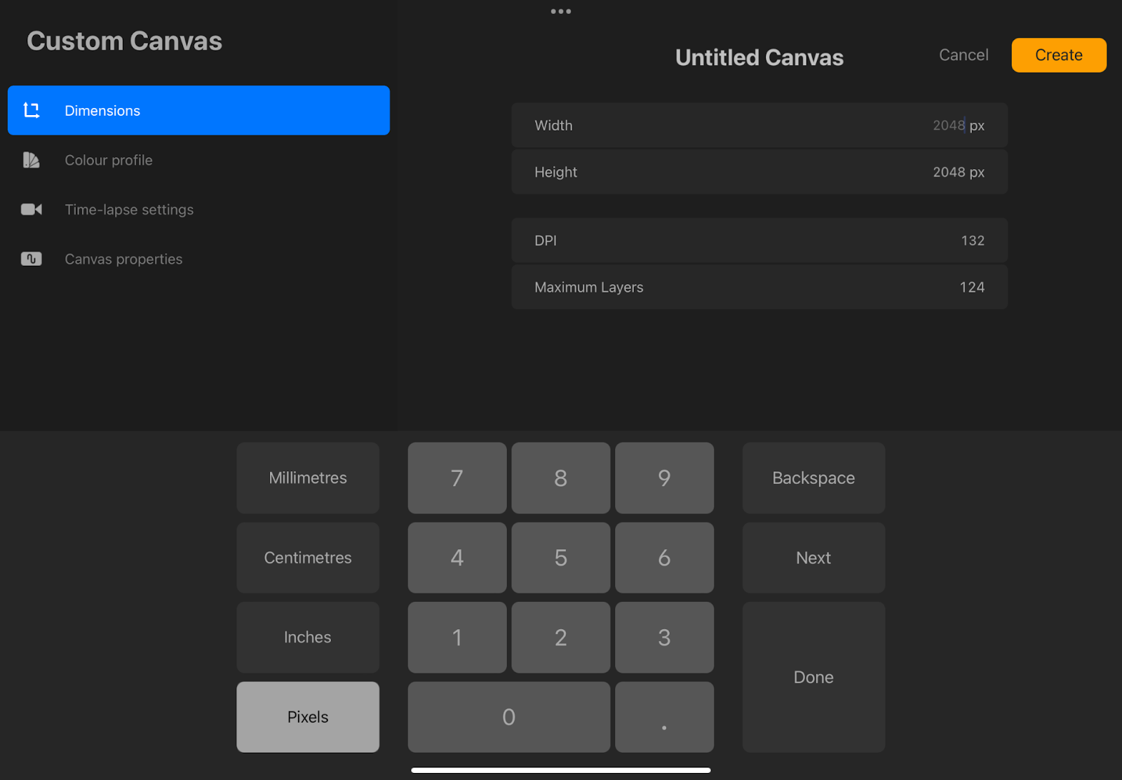
To create a new canvas press on the ‘+’ in the gallery view
Choose which size, either the default or create a custom size
Canvas sizes can be in mms, cms, inches or pixels.
DPI or dot per inch can also be selected for the new canvas from this view.
The colour profile can also be selected, it will default to RGB but CMYK is the preferred option for designs that will be printed.
Time-Lapse Settings, users can record and export videos.
Canvas properties – background colour can be selected or made transparent, this can also be done later on.
Once all these settings have been decided on, hit ‘Create’ to open our new canvas.
Creating a Canvas

Slide 10
Hand Gestures/Shortcuts
Pinch to Zoom - using two fingers place them on the canvas and move them together to zoom out or apart to zoom in.
Pinch-Twist to Rotate - pinch the canvas and twist your fingers in a circular motion to rotate the canvas.
Quick Pinch to Fit to Screen - Same gesture as Pinch to Zoom but done at a faster rate. Do the same gesture in revere to return to the previous view.
Two-Finger Tap to Undo - Tapping two fingers together on the canvas to undo. Rapidly undo a bunch of actions by holding two fingers.
Three-Finger Tap to Redo - Tap three fingers together on the canvas to redo. Rapidly redo a bunch of actions by holding three fingers.
Three-finger Swipe to Cut/Copy/Paste - Swipe three fingers down on the canvas to bring up the Cut/Copy/Paste option menu.
Four-Finger Tap for Full Screen - tapping four fingers on the screen will enter Full-Screen mode with the interface disappearing. To bring the interface back, four-finger tap again or tap the full-screen button in the top left corner.
All the gestures can be changed under the actions tab (wrench icon button), then Prefs and Gesture Controls to open the Gesture Controls panel.

Slide 11
Brush options
With Procreate you can create using an apple pencil or even your finger. Let’s go over some of the essential brush options that you have access to.
Overview of the brush options:
Paint
Smudge
Erase
Brush Overview
Notes:
Talk about the different brush options – demonstrate.

Slide 12
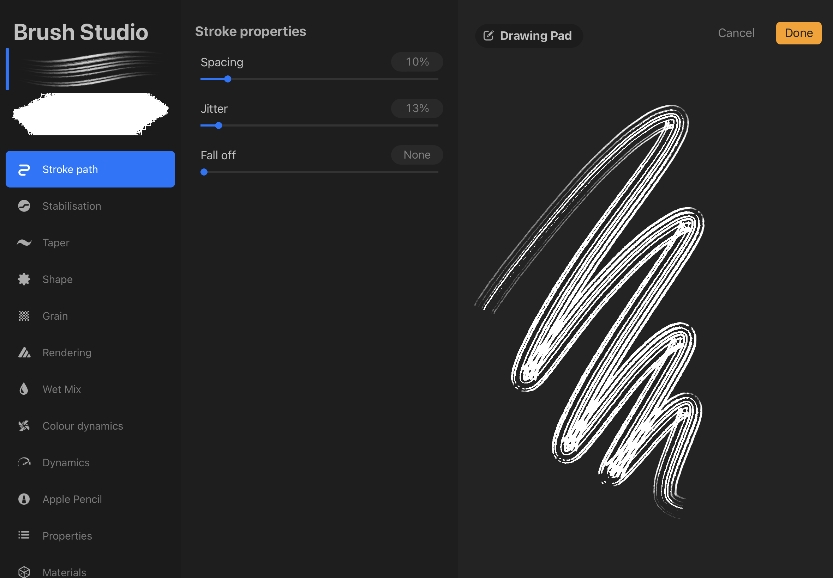
Brush Studio is a menu that allows you to fully customise the pre-made brushes in Procreate, or even create your own brush!
This interface is divided into three parts: Attributes, Settings and Drawing Pad.
Attributes:
Contains 12 characteristics of your brush. Shape, gain and size can all be adjusted for the brush here.
Settings:
The settings are different for each of the 12 characteristics of the brush.
Drawing Pad:
This allows you to preview and test out the changes.
Brush Studio
Notes:
Talk about brush studio, do a little show and tell and overview.

Slide 13
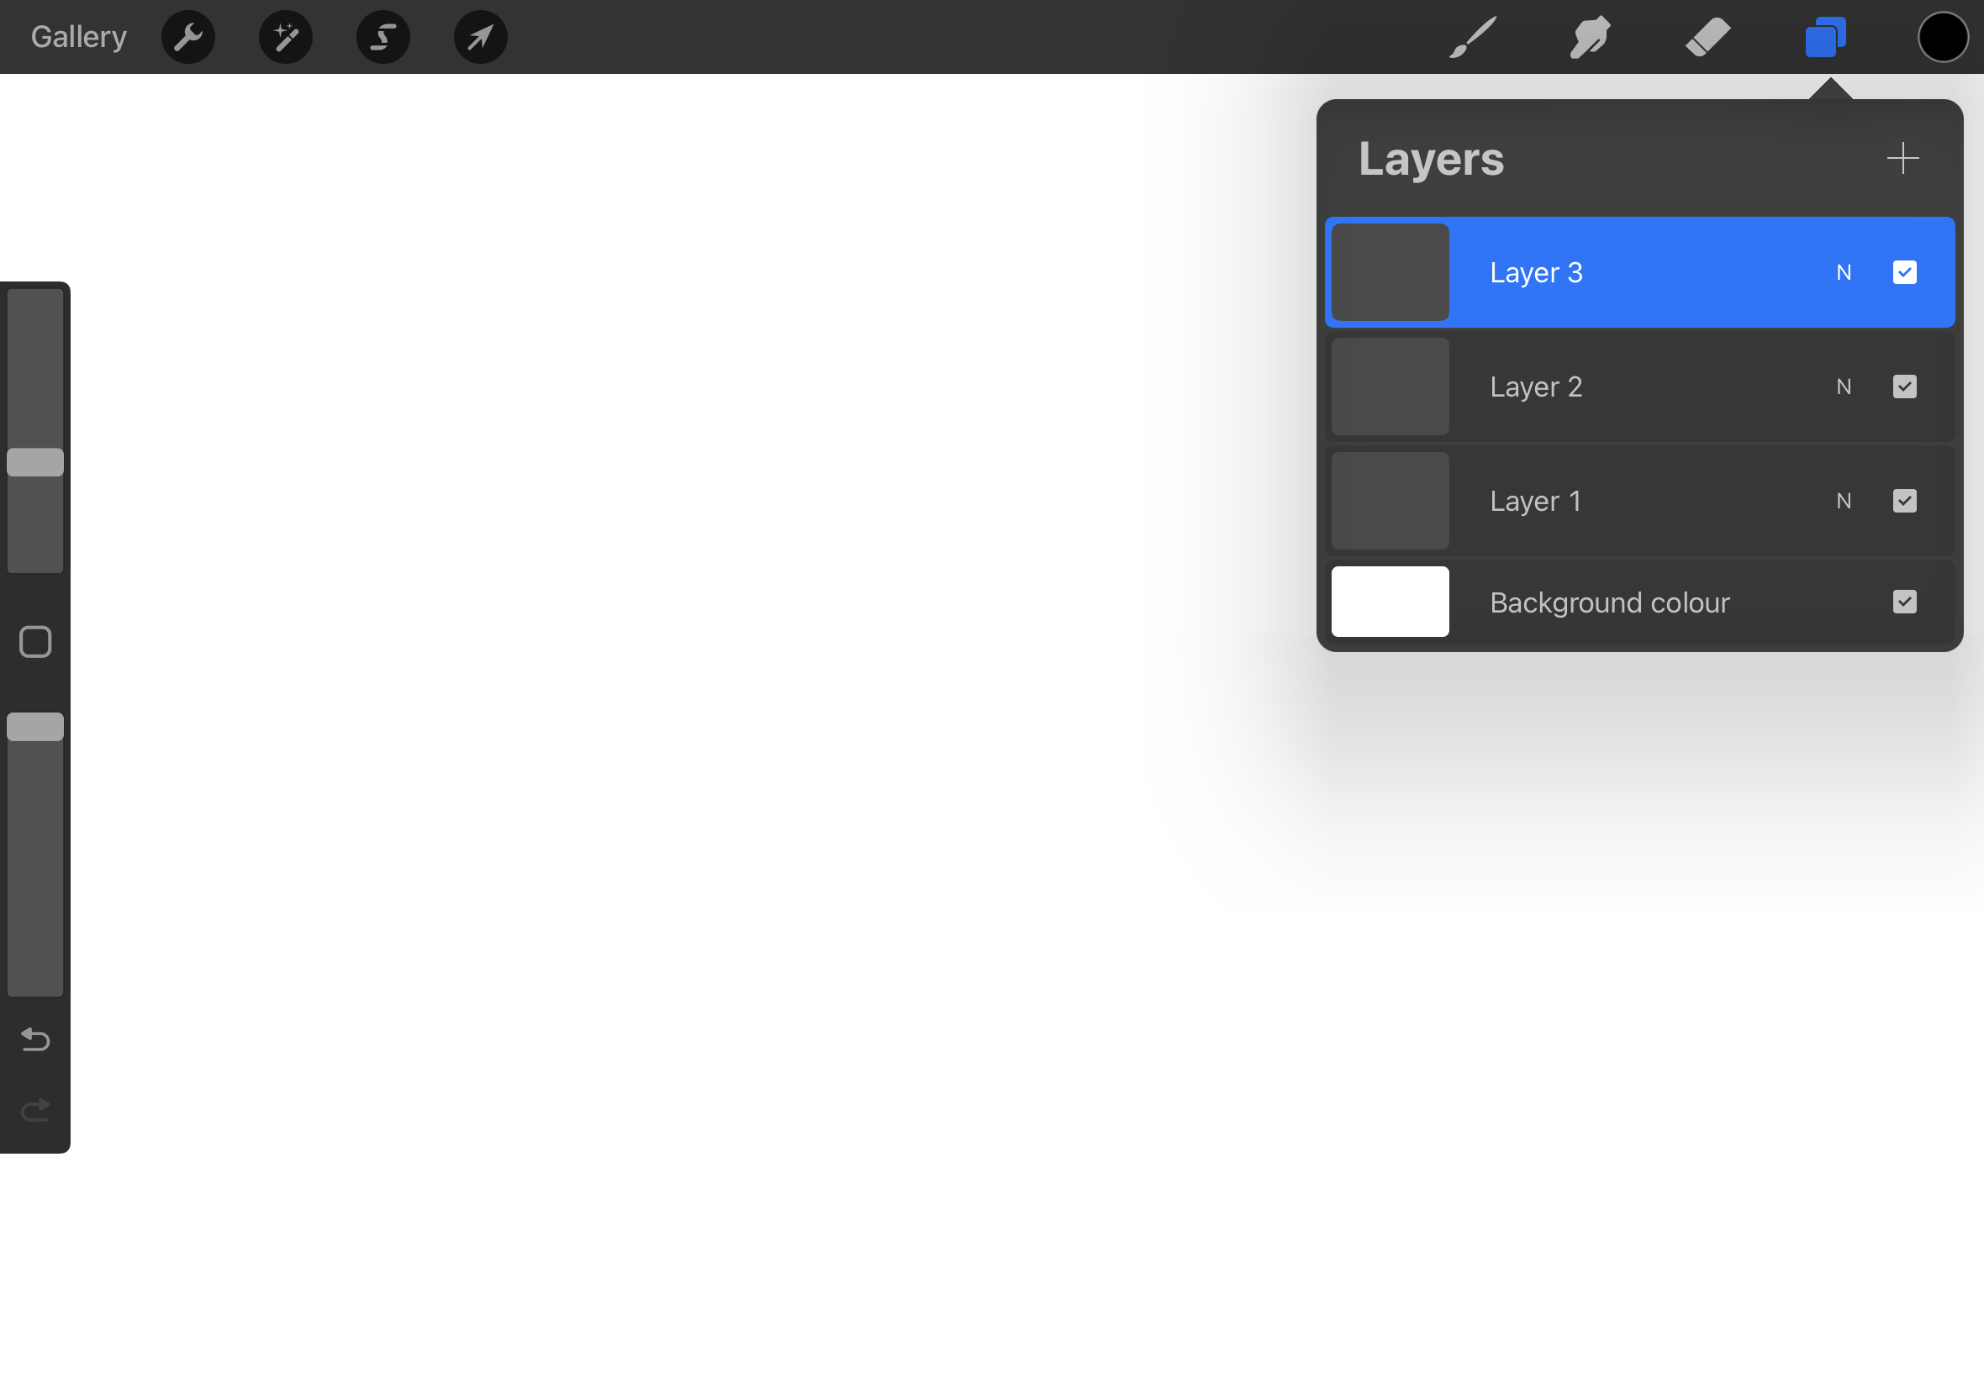
Layers are super helpful in separating elements of your artwork, allowing you to make changes to one layer on the artwork without affecting the others.
Layers can be grouped into a folder, copied, pinned and hidden.
The bottom of the layer menu is the background layer with a colour. This is where the colour for the background can be selected or turned off completely for exporting transparent PNG files.
Introduction to Layers

Slide 14
Saving files:
New canvases are always automatically saved into the Procreate gallery. Within this gallery, you can create stacks to help organise your artwork.
Sharing your work:
Procreate has a pretty easy way of sharing your artwork with friends, family or the world. You can share the artwork via the Gallery or the actual project file itself.
Saving files + Sharing

Slide 15
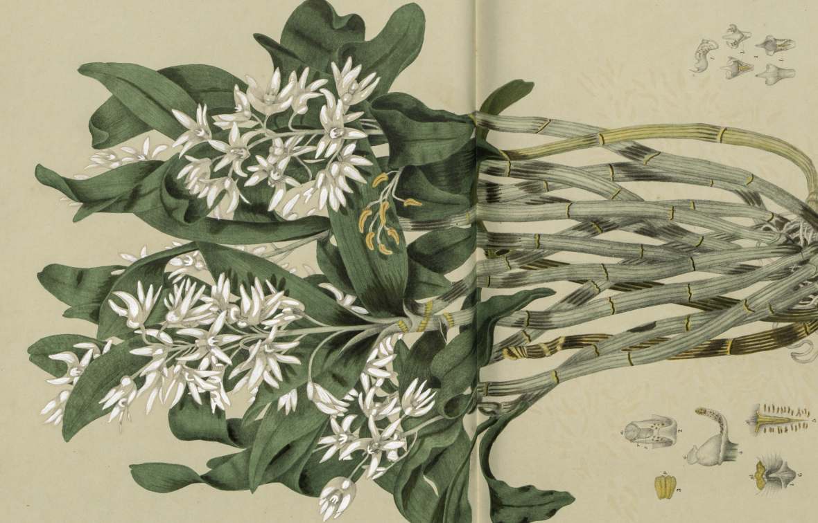
The State Library Collections have a large range of copyright free images that we can use for inspiration when creating our artwork.
We are going to be getting a feel for procreate by tracing and redrawing different botanical illustrations found via One Search.
STATE LIBRARY COLLECTIONS
Link

Slide 16
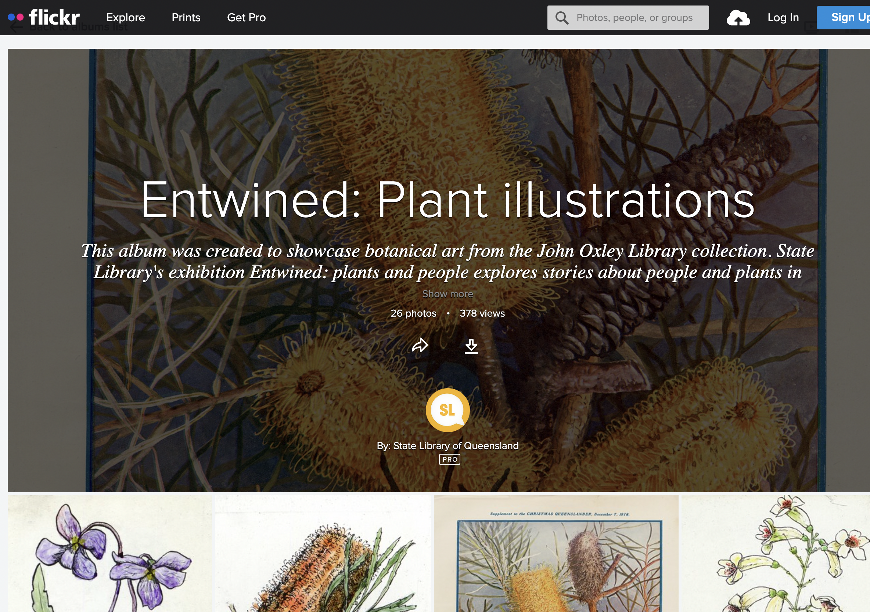
Flickr - SLQ
Flickr is a great way to look at curated albums created using the State Library’s collection
SLQ Flickr collection link

Slide 17
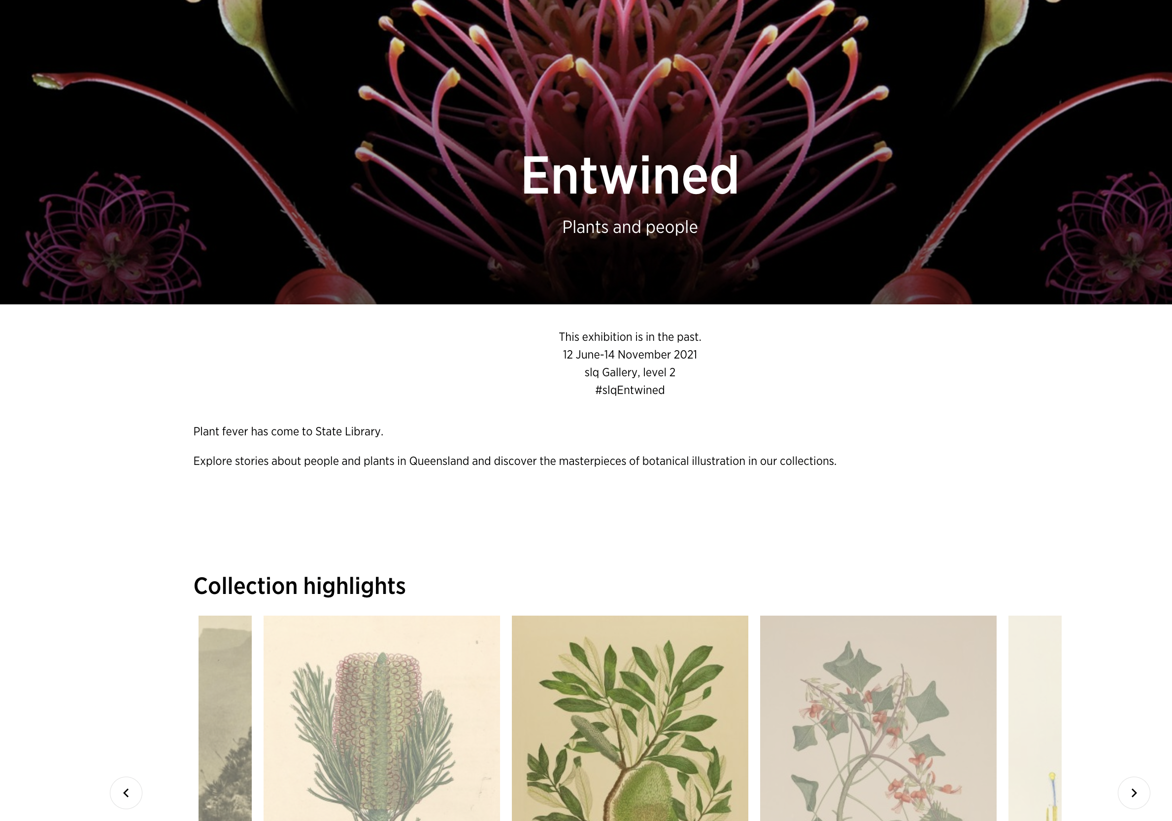
Entwined:
Plants and people
Past exhibition focused on botanical illustrations within the collection.
Pick an illustration and start drawing!
Start with the linework and then try adding some colour.
Collection link

Slide 18
THANKS FOR ATTENDING
Please complete our survey that will be sent out via Eventbrite.
Contact us on appliedcreativity@slq.qld.gov.au

