Slide 1
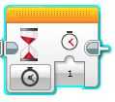
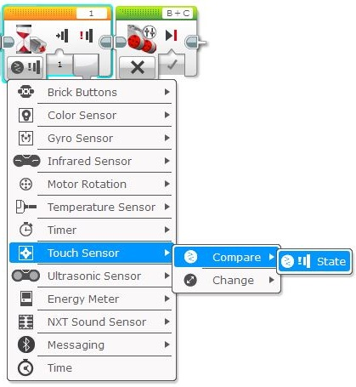
WAIT Block (Touch Sensor)
Using WAIT block to read a Touch sensor (PART 1)
The WAIT block can also be used to pause a program while it “waits” for a sensor value to be reached.
This is done by clicking on the “mode” button , selecting the desired sensor to be monitored (Touch in this case) & then selecting the type of change you’d like the WAIT block to look for.
3. Select what change you wish the sensor to detect.
COMPARE is the most commonly used.
Compare = compares what the sensor detects against a value that you select or nominate.
Change = “WAIT” until any change in switch value has been detected.
1. Click on the “mode” button.
2. Select the sensor to be monitored.
In this case, “Touch sensor” has been selected.
4. STATE is the only option for TOUCH sensor COMPARE function.
This will COMPARE the switch state with the state you are looking for (pressed or not pressed).
Switch state will be explained in part 2.

Slide 2
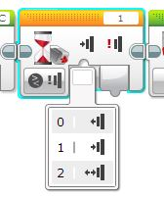
WAIT Block (Touch Sensor)
Using WAIT block to read a Touch sensor (PART 2)
Before the Touch sensor is ready to be used, it needs to have TWO more parameter set.
5. SET THE SENSOR PORT!
This tells the WAIT block what port the sensor is connected to.
6. SET THE TRIGGER STATE OF THE SENSOR.
This is what state the switch should be in for the WAIT block to allow the sequence to continue to the next block.
Click on the small window & select one of the three options.
The window below shows what they are.
WAIT block will trigger when switch changes from a PRESSED state to a RELEASED state.
- WAIT block will trigger when switch changes from a RELEASED state to a PRESSED state (most common use).
WAIT block will trigger when switch changes state from what it was when program started (not recommended).

Slide 3
WAIT Block (Touch Sensor)
Using WAIT block to read a Touch sensor (PART 3)
In the sequence below, the WAIT block has been set to “TOUCH sensor, compare state, pressed”.
It will “compare” the TOUCH sensor state with what has been selected; in this case, “pressed”.
When it “sees” the TOUCH sensor has been “pressed”, it will allow the sequence to move to the next block.
In this sequence, the robot will move forward (TANK block simply turned ON) & the WAIT block will pause the sequence (motors still turning) until the TOUCH sensor is pressed.
The robot then stops because the next block after the WAIT block is a TANK motor block with the STOP function set.
NOTE: When using the WAIT block like this, ensure a block is used after the WAIT block to stop whatever function was turned on prior to the WAIT block (in this case, both large motors were turned ON).
Make sure correct ports are set!
Note that this TANK block has been set to ON.
This makes both motors turn continuously & they won’t turn off until another TANK block with motor function OFF is used.
Note that this TANK block has been set to OFF.
This stops the motors after the WAIT block has detected the touch sensor has been pressed.
If this block wasn’t used, the motors would keep turning.
WAIT block will trigger when it sees the TOUCH sensor has been pressed.

