Slide 1
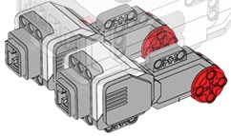
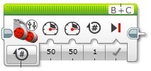
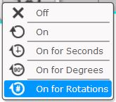
TANK Motor Block
Used to run TWO Large motors at the same time.
1. MODE SELECT.
Choose how motor will operate.
For positioning:
On for degrees
On for rotations
is recommended.
When “ON” mode is selected, BOTH motors will keep running until another block tells them to turn “OFF”!
5. SELECT MOTOR PORTS
Selects which brick ports the motors are connected to.
Two ports need to be selected as there are two motors.
Any combination of A, B, C or D
Turns motor OFF
Motor keeps running
4. BRAKES
Tick = ON
On is recommended.
2. SET SPEEDS FOR BOTH MOTORS INDIVIDUALLY.
Enter any number from -100 to 100 using slider or keyboard.
(keyboard is easier)
“0” = stopped
“100” = full speed forward
“-100” = full speed reverse
3. SET the number of rotations, degrees or time period (secs) for the motors to run.
This setting is dependent on the MODE selected & the one setting applies to BOTH motors.
Use keyboard to enter data.
Decimals can be used here.

