Slide 1
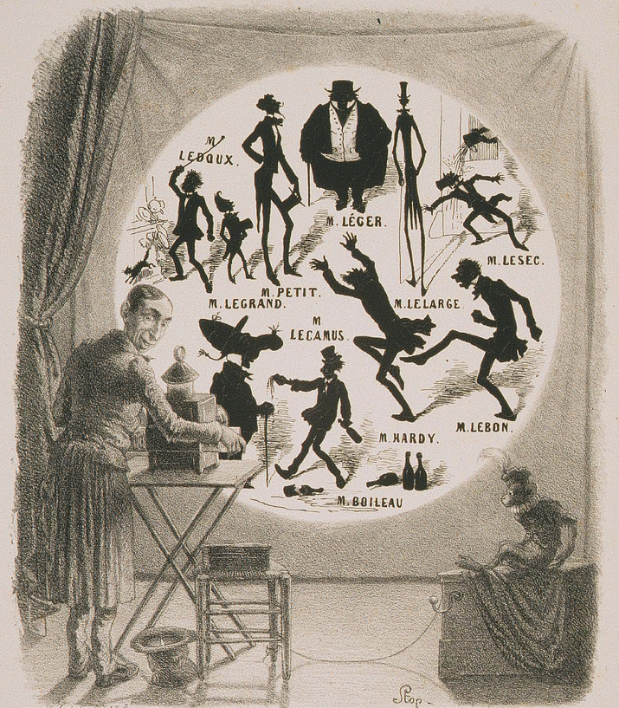
Bertauts. (1835). Lithograph of Magic Lantern show.
Art of Projection
Session Two
Dr Waldemar Jenek
30.03.2024

Slide 2
Acknowledgement of Country
We acknowledge Aboriginal and Torres Strait Islander peoples and their continuing connection to land and as custodians of stories for millennia. We respectfully acknowledge the land on which we all meet today, and pay our respects to elders past, present and emerging.

Slide 3
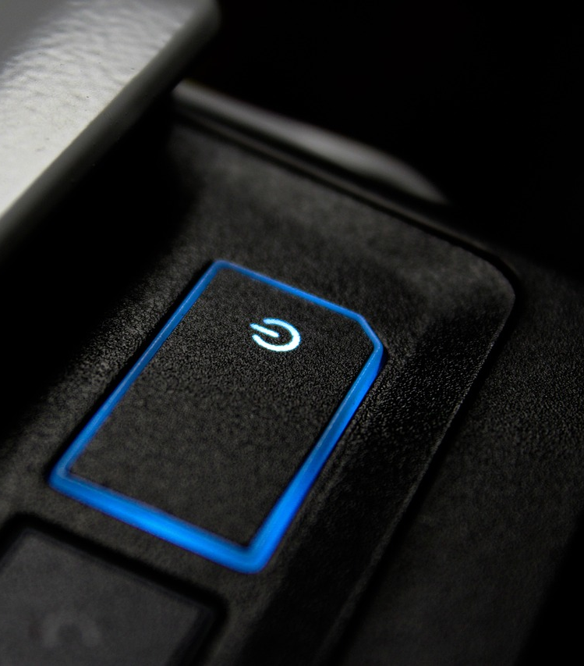
Session Overview
Welcome
Check in and get set up on a computer
Brief recap of Session One
Overview of workshop
Today’s Goals and Timeline
Image by Viktor Kosilov from Pixabay

Slide 4
Equipment
Computer with Premiere Pro
Laser Cutter
iPads and laser-cut hologram kits.
SLQ collection items (digitized slides and videos).
laser light is cutting wood By jonnysek

Slide 5
Health & Safety
For all workshops at The Edge we like to familiarise participants with:
Exit points
Lab Risk Assessments
Safe operating procedures (SOP)

Slide 6
Objectives
Understanding the history of projection and illusion techniques
Introduction to basic video editing
Creating a personal hologram design
Exploring Open Lab resources, including laser cutter induction
Hands-on experience in creating an illusion device

Slide 7
Historical Overview of Projection and Illusion Techniques
Magic Lanterns: The Early Days of Projection
Holographs and Holograms: Evolving Visual Illusions
Pepper's Ghost: Classic Illusion Technique

Slide 8
Magic Lanterns: The Early Days of Projection
Early type of image projector using pictures on glass slides.
Developed in the 17th century, popular in the 19th.
Educational tool and entertainment, precursor to slide projectors and cinema.
Section of a magic lantern, vintage engraving. By Morphart
Notes:
Recap from Session 1

Slide 9
Magic Lanterns: The Early Days of Projection
Auguste Lumière (1862–1954) and Louis Lumière (1864–1948), pioneers of early cinema.
Sons of Antoine Lumière, a painter and photographer.
1895: Invention of the Cinématographe Lumière, a portable motion-picture camera, printer, and projector.
Lumiere brothers on postage stamp of Togo By Silvio

Slide 10
Magic Lanterns: The Early Days of Projection
Notable for being lightweight, operated with a hand crank, and capable of projecting to an audience.
December 28, 1895: Held the first public movie screening at Salon Indien du Grand Café in Paris.
Screened films like "Workers Leaving the Lumière Factory" and "The Arrival of a Train".
https://youtu.be/aFkSjdaqbyE?t=182

Slide 11
Introduction to Video Editing
Basics of Video Editing: Tools and Techniques
Editing a Video/Image for Hologram Use
Demo: Simple Video Editing Using Premiere Pro

Slide 12
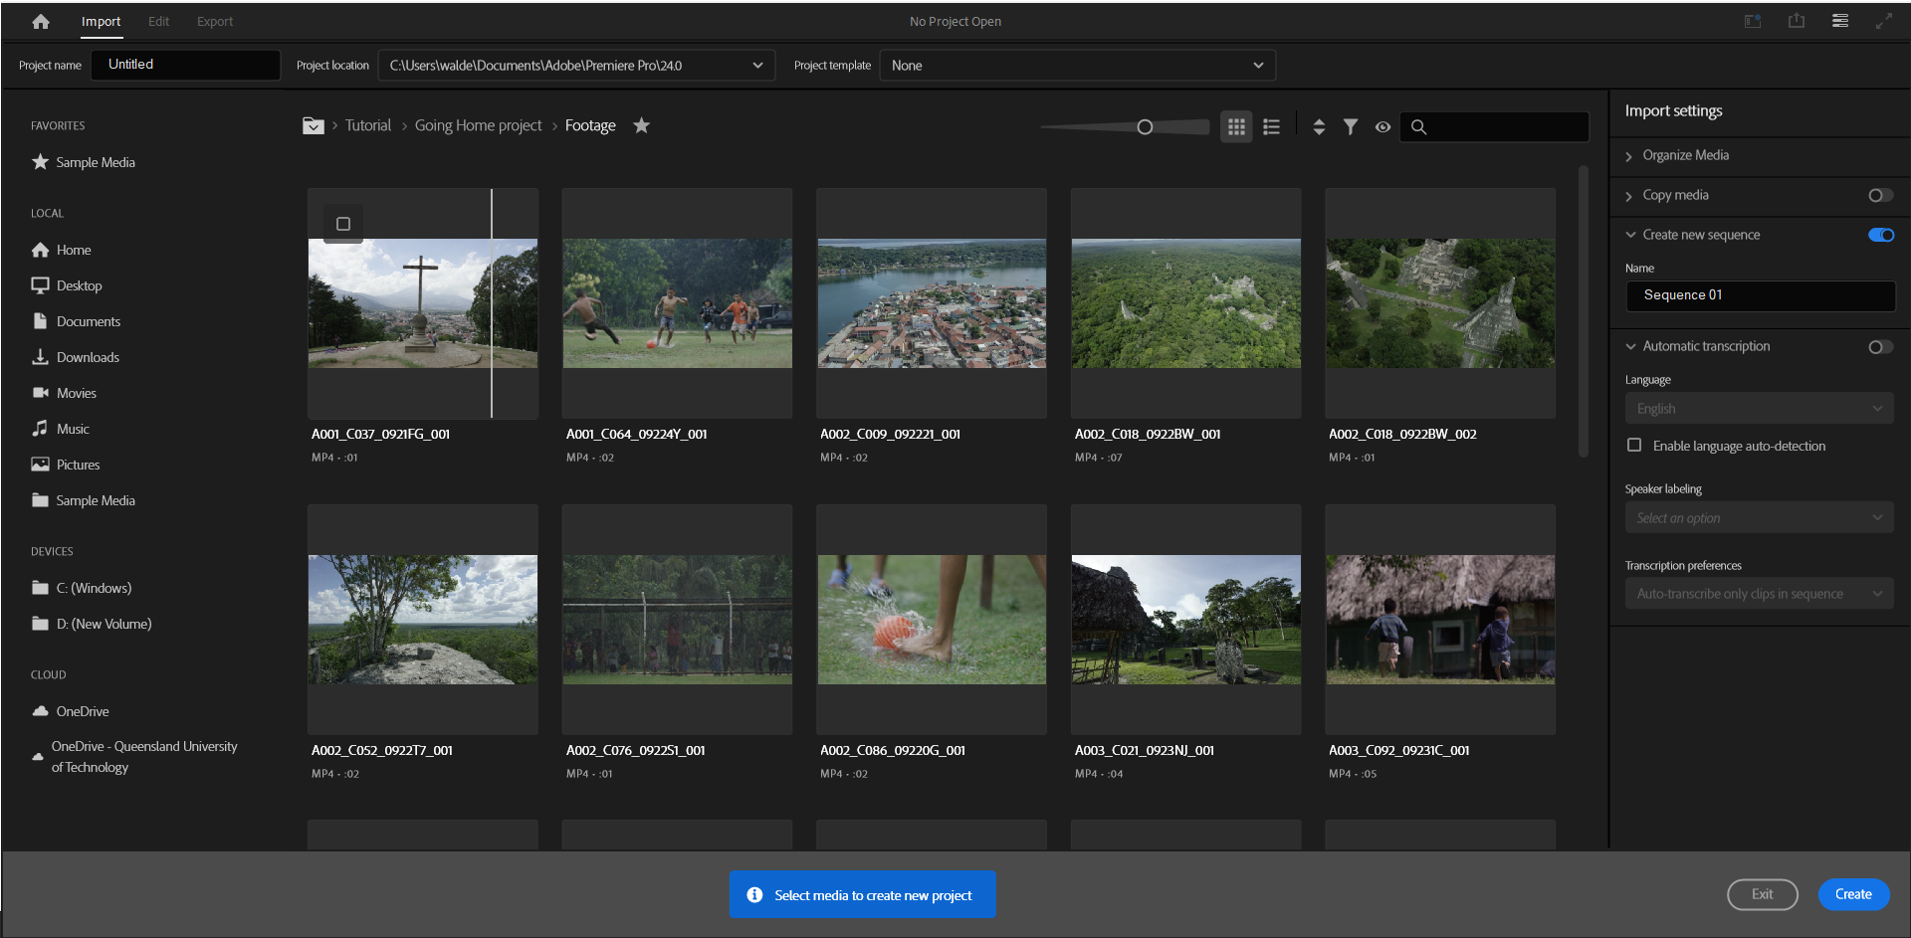

Slide 13
Premiere Pro
Project (bottom left): Where you import and organize your media
Source Monitor (top left): Where you view and trim your raw media
Program Monitor (top right): Where you view your timeline sequence
Timeline (bottom right): Where you create your edit

Slide 14
Importing Media
Load your video file into the Source Monitor by double-clicking it in the project panel.
Use the Mark In ({) and Mark Out (}) buttons to define the start and end of the clip.
The grey bar under the clip shows your selected range.
Adjust the length of this selection on the timeline as needed.

Slide 15
Transitions
Transitions occur between each piece of footage or audio segment.
Enhances the flow and maintains audience engagement.
Straight Cut
Dissolve/Fade
Dip to Black
Drag and drop transitions from the Effects panel to the timeline.
Locating Effects Panel: Select Window > Effects from the main menu or press Shift+7.

Slide 16
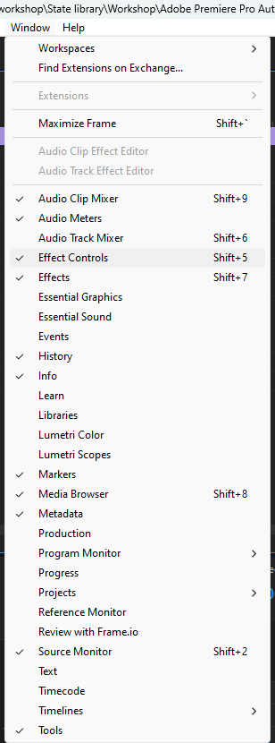
Effect panel
Keyframes
Opacity
Audio
Colour Correction
Position
Rotation

Slide 17
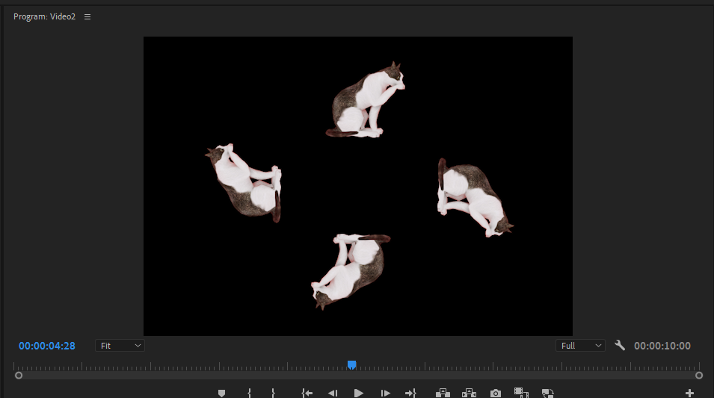
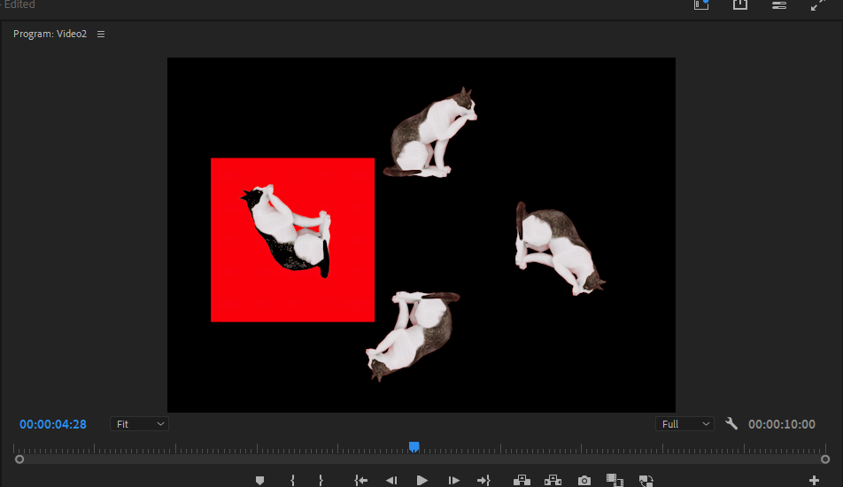
Effect panel
Color Key

Slide 18
Effect panel
Transparent video
Grid

Slide 19
Exporting Video
Ensure the Timeline panel is active.
Navigate to File > Export > Media
Setting Export Preferences
In the Export Settings dialog box, select Format: H.264.
Choose Preset: Match Source – High Bitrate.
Choosing File Location and Name
Click the blue export button
Click Export to start creating the new video file.
Wait for the file to be processed and ready for sharing.

Slide 20
Break Time
15-30 Minutes Break
Interactive Q&A Segment

Slide 21
Laser Cutter and Open Lab Tools Overview
Introduction to The Edge's Open Lab Tools
Laser Cutter: Safety and Operation
Potential of Laser Cutter in Creative Projects

Slide 22
Creating a Floating Hologram (Pepper’s Ghost)
Step-by-Step Guide to Designing Your Hologram
Using iPads for Hologram Design
Laser Cutting Your Hologram Device

Slide 23
Explaining the Pepper’s Ghost Illusion
Introduction of the Dircksian Phantasmagoria in the 1860s by Henry Dircks.
Adaptation of an older Italian optical illusion involving glass and light.
Lack of popularity due to its complexity and cost, requiring significant theater modifications.
John H. Pepper's simplification using a sheet of glass, making it feasible for existing theaters.
Popularization of the effect, known as Pepper's Ghost, in England and Australia.
Behind-the-scenes of a basic Pepper’s Ghost illusion. Image by Wapcaplet — Own work. Licensed under CC BY-SA 3.0, via Wikimedia Commons.

Slide 24
Explaining the Pepper’s Ghost Illusion
Technique: A large piece of glass placed at an angle reflects a hidden room creating a ghostly apparition.
Diagram Pepper's Ghost Waldemar Jenek

Slide 25
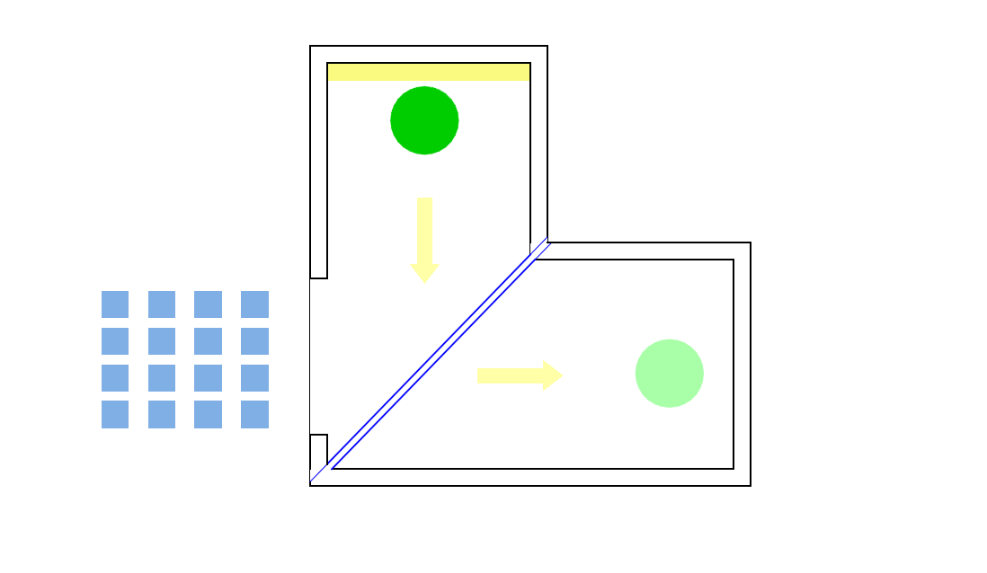
Explaining the Pepper’s Ghost Illusion
Technique: A large piece of glass placed at an angle reflects a hidden room creating a ghostly apparition.
Diagram Pepper's Ghost Waldemar Jenek

Slide 26
Practice and Experimentation
Creating Your Holograms
Tips for Refining Designs
Group Sharing and Feedback
https://www.youtube.com/watch?v=V7zGv-Q0Pn8

Slide 27
Practice and Experimentation
Creating Your Holograms
Tips for Refining Designs
Group Sharing and Feedback
https://www.youtube.com/watch?v=rwoUsz07Rbg

Slide 28
Hands-On: Practice and Experimentation
Creating Your Holograms

Slide 29
Wrap-Up and Next Steps
Recap of Key Learnings from Session two
Preview of Next Session: "Illusion Techniques"
Feedback Collection and Closing Remarks

Slide 30
Q&A Session
additional resources

Slide 31
Images

Slide 32
THANKS FOR ATTENDING
Please complete our survey that will be sent out via Eventbrite.
Tag us on socials @statelibraryqld
Contact us on appliedcreativity@slq.qld.gov.au

