Slide 1
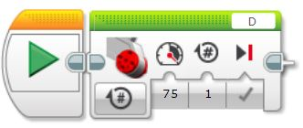
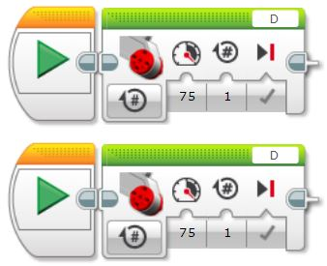
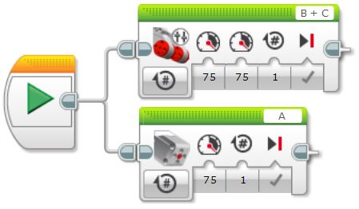
START Block
Required at the beginning of a sequence (program).
A START block must be used at the start of every sequence.
Different sequences (code, program, etc.) can be started simultaneously by using two or more separate START blocks at the beginning of each sequence.
This gives the advantage of being able to run each sequence individually by clicking on the start block of the desired sequence. Good for testing.
When downloaded to the robot, all sequences will start at the same time.
One START block can be used to start two or more sequences by using “wires” as shown in the picture on the left.
Clicking on this START block will start both sequences at the same time.
When downloaded to the robot, both sequences will start at the same time.
Useful if running a lot of sequences, but method above is better as it allows each sequence to be tested individually.

