Slide 1
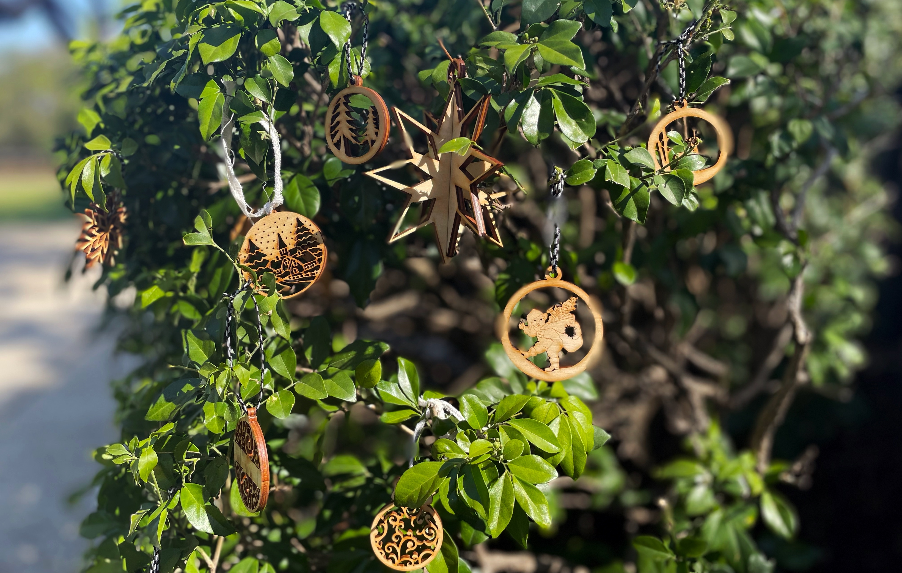
Laser Cut Ornaments
Developed by Ellie Dumigan, 2023

Slide 2
Acknowledgement of Country
We acknowledge Aboriginal and Torres Strait Islander peoples and their continuing connection to land and as custodians of stories for millennia. We respectfully acknowledge the land on which we all meet today, and pay our respects to elders past, present and emerging.

Slide 3
Be inspired by holiday themed images from the state library collection or select free to use vectors to create your own unique ornaments.
Learn about the creative process through using Inkscape to create vectors and preparing the design to be cut on the laser cutter.
WORKSHOP SUMMARY
This journey will see you:
Learn to create vector files suitable for the laser cutter in free and open-source software (Inkscape).
completing a laser cutter induction, so you can come back
and make more!
laser cutting your files
Assembling and adding the final touches to your creations

Slide 4
Laser Cutter
Scissors
Computer with Inkscape
Materials (per participant)
==
An A2 sheet 4mm plywood
Ribbons
Cord
TOOLS & MATERIALS
==

Slide 5
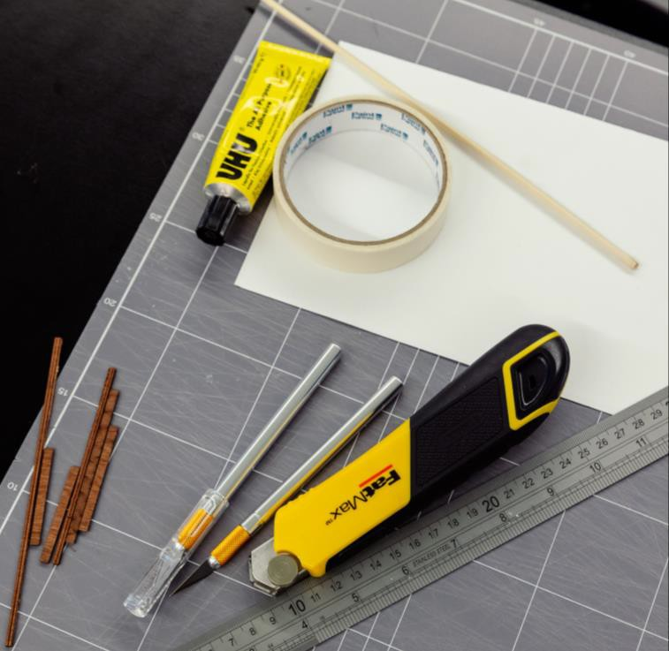
HEALTH & SAFETY
For all workshops at The Edge we like to familiarise participants with:
Exit points
Lab Risk Assessments
Laser safe operating procedure (SOP)
Any other SOP

Slide 6
Overview
WORKSHOP
OVERVIEW
Welcome
Check in and get set up on a computer
Why did you sign up? what are you hoping to get out of this series?
SLQ account logins
Overview of workshop
Be inspired by State Library's collections and research
and reference resources.
Learn the basics of Inkscape and vector design.
Choose from our designs or create your own designs for your ornaments.
Laser cutter induction/demo
Designing and cutting out designs
Final touches
End goals of workshop
A designed and cut laser ornaments.
LASER CUTTER ORNAMENT PIC HERE

Slide 7
LET'S GET STARTED
One Search

Slide 8
The State Library has a wide range of images within the collection which we are going to be using to create our ornament designs.
STATE LIBRARY COLLECTIONS
LINK

Slide 9
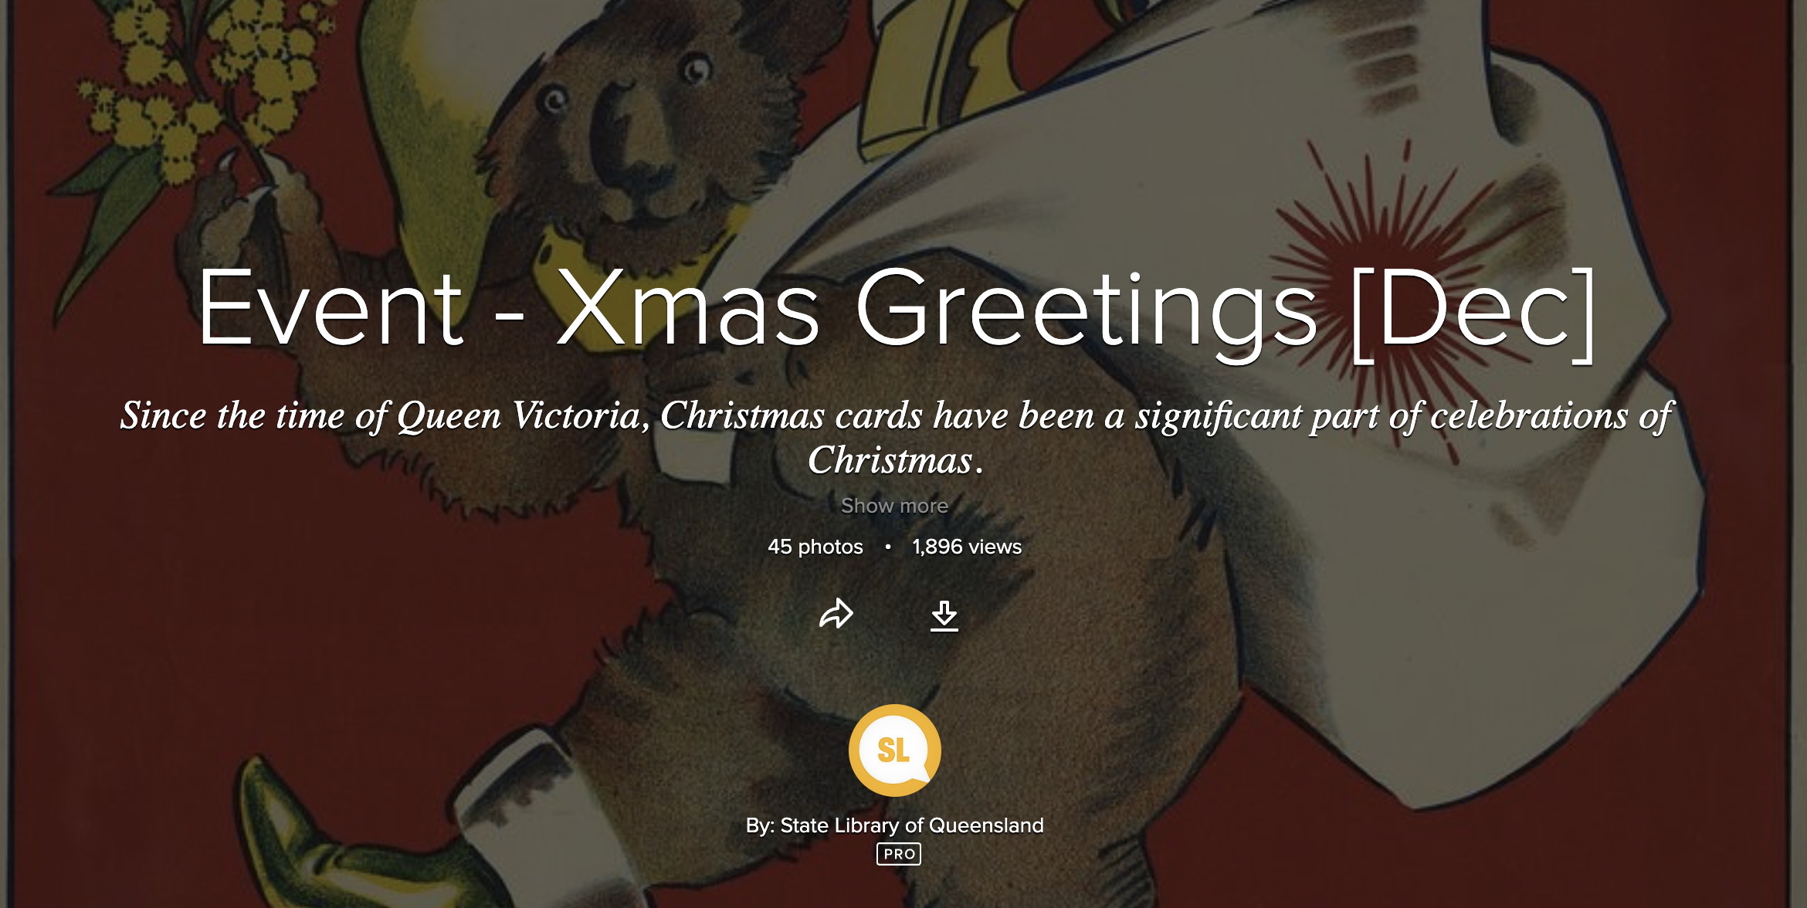
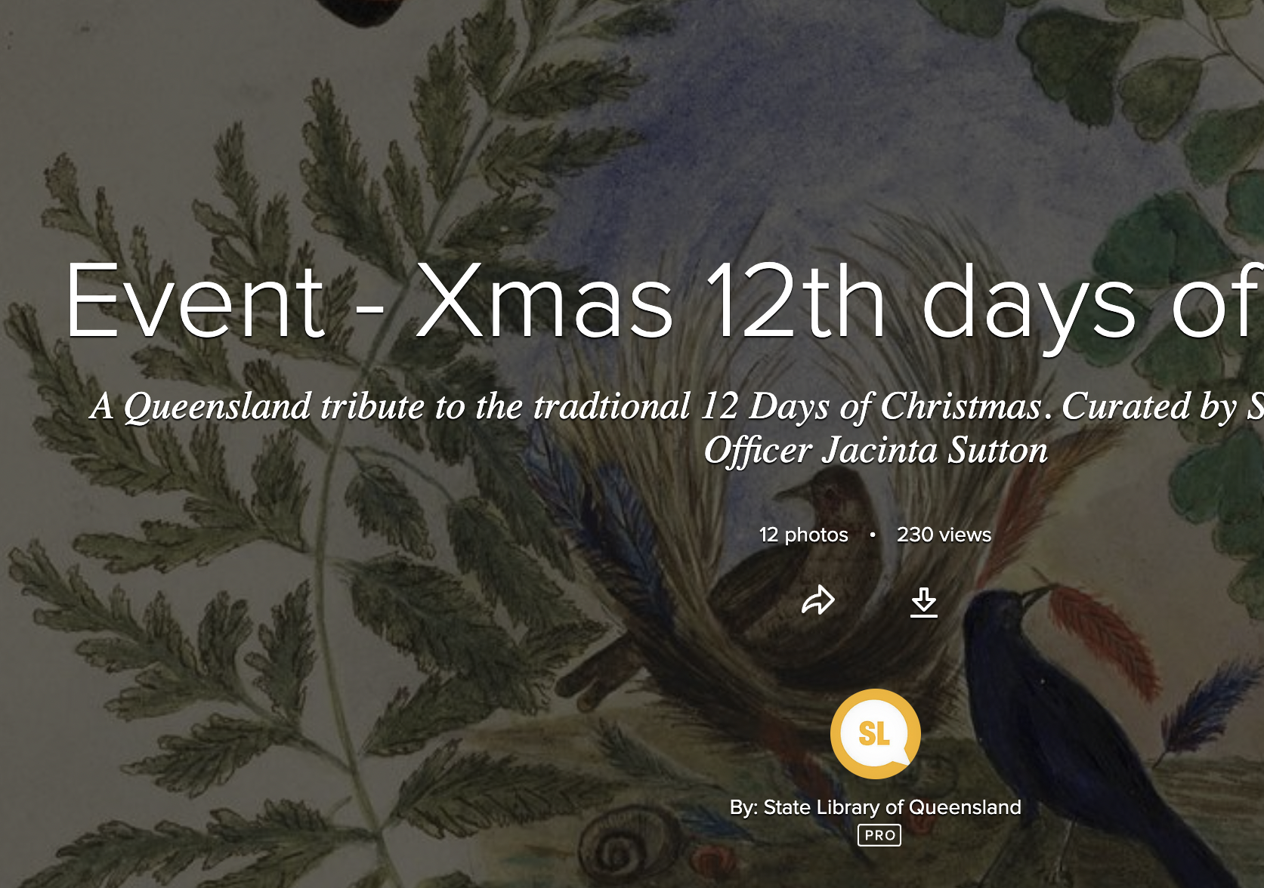
Event - Xmas Greetings
Event - Xmas 12th Days of Christmas
Flicker – STATE LIBRARY COLLECTIONS
Event - Xmas Santa Claus

Slide 10
THE BASICS
OF VECTOR DESIGN
Inkscape 101

Slide 11
INKSCAPE TIPS
Most important - check the size of your document and make sure you are working in A2 landscape and millimeters
Remember to group and ungroup as needed
Keeping your 'parts' assigned to different
layers can help
Naming your layers will help keep you
organised

Slide 12
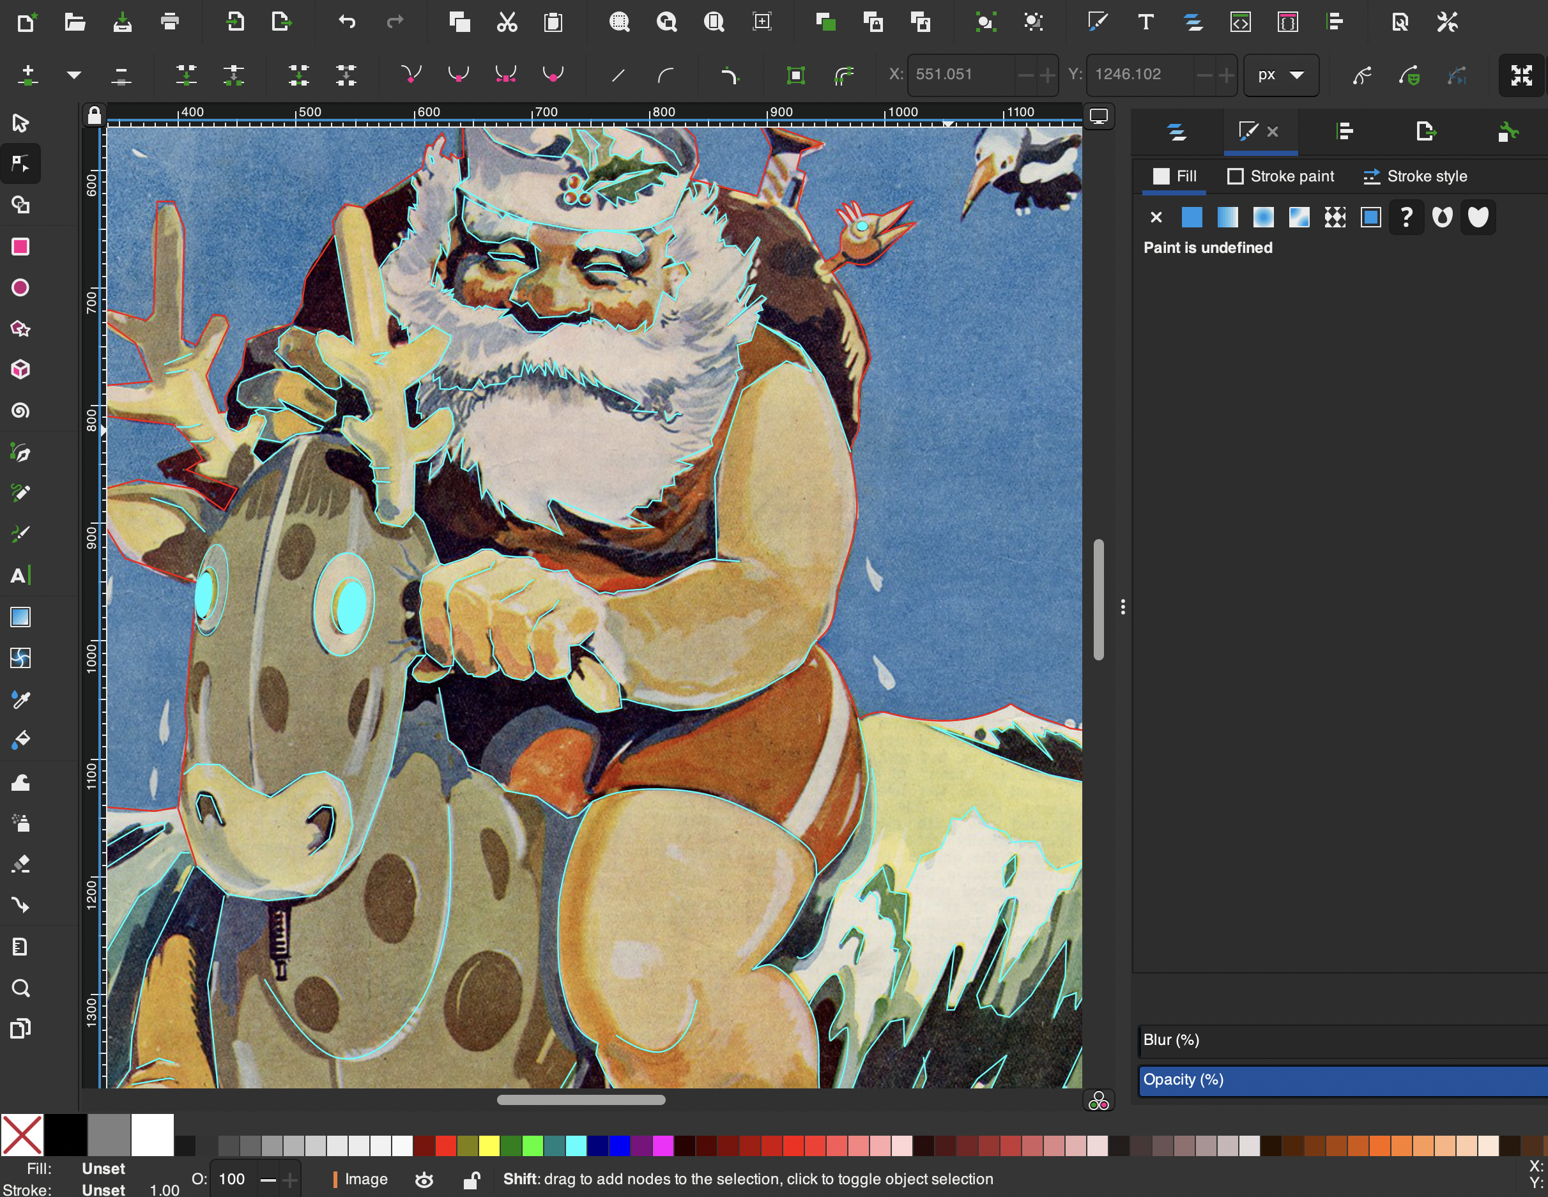
CREATING VECTORS
We're going to screenshot an image from one of the albums on the State Library Flicker account.
We are going to trace the image using our pen and shape tools to practice creating vector designs.

Slide 13
THANKS FOR ATTENDING
Please complete our survey that will be sent out via Eventbrite.
Contact us on appliedcreativity@slq.qld.gov.au

