Slide 1
Digitising your collections
Notes:
Introduce yourself

Slide 2
Aims of training session today
Introduction to digitisation. What is digitisation?, why we should digitise our collections?, what equipment is needed?
Learn the skills for scanning, capturing & basic image editing.
Look at the best ways to preserve and store your digital files.
Brief look at copyright.

Slide 3
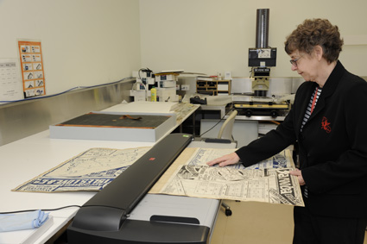
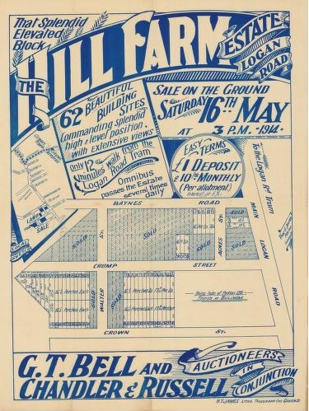
What is Digitisation?
The process of turning original physical items (analogue) into electronic format (digital) that can be read on a computer or device.
Digitisation is creating a digital surrogate, electronic copy or photograph of a physical item, often called turned digital.
Notes:
What is Digitisation?
The process of turning original physical items (analogue) into electronic format (digital) that can be read on a computer or device.
Digitisation is creating a digital surrogate, electronic copy or photograph of a physical item, often called turned digital.
Items that are commonly digitised include:
Image Formats : Photographic Prints / Albums / Film Negatives/ Slides/ Lantern Slides / Glass Plate Negatives
Document Formats: Books/ Diaries /Letters /Postcards / Cards/ Parchments/ Certificates/ Drawings / Artwork / Posters
AV Formats: Videotapes/ Audio reel tapes/ Home Movie Films/ Audio Cassettes/ Records

Slide 4
Why is Digitisation important?
Your physical material can be fragile and damaged easily. Creating a digital copy will help preserve the item.
AV content may require outdated & inaccessible equipment to view it.
Digital files allows easier access to your content and gives you more flexibility to share your content. This reduces unnecessary handling & potential damage to your collections.
Notes:
Why is Digitisation important?
Collection material can be fragile, collection items are susceptible to the effects of aging, deterioration, natural disasters, pest infestations, mould, fading, and damage due to handling.
Access to content Digitising gives you the flexibility to access and share your content more readily with family and friends protecting it from unnecessary handling. With regards to audio-visual and film collections, the equipment to view your item may no longer be available and attempting to play or access them may cause damage.
Preserving content for the future Digitisation of a physical item helps to preserve these memories for future generations by reducing handling and increasing accessibility. For information on how to care for your original collections after they have been digitised — http://www.slq.qld.gov.au/resources/preservingcollections/preservation_guides/general-care-of-your-collections

Slide 5
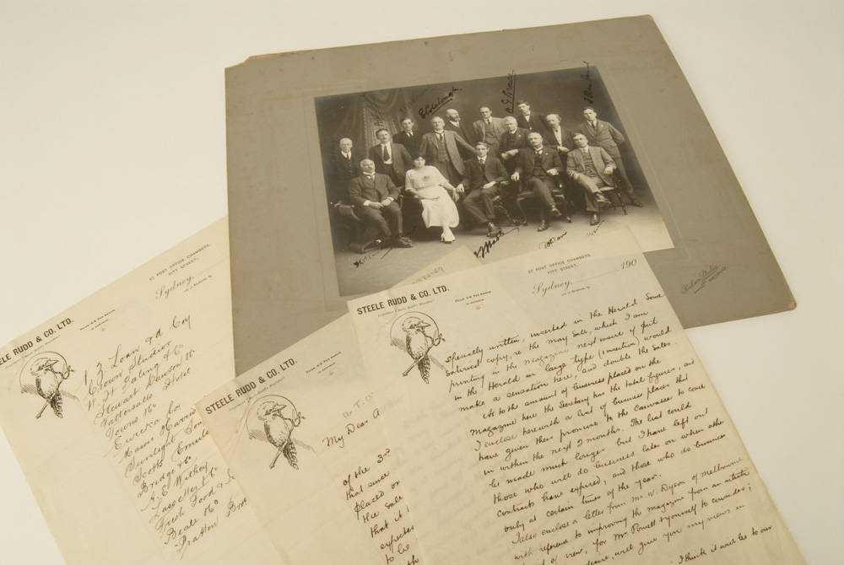
What collections do you have and want to digitise?
Notes:
Activity: Get the participants to briefly share with the group what collections they have and why they want to digitise them. This is an opportunity to analyse the participants skill level and knowledge and if there are some participants with advanced skills they can help others who are beginners.

Slide 6
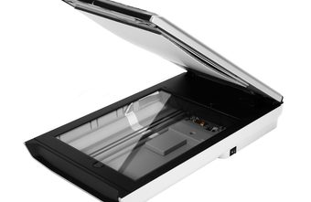
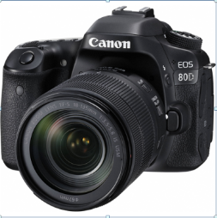
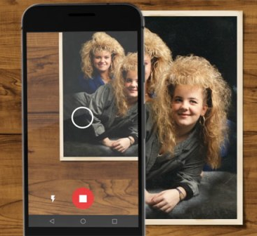
What equipment do I need to Digitise?
Flatbed Scanner - suitable for two dimensional, flat items such as documents and photographs.
Digital Camera (DSLR) – ideally set up on a copy stand, is most suitable for books, albums and three dimensional objects.
Smart Phone with PhotosScan by Google App installed.
Notes:
What equipment do I need to Digitise?
For Best Quality:
Flatbed Scanner A flatbed scanner is most suitable for two dimensional, flat items such as documents and photographs.
Digital Camera (DSLR) A digital camera, ideally set up on a copy stand, is most suitable for books, albums and three dimensional objects.
If you don’t have access to this type of equipment but you do have a smart phone you could use the PhotoScan by Google Photos App available from Apple Apps Store or Androids Google Play. An easy, quick option but the quality of the digital file produced will be much lower than a scanner or DSLR camera.

Slide 7
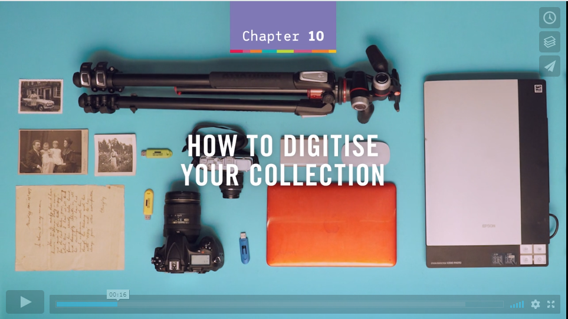
Video: https://youtu.be/MEyDt0DNjWU
Notes:
https://vimeo.com/262919728 – Watch How to Digitise your Collections video for overview before morning tea.

Slide 8
Scanning and Capture – specification guidelines
Scanner (Scanning)
Resolution for images: 600 dpi
Resolution for text-based content: 300 dpi
24-bit colour
Save as a TIFF
Camera (Capture)
Type: DSLR
Resolution: 24 mega pixels
Sensor: DX
Lens: 50mmSave as options are JPEG, TIFF & RAW Initially select RAW (minimally processed image direct from the camera sensor)
Notes:
Capture specifications and guidelines
The following is recommended as the minimum capability of a camera or scanner. Anything that exceeds these minimum standards would be suitable. It is important to note that the better the quality or resolution of the scans/images the larger the file size. Ensure you have adequate storage space for your files.
Scanner
Resolution for images: 600 dpi
Resolution for text-based content: 300 dpi
24-bit colour
Save as a TIFF
Camera
Type: DSLR
Resolution: 24 mega pixels
Sensor: DX
Lens: 50mm
Save as options are JPEG, TIFF & RAW Initially select RAW (minimally processed image direct from the camera sensor)

Slide 9
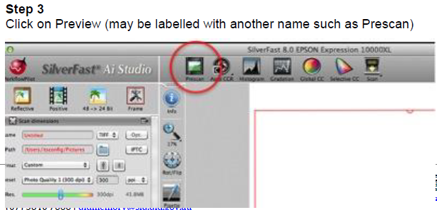
Scanning and Capture – Scanning
Notes:
Step 3
Click on Preview (may be labelled with another name such as Prescan)

Slide 10
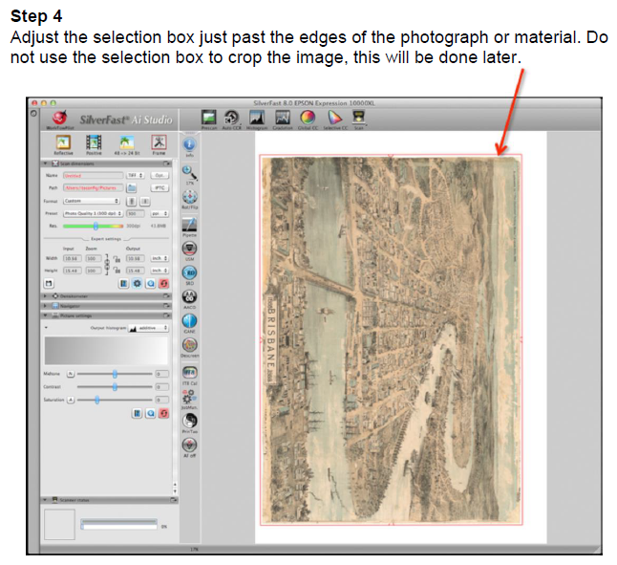
Scanning and Capture – Scanning
Notes:
Step 4
Adjust the selection box just past the edges of the photograph or material. Do not use the selection box to crop the image, this will be done later.

Slide 11
Scanning and Capture – Scanning
Notes:
Step 5
Set the scanning parameters to the following:

Slide 12
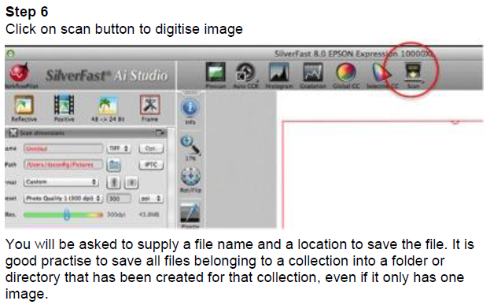
Scanning and Capture – Scanning
Notes:
Step 6
Click on scan button to digitise image
You will be asked to supply a file name and a location to save the file. It is good practise to save all files belonging to a collection into a folder or directory that has been created for that collection, even if it only has one image.

Slide 13
Scanning and Capture – Capture
Notes:
Capture
A capture device is generally a digital camera. The lens of the camera focuses a picture onto an image sensor that converts the scene into pixels of digital information.
Digital cameras can be found on many devices from phones and tablets through to high end, professional Digital Single Lens Reflex (DSLR) equipment.
When using a camera to capture a scene or event, much depends on the photographer’s eye as to composition, focus and depth of field. However, when using such equipment to capture copies of pictorial content, some basic principles can be applied.
Step 1
Make sure the original item is evenly lit (shouldn’t be an issue if using a copy stand with lights)

Slide 14
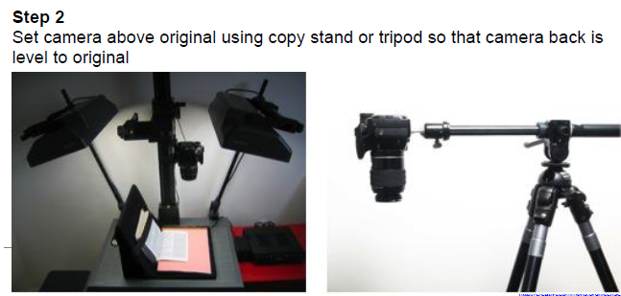
Scanning and Capture – Capture
Notes:
Step 2
Set camera above original using copy stand or tripod so that camera back is level to original

Slide 15
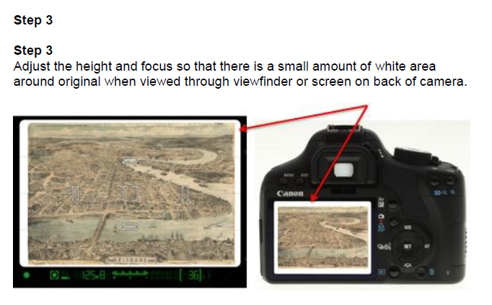
Scanning and Capture – Capture
Notes:
Step 3
Adjust the height and focus so that there is a small amount of white area around original when viewed through viewfinder or screen on back of camera.

Slide 16
Scanning and Capture – Capture
Notes:
Step 4
Set the camera to manual setting (M) and adjust exposure using a combination of shutter speed and aperture (may need to take some test shots to confirm correct exposure) Step 5
Select the white balance by pushing the WB button on the camera and then select the option that matches the lighting type (daylight, tungsten, fluorescent, etc.).

Slide 17
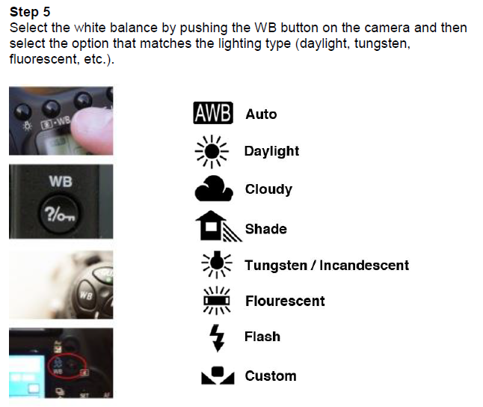
Scanning and Capture – Capture
Notes:
Step 5
Select the white balance by pushing the WB button on the camera and then select the option that matches the lighting type (daylight, tungsten, fluorescent, etc.).

Slide 18
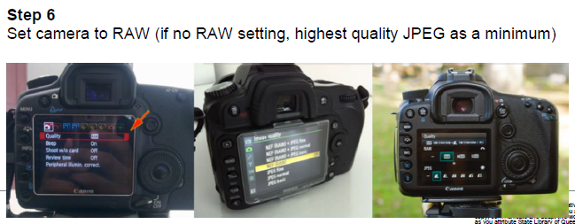
Scanning and Capture – Capture
Notes:
Step 6
Set camera to RAW (if no RAW setting, highest quality JPEG as a minimum)

Slide 19
Scanning and Capture – Capture
Notes:
Step 7
Set camera to self-timer or use a cable release.
Now that you have scanned or captured your images, the next step is to review and finalise the images for archival storage, using image editing software. This is explained in the next section of this training course.

Slide 20
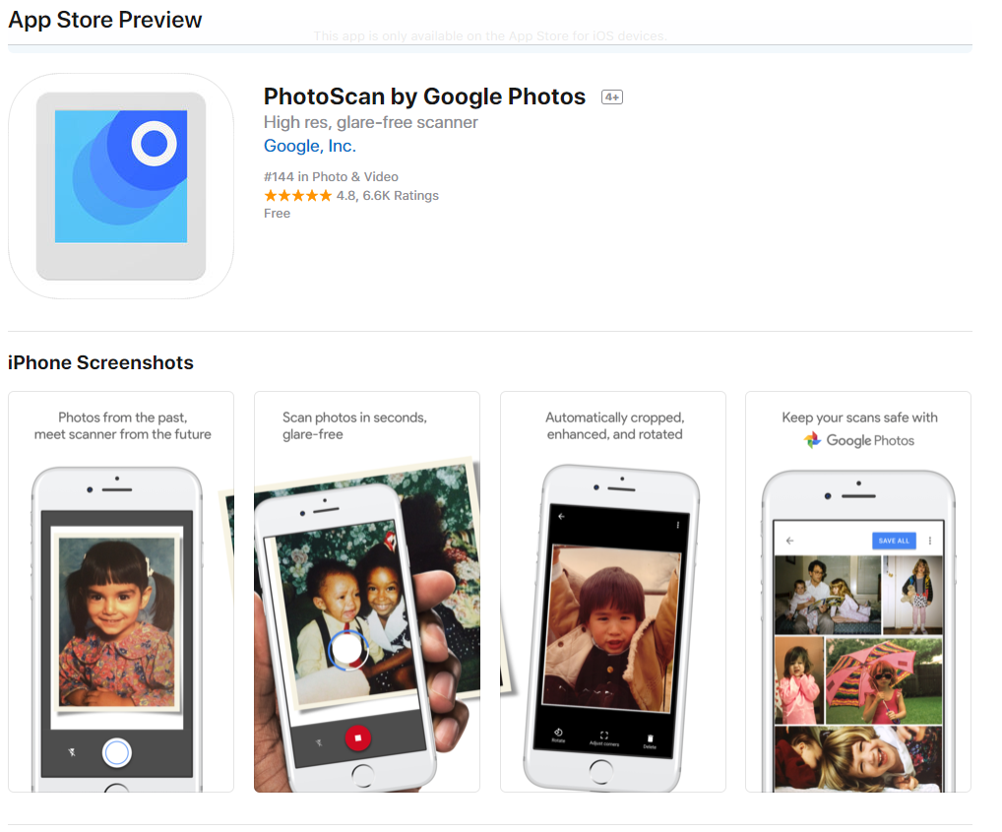
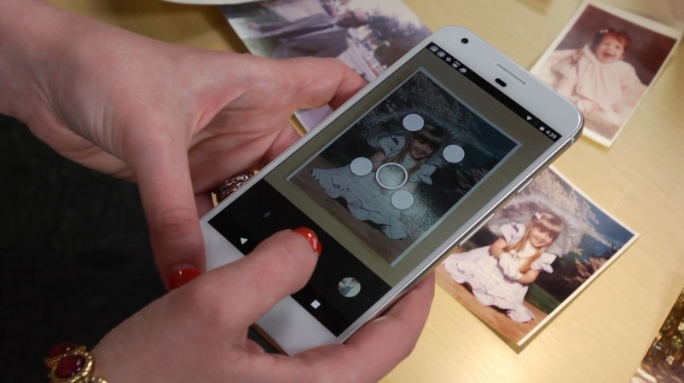
Alternative – PhotoScan by Google
Video: https://youtu.be/MEyDt0DNjWU
Notes:
Play video https://youtu.be/MEyDt0DNjWU

Slide 21
Alternative – PhotoScan by Google
Download the App. Open the PhotoScan app .
To start the scan, hold your phone directly above a photo. Tap the button to take a picture. It'll automatically save to the Google Photos app.
Move your phone around to get the circle over each of the 4 dots.
When the photo has processed, go to the lower right and tap the photo thumbnail.
Select a photo to rotate, adjust the corners, or delete.
To see your scanned photos, go to the Photos app on your phone and search the "PhotoScan“ folder.
Notes:
https://support.google.com/photos/answer/7177983?hl=en
Scan a photo
Open the PhotoScan app .
To start the scan, hold your phone directly above a photo. Tap the button to take a picture. It'll automatically save to the Google Photos app.
Move your phone around to get the circle over each of the 4 dots.
When the photo has processed, go to the lower right and tap the photo thumbnail.
Select a photo to rotate, adjust the corners, or delete.
To see your scanned photos, go to the Google Photos app and search "PhotoScan".
To scan pictures faster, you can turn off Glare removal . You won't have to move your phone to scan, but it won't remove glare.
Scanning tips
Don’t tilt your phone while scanning.
To better frame your photo, place the photo on a flat surface with a contrasting background. Avoid scanning on carpet.
To scan vertical photos, hold your phone vertically. To scan horizontal photos, hold your phone horizontally.
To help remove residual glare, shadows and get better images, make sure flash is turned on.
If there is too much glare, move to a place with less lighting.
Remove photos from sleeves or albums. If the photo is in a glass frame, turn on your flash.
If you have any issues with your scan, try scanning again.

Slide 22
Morning Tea

Slide 23
Basic Photo Editing - Free software
Notes:
Free image software
GiMP http://www.gimp.org – Similar to Photoshop
Google Snapseed – App can be downloaded for Apple OS or Android phones and tables. Snapseed can also now be downloaded for PCs.
For the adjustment of heritage-based images, a very minimalistic approach should be adopted. For instance, adjustments to brightness and contrast should only be made so as to enhance the detail in the image while still maintaining the look of the original. The same rule applies to corrections in colour. These should only be applied so that the digital copy matches the colour of the original image. Digital copies may be cropped so long as this does not interfere with the integrity of the object – e.g. white borders on a photograph or mount board that adds no aesthetic or historical value to the image.

Slide 24
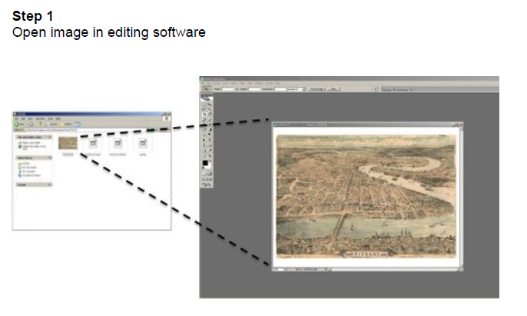
Basic Photo Editing – Image from Scanning
Notes:
Step 1
Open image in editing software

Slide 25
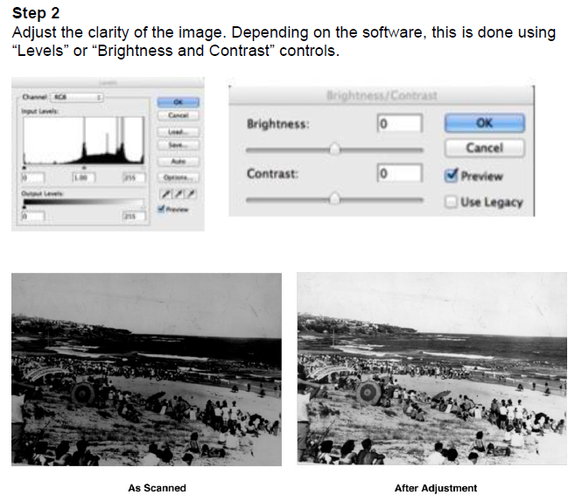
Basic Photo Editing – Image from Scanning
Notes:
Step 2
Adjust the clarity of the image. Depending on the software, this is done using “Levels” or “Brightness and Contrast” controls.
Step 2a (colour corrections)
Colour images will sometimes require corrections to match the original. This can be achieved using Colour Balance or Colour Hue controls.

Slide 26
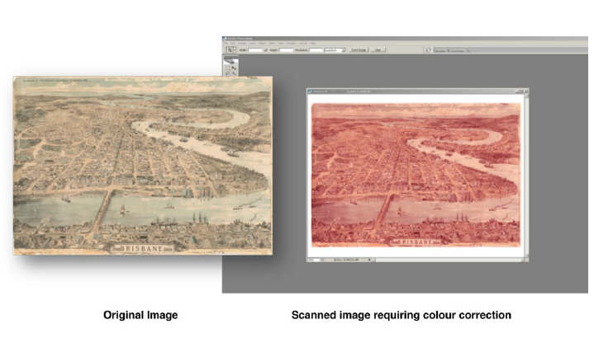
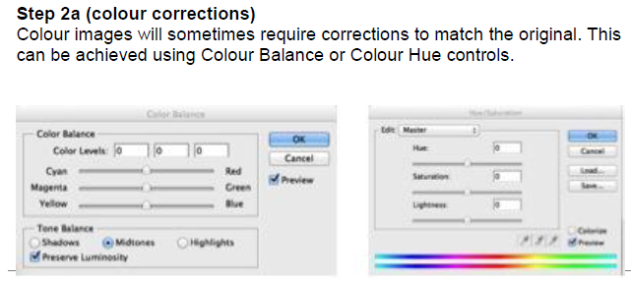
Basic Photo Editing – Image from Scanning
Notes:
Step 2a (colour corrections)
Colour images will sometimes require corrections to match the original. This can be achieved using Colour Balance or Colour Hue controls.

Slide 27
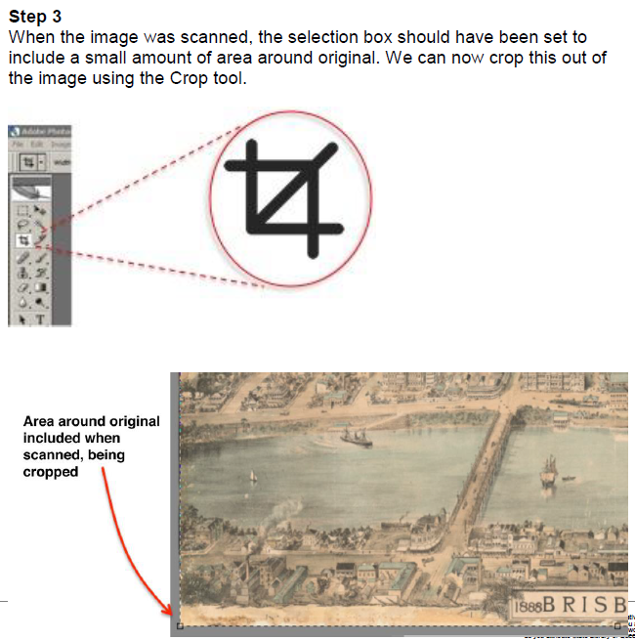
Basic Photo Editing – Image from Scanning
Notes:
Step 3
When the image was scanned, the selection box should have been set to include a small amount of area around original. We can now crop this out of the image using the Crop tool.

Slide 28
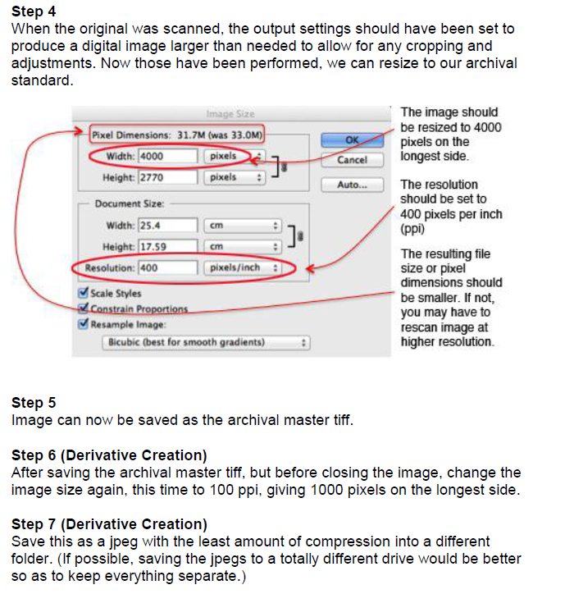
Basic Photo Editing – Image from Scanning
Notes:
Step 4
When the original was scanned, the output settings should have been set to produce a digital image larger than needed to allow for any cropping and adjustments. Now those have been performed, we can resize to our archival standard.
Step 5
Image can now be saved as the archival master tiff.
Step 6 (Derivative Creation)
After saving the archival master tiff, but before closing the image, change the image size again, this time to 100 ppi, giving 1000 pixels on the longest side.
Step 7 (Derivative Creation)
Save this as a jpeg with the least amount of compression into a different folder. (If possible, saving the jpegs to a totally different drive would be better so as to keep everything separate.)

Slide 29
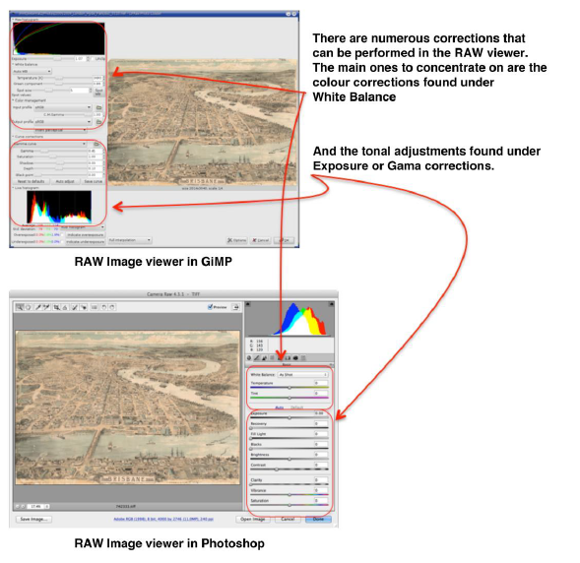
Basic Photo Editing – Image from Capture RAW/TIFF
Notes:
Section 2 (Captured Images)
The information in this section assumes that the images have been captured in RAW/ TIFF format. If the images have been captured in another format such as JPEG or TIFF, they should be treated the same as scanned images in
Section 1.
Step 1
Open the captured RAW image in your editing software. Depending on the software used, you will see a number of tools available to correct or enhance the RAW file. Be aware that some software needs to be updated so it recognises the files coming from your camera. This is particularly so if you have a new camera but much older software.
Other tools can be used at this time such as cropping, straightening, rotating, spot removal, etc. However, these are probably best performed in the editing software itself, once the above corrections are done and the result saved.
Step 2
Once corrections are completed, you can either save the image as a TIFF or open it in your editing software to make any final adjustments. From this point, the image file should be treated the same as a scanned image and any necessary adjustments made as outlined in Section 1
Step 3 (Derivative Creation)
Derivatives can then be created as outlined in Section 1, steps 6 & 7 on page 13 of this guide.

Slide 30
Video: https://vimeo.com/62131787
Notes:
Watch Video - https://vimeo.com/62131787

Slide 31
Notes:
No easy way to make sure your digital copies will last but you can reduce the risk by:
1: Identify what you want to save
2: Decide what is most important to you
3: Organise the content
4: Save copies in different locations

Slide 32
Preservation & storage digital file tips
Have your digital images organised. E.g. in folders by year, event etc.
Save your original scan or capture digital image, then SAVE AS and crate a copy when you edit, resize or change the original image.
Digital image files should be backed up regularly. Keep a back up copy of your images on an external hard drive or upload to an online cloud service. You can download free back up software to help copy files over to external hard drives.
Notes:
Have your digital images organised. E.g in folders by year, event etc.
Save your original scan or capture image, then SAVE AS and crate a copy when you edit, resize or change the original image.
Images should be backed up regularly. Keep a back up copy of your images on an external hard drive or via a cloud service. You can download free back up software to help copy
Cloud Service comparison http://au.pcmag.com/storage-devices-reviews/3696/guide/the-best-cloud-storage-and-file-sharing-services-of-2018

Slide 33
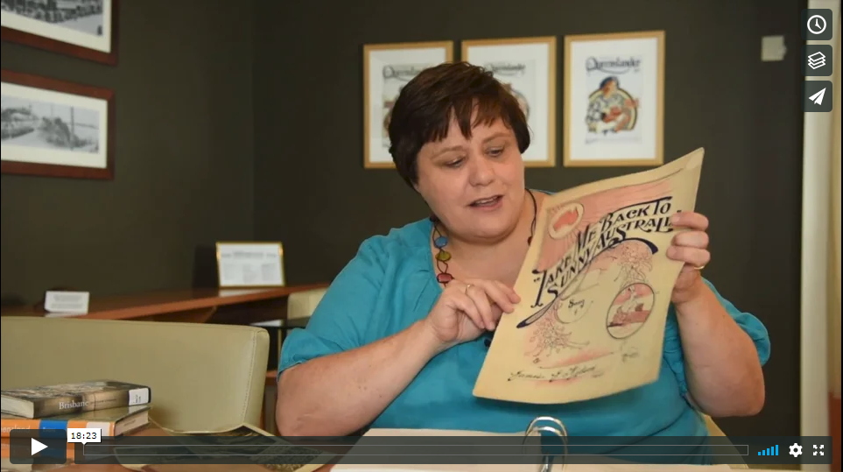
Copyright
https://vimeo.com/128837435

Slide 34
Any questions?
Notes:
Questions

