Slide 1
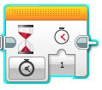
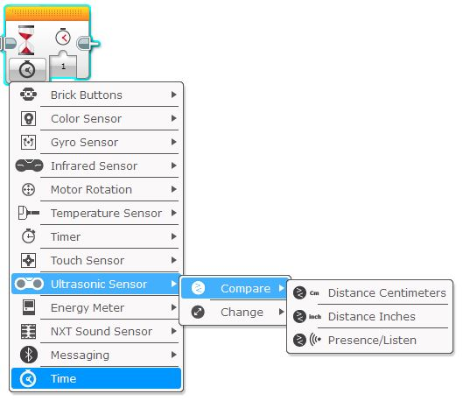
WAIT Block (Ultrasonic Sensor)
Using WAIT block to read distance using the ultrasonic sensor (PART 1)
The WAIT block can be used to pause a program while it “waits” for a sensor value to be reached.
This is done by clicking on the “mode” button , selecting the desired sensor to be monitored (Ultrasonic in this case) & then selecting the type of change you’d like the wait block to look for.
3. Select what change you wish the sensor to detect.
Compare = compares what the sensor detects against a value that you select or nominate.
Change = “WAIT” until any change in sensor value has been detected.
1. Click on the “mode” button.
4. Select “Distance Centimetres”
2. Select the sensor to be monitored.
In this case, “colour sensor” has been selected.

Slide 2
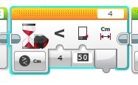
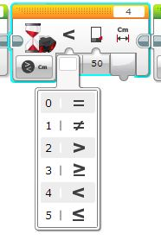
WAIT Block (Ultrasonic Sensor)
Using WAIT block to read distance using the ultrasonic sensor (PART 2)
Before the ultrasonic sensor is ready to be used, it needs to have three more parameters set.
5. SET THE SENSOR PORT
This tells the WAIT block what port the sensor is connected to.
6. SET THE TRIGGER DISTANCE.
This is the distance you’d like the WAIT block to be triggered at.
This is entered in the second window using the keyboard.
Distance is in centimetres.
7. SET HOW THE WAIT BLOCK IS TO COMPARE THE DISTANCE READING FROM THE SENSOR.
The WAIT block needs to know wether you want it to trigger when the sensor distance reading is higher, lower or equal to the distance you’ve set in step 6.
This is set by clicking on the first window & selecting one of 6 different options.
The meaning of each option is explained in the table below.
- WAIT block will trigger when sensor distance EQUALS the set trigger distance (NOT RECOMMENDED)
- WAIT block will trigger when sensor distance DOES NOT EQUAL the set trigger distance (NOT RECOMMENDED)
- WAIT block will trigger when sensor distance IS GREATER THAN the set trigger distance .
- WAIT block will trigger when sensor distance IS GREATER THAN OR EQUAL TO the set trigger distance .
- WAIT block will trigger when sensor distance IS LESS THAN the set trigger distance .
- WAIT block will trigger when sensor distance IS GREATER THAN OR EQUAL TO the set trigger distance .

Slide 3
WAIT Block (Ultrasonic Sensor)
Using WAIT block to read distance using the ultrasonic sensor (PART 3)
In the sequence below, the WAIT block has been set to “Compare distance in centimetres”.
It will “compare” the distance the sensor sees with the distance set in step 6 (in this example, 10cm).
In this sequence, the robot will move forward (TANK block simply turned ON) & the WAIT block will pause the sequence (motors still turning) until the distance sensor sees an object in front of it that is LESS THAN OR EQUAL TO 10cm.
The robot then stops because the next block after the WAIT block is a TANK motor block with the STOP function set.
NOTE: When using the WAIT block like this, ensure a block is used after the WAIT block to stop whatever function was turned on prior to the WAIT block (in this case, both large motors were turned ON).
Make sure correct ports are set!
Note that this TANK block has been set to ON.
This makes both motors turn continuously & they won’t turn off until another TANK block with motor function OFF is used.
Note that this TANK block has been set to OFF.
This stops the motors after the WAIT block sees a distance less than or equal to 10cm).
If this block wasn’t used, the motors would keep turning.
WAIT block will trigger when sensor sees a distance of LESS THAN OR EQUAL TO 10cm.

