Slide 1
CRAFTING THE GRUMPUS’ TREASURED TOMES Session 1
Notes:
Before session:
Email participants:
Can bring own laptop, install inkscape (link to), bring mouse with scroll wheel that can be clicked in!!! (else have laptops here)
Bring USB to transfer files home
Divvy up books between participants, give them links
Finalise webpage including videos of inkscape
Set up laser with demo cut
Materials:
Per participant:
Sample inkscape file + cut demo from laser for reference
Template for covers file (outline on base layer, include good image for live trace) on laptops have layer 2 active.
Laptop +power supply
Inkscape installed (all on same version)
Internet connection

Slide 2
Acknowledgement of Country

Slide 3
Intros!
Notes:
Billie = Not a bookbinder, just an overly enthusiastic maker, background in theatrical costume making and 3D printing, facilitator here at Fabrication Lab
Shane = Conservation Team = real book binder! ☺

Slide 4
Why did you sign up?
Why do you want to make a book?
What do you hope to get out of these sessions?

Slide 5
GRUMPUS
What do you know already?

Slide 6
The Great and Grand Rumpus
Ideas from children put into ‘The Well’
Artists, designers, people like you bring to life in interactive exhibition in Library Gallery later in year
These books will be exhibited there
Books will contain printed copies of the art from The Well
Our covers will be inspired by the art in The Well
Notes:
About Grumpus: https://wiki.slq.qld.gov.au/doku.php?id=engagement:grumpus:start
The Well: https://wiki.slq.qld.gov.au/doku.php?id=engagement:grumpus:grumpuslandonline:rrldev:thewellhome

Slide 7
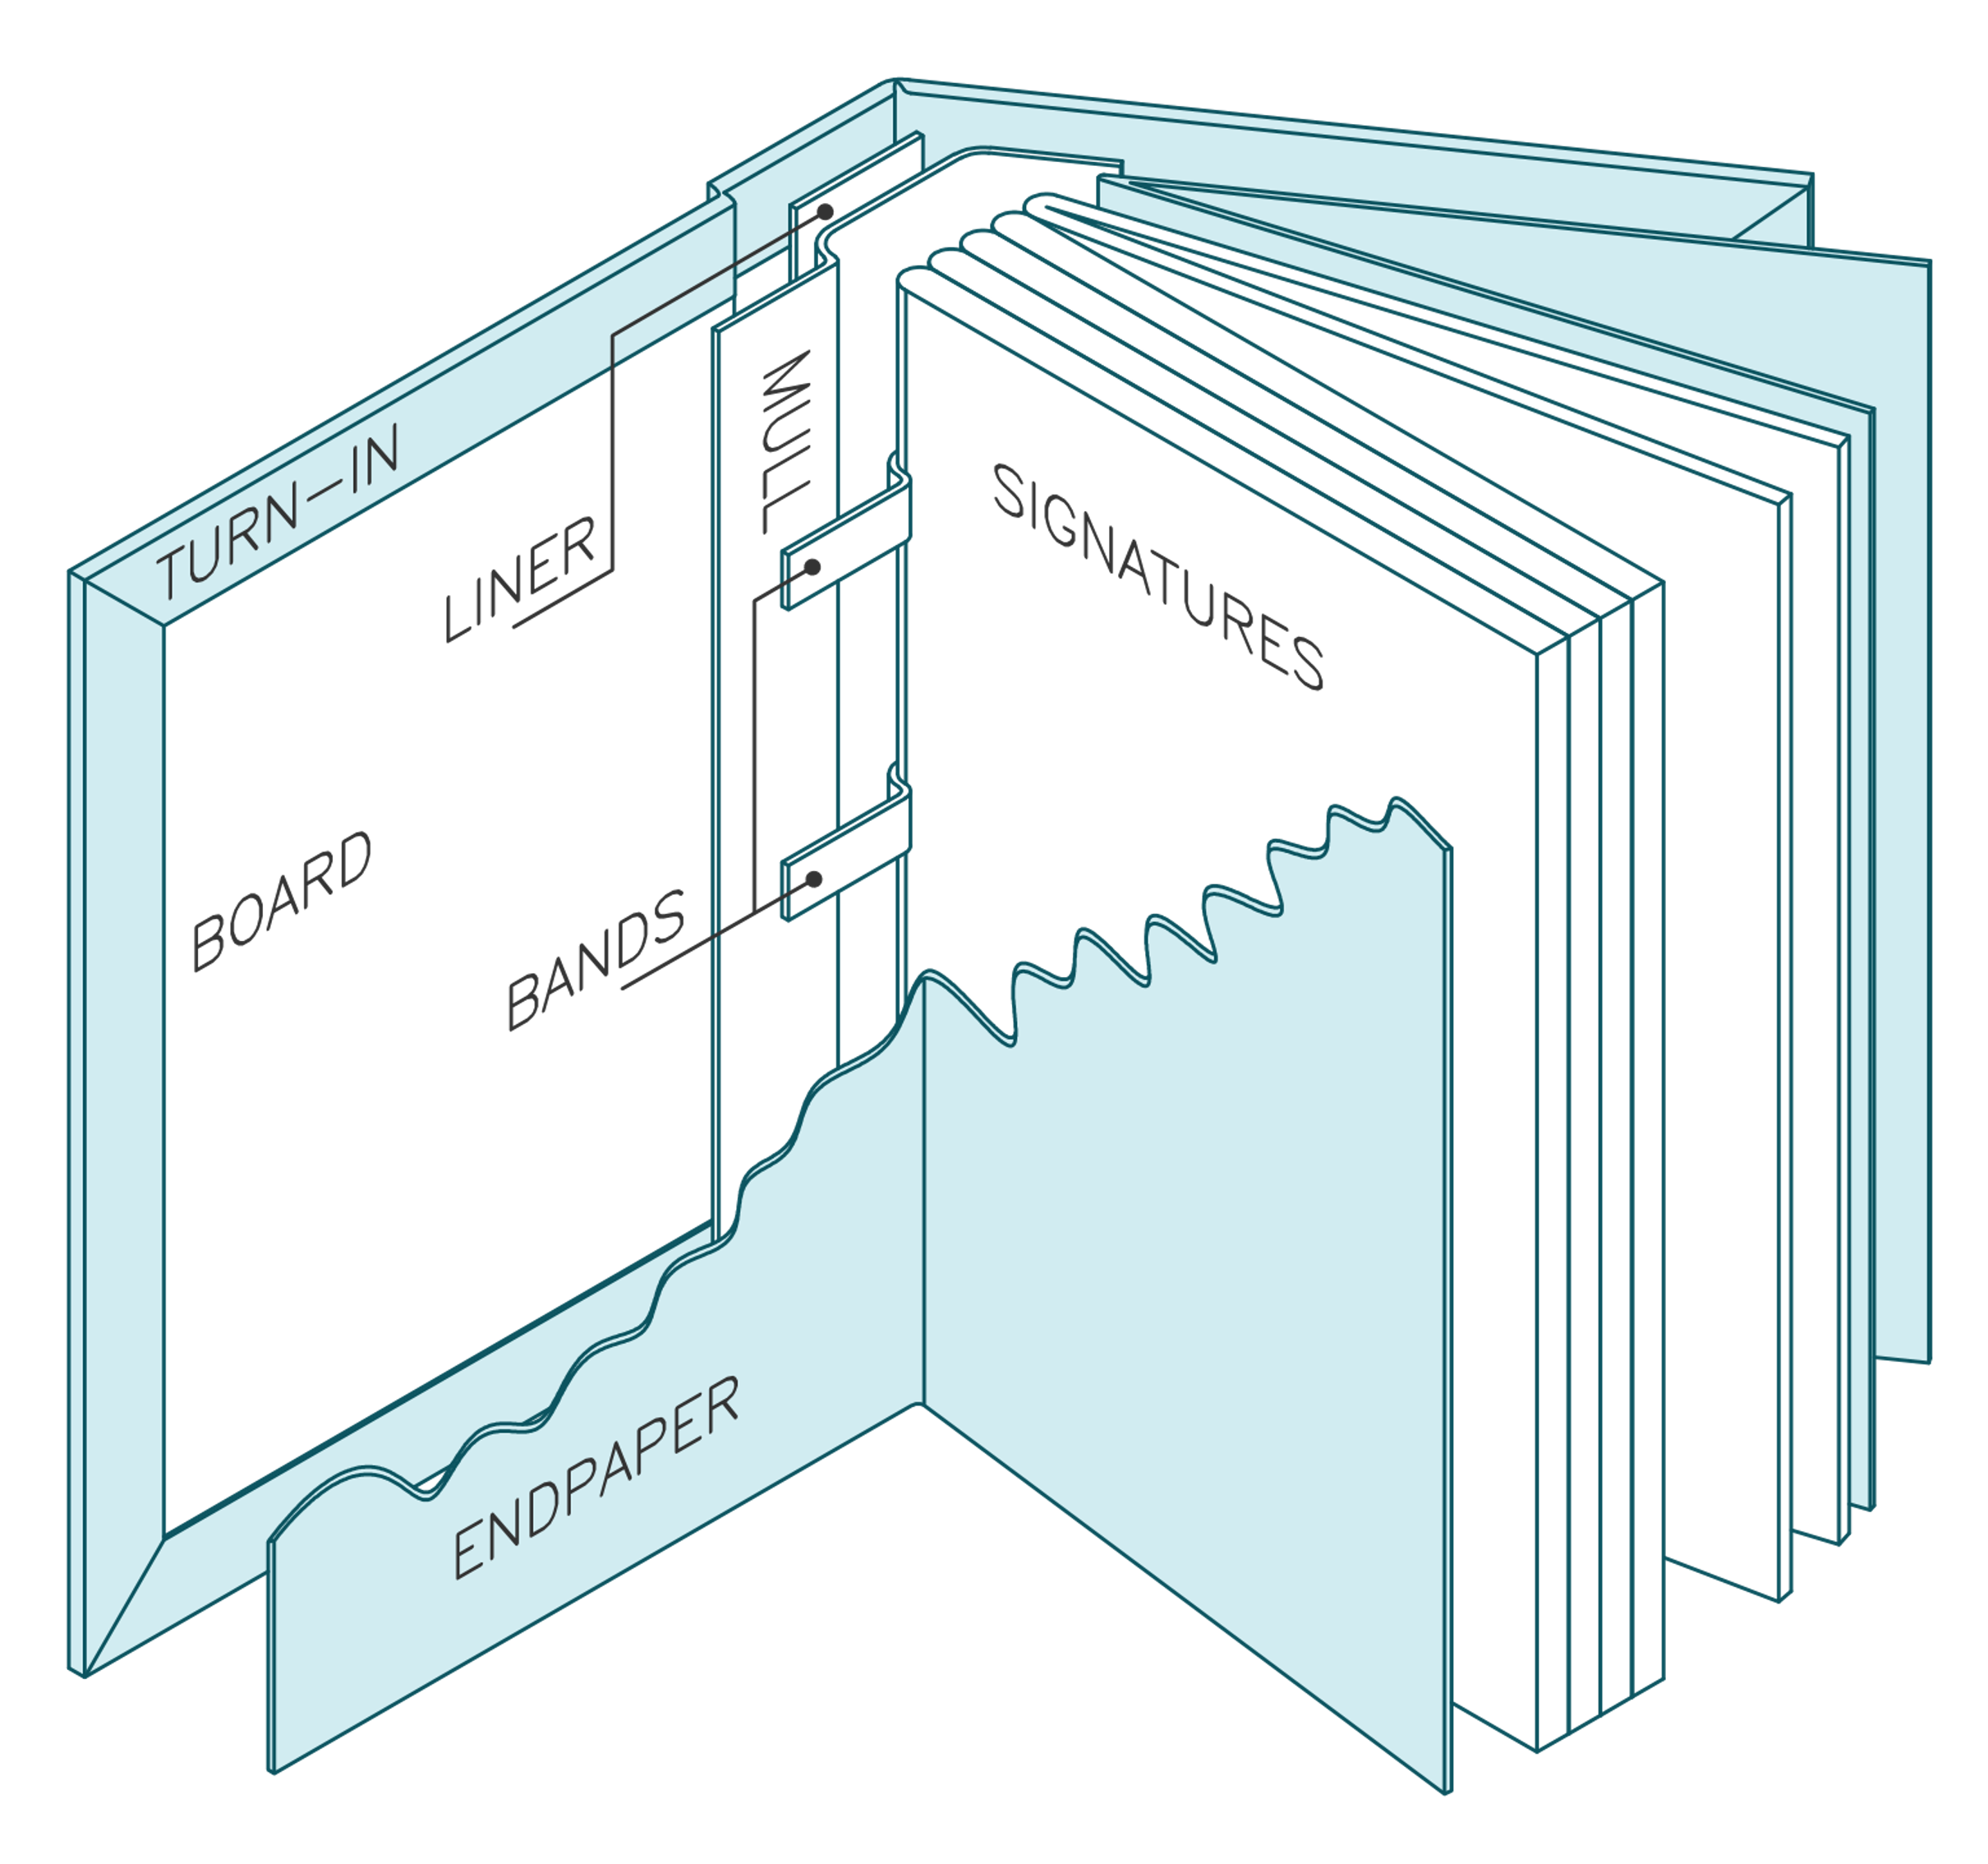
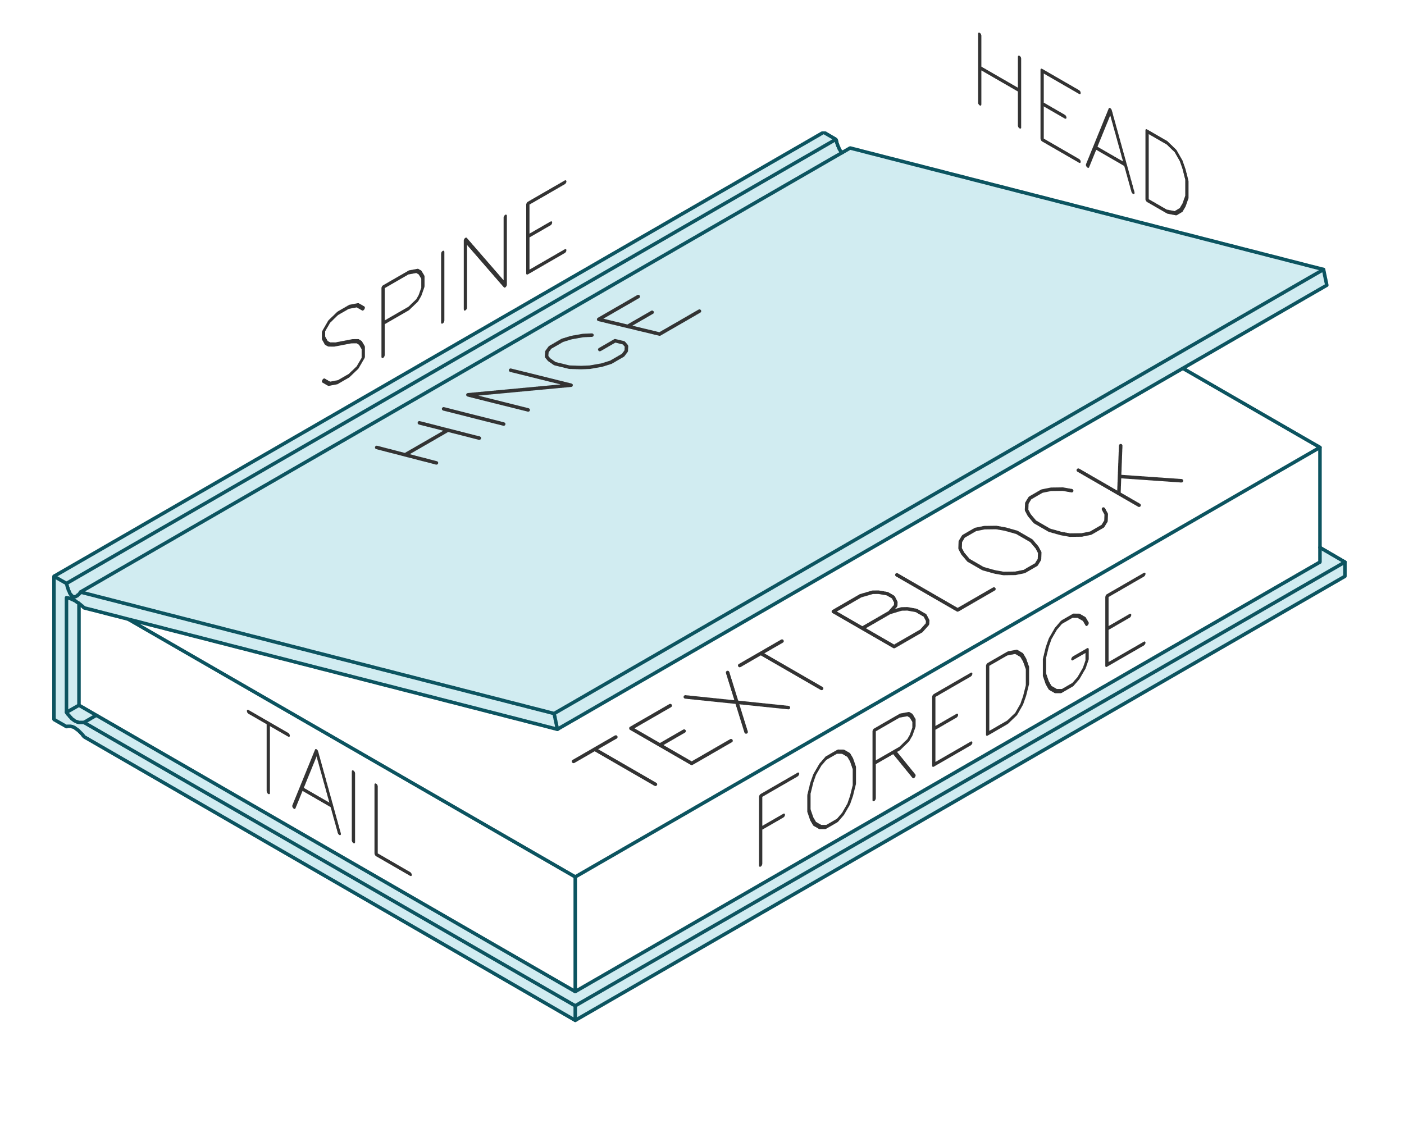
Our books
Notes:
Demo pieces
Laser cut plywood cover, painted and metal leafed,
traditionally bound rest
Headband & ribbon
Show inner workings at back page, talk about gluing
We’re starting on covers today

Slide 8
Course Overview
Cover Design: Inkscape
Making the text block: fold, sew, glue
Bonus: Water marbling end papers
Laser cutting induction
Bonus: Conservation Tour + Guillotine
Bonus: Cutting, painting, metal leafing covers
Putting it all together

Slide 9
Why laser cut a book cover?
Notes:
Allows us to make intricate things oncemore, as a lot of the fine work in many handcrafts have been pushed out by mass manufacturing due to time/labour costs involved in hand making something like this.
Very customisable, don’t need to make a big brass stamp for each book cover, or lots of little ones, manually carve something like this.
Also very repeatable! Can expect the same results from the same file.
Opens it up to people who haven’t got the dexterity or practice, as this is very accurate, and being able to design it first digitally is a lot more forgiving than hand carving something!

Slide 10
Laser cutting demo & overview
Demo
Induction in session 3

Slide 11
Bitmap vs Vector Graphics
BITMAP
(pixels)
VECTOR
(math lines)
Notes:
bitmap = pixels (like photo) = bad
vector = lines made of maths infinitely zoom in and will always be crisp
Because they are just maths, they are very easily read by laser cutter
We don’t need to know maths! Special software allows us to make it. Inkscape is one such example.
Most digital images we use day to day (such as JPEGs, GIFs and PNGs) are called bitmaps, they are made up of thousands of little blocks of colour called pixels. These are great for photos but they don't provide enough information for a lot of digital fabrication technologies (such as CNC routers and laser cutters).They also can't be made larger without the image “pixelising” and looking ugly, so bitmaps are not well suited to various graphic design applications like logos.
This is where vector images excel. Vectors are essentially lines made of maths, so you can zoom in and out infinitely without the image blurring, and they are much easier for machine software to interpret. Thankfully, we don't need to program the maths these lines are made of, we have software that will work all that out for us, and they are able to save the images out in various vector formats, some of the most common being SVG and DFX, though PDFs can also contiain vectors (but it gets confusing because they can also contain other things like bitmaps!).

Slide 12
Inkscape (vector software)
Free & Open source
Download online for free inkscape.org
Let’s get started!
Notes:
Because open source, plugins for all kinds of things.
Download Inkscape at home here for free: https://inkscape.org/

Slide 13
Open Inkscape
From taskbar at bottom of screen
Looks like a little snow-capped mountain

Slide 14
Open Template
File > open
Navigate to template on desktop
Click [Open]
Notes:
Open Template
File > open
Navigate to template on desktop
Click Open

Slide 15
Adding shapes
THERE’S A VIDEO OF THIS ON THE WIKI!
Adding rectangles
Adding squares
Ellipses
Circles

Slide 16
Navigation
Moving around
Click in mouse wheel + move mouse
Zooming in and out
Ctrl + scroll wheel
Notes:
Navigation
Moving around
Click in mouse wheel + move mouse
Zooming in and out
Ctrl + scroll wheel

Slide 17
Selecting things
Click black mouse icon on tool bar at left
Then click on the thing you want to move
The little black arrows show you’ve selected it.
Click the white space to de-select

Slide 18
Moving things
THERE’S A VIDEO OF THIS ON THE WIKI!
Click black mouse icon on tool bar at left
Then click and drag the thing you want to move.
Let go when it’s in the right place.
Click the white space to de-select it.

Slide 19
Rotating Things
THERE’S A VIDEO OF THIS ON THE WIKI!
Click black mouse icon on tool bar at left
Click on the thing you want to rotate.
Wait a second.
Click again on the thing you want to rotate and the arrows on the outside of the object will change.
Click and drag one of the corner arrows to rotate the object.
Notes:
Rotating Things
Click black mouse icon on tool bar at left
Click on the thing you want to rotate.
Wait a second.
Click again on the thing you want to rotate and the arrows on the outside of the object will change.
Click and drag one of the corner arrows to rotate the object.

Slide 20
Adding text
Text tool
Resizing:
Overall
Text box

Slide 21
Custom Shapes: Pen Tool
THERE’S A VIDEO OF THIS ON THE WIKI!
Adding points
Dragging points
Dragging lines
Corners vs smooth
Adding points
Deleting points
Practice makes perfect!
Notes:
Don’t worry if it’s a bit uncomfy now! You will get the hang of it in no time.

Slide 22
Live Trace
Choosing (or making!) a good image:
“Stencil-like”
No thin lines
High contrast

Slide 23
Live Trace
THERE’S A VIDEO OF THIS ON THE WIKI!
How to
Notes:
Inserting image
Video on wiki

Slide 24
Saving
Inkscape SVG –for editing
PDF – for cutting on laser
!!! SAVE TO YOUR USB !!!

Slide 25
Laser colours and meanings
Black Fill = Etch
← In Inkscape
Laser cut →
Notes:
Could be laser session?
Sample piece

Slide 26
Changing Colours
THERE’S A VIDEO OF THIS ON THE WIKI!
Fill using palette

Slide 27
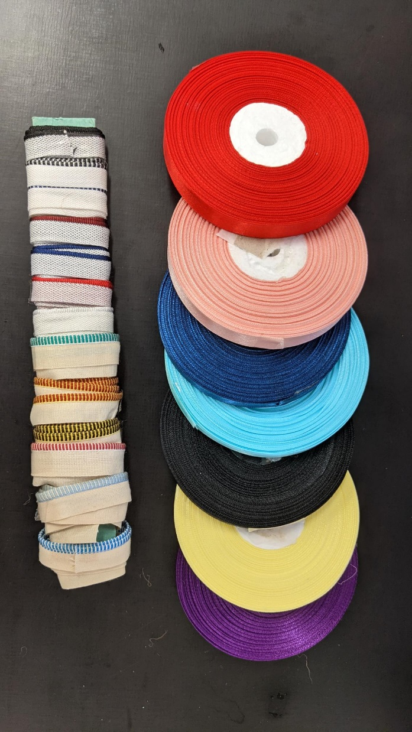
Colours after cutting
Painting (bonus sesh)
Gold/Silver/Copper leaf
Headband
Ribbon
Bookcloth
Notes:
Can bring your own ribbon (60cm) or acrylic paint if you wish.

Slide 28
Creativity
Creativity is not about coming up with totally new ideas from nothing. It’s about mashing knowledge together to form something new
More knowledge= more creativity, gather!
Notes:
Creativity isn’t about coming up with totally new ideas. Creativity is about mashing bits of knowledge together to form something new. When we experience something new, the knowledge is fed a few times between short and long term memory while our brains work out where to index new knowledge so it can store it somewhere to use later. As travels this path, it actually literally scrambles through our existing memories, through the rest of our knowledge it bumps into other ideas, and it’s these intersections of ideas where creativity happens. If’ you’re into 3D printing you might find inspiration in woodworking, as an example, because they both have grain lines, so your brain might try to relate them to each other, and then you might find that some of the knowledge you have from woodworking applies to 3D printing, like for example that the strength of a object produced by a 3D printer is determined by the direction of the grain line. And thinking on that more you might start to see other opportunities, like that you could use traditional no-nail wood joints to join 3D printed parts without glue. And as you dwell there on the overlap between ideas you will find more and more. A woodworking sanding bow can be used to easily sand 3D prints, I wonder if I could 3D Print a woodworking bow? So it’s this iterative process of getting a new idea and mooshing it together with existing knowledge. These intersections of concepts and the ideas therein are where the ‘magic’ of creativity happens. And knowing this is great, because it means that we can influence our own creativity. It’s not some divine, ethereal power some people are blessed with and others not. The more information you're gathering and the less familiar that information is, the more your brain scrambles thoughts, and the more likely you are to come up with a creative idea. So, when you’re making a new packaging design, you don’t’ need to start with nothing, take a look at packages of brands you already like, find colours you like from a favourite pillow at home, find little decorative elements that aren’t even from print, like all the beautiful wood cuts we have on traditional Queenslander-style houses, as an example. And feel free to google! I also really like sites like Pinterest, that allow me to collect images under headings. My 3D printing board is filled with embroidery, fish scales, art nouveau jewelry, book binding jigs, sanding bows, old alleyways, military medals, polly pockets, images of cracked surfaces… All kinds of things, all that inspire my 3D printed works and almost none of them that are actually 3D printed. Find things you like, a moosh them together. ☺ You feed more in, you get more out.

Slide 29
Inspiration
Primarily: The Well
Also: Old book covers/ illustrations via pinterest, Archive.org, PublicDomainReview.org, googling, etc
It’s about the concept, not a literal interpretation
Notes:
The Well: https://wiki.slq.qld.gov.au/doku.php?id=engagement:grumpus:grumpuslandonline:rrldev:thewellhome
The aim isn’t to reproduce the children’s art in laser form, but to make something inspired by it.

Slide 30
Copyright
Art from well all ok,
Your own drawings all ok (inspired by The Well)
Good sources of free images on wiki like archive.org (just check licences)
Fonts: check the licenses
Notes:
https://archive.org/details/StencilCatalogsCutStencilsForTheUseOfPracticalMen/page/n51/mode/2up?view=theater
https://archive.org/details/ExcelsiorFrescoStencils/page/n43/mode/2up
https://archive.org/details/250stencildesign00kpra/page/30/mode/2up
https://www.pinterest.com.au/billieruben8695/book-covers/
https://publicdomainreview.org/

Slide 31
Coming up
Cover Design: Inkscape
Making the text block: fold, sew, glue (21st Sept)
Bonus: Water marbling end papers (23rd Sept drop in 2-8pm)
Laser cutting induction
Bonus: Conservation Tour + Guillotine (TBC)
Bonus: Cutting, painting, metal leafing covers (book in open lab 12-6pm wed, 6-8pm thurs, 12-6 sat)
Putting it all together!
Notes:
Next fortnight we will be sewing and gluing our text together!

Slide 32
Homework
Read a bit about the GRUMPUS
Gather inspiration from The Well
Draft cover for next session in a fortnight on template! Email Inkscape (SVG) files to me to me by Monday 20th Sep billie.ruben@slq.qld.gov.au
Notes:
*** Link to template ***
Download Inkscape at home here for free: https://inkscape.org/
If you don’t have a computer at home you can come in and work on it here during open lab times
GRUMPUS: https://wiki.slq.qld.gov.au/doku.php?id=engagement:grumpus:start
THE WELL: https://wiki.slq.qld.gov.au/doku.php?id=engagement:grumpus:grumpuslandonline:rrldev:thewellhome
Draft cover for next session in a fortnight on template! Email Inkscape (SVG) files to me to me by Monday 20th Sep billie.ruben@slq.qld.gov.au

Slide 33
Help
Wiki page for this course loads of notes, links and Inkscape videos!!
Wiki page for Inkscape
Open Lab Help: Wed 12-6pm, Thurs 12-8pm, Sat 12-6pm
Google
Notes:
Wiki page for this course: https://wiki.slq.qld.gov.au/doku.php?id=workshops:prototypes:laser_cut_books&s[]=bookbinding
Wiki page for Inkscape: https://wiki.slq.qld.gov.au/doku.php?id=facilities:fablab:software:inkscape

Slide 34
Keeping Tidy: Layers, Orders, Groups
Like overhead transparencies
Separate bits of work, make things not-editable.
Can also change order of objects on a layer (demo)
Grouping

Slide 35
Combining Shapes
Union
Difference

Slide 36
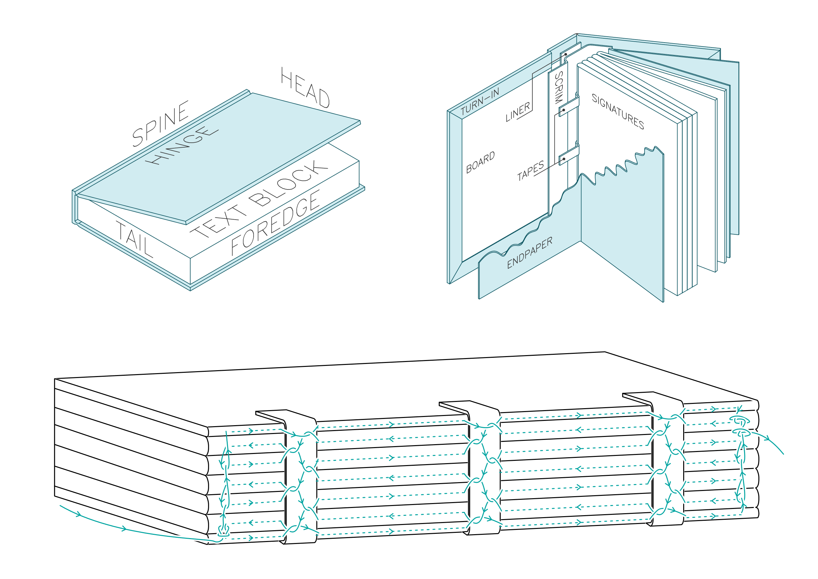
CRAFTING THE GRUMPUS’ TREASURED TOMES Session 2
Notes:
Before session:
Email participants after first session with homework
Have the books printed (5 sheets per signature, grain line running along short edge,
Have end papers printed
Finalise sewing video
Gather materials:
Bone folder each
Brayer each
Awl each
Punching template each
Printed pages each
Scissors each
Sewing needle each (blunt thin good, can sand down tip)
Waxed linen or polyester thread each (enough to weave back and forward between all signatures)
Single ply cardboard each (for under punching)
Tapes each

Slide 37
Grumpus: What has come before
The story thus far

Slide 38
Drafts Review

Slide 39
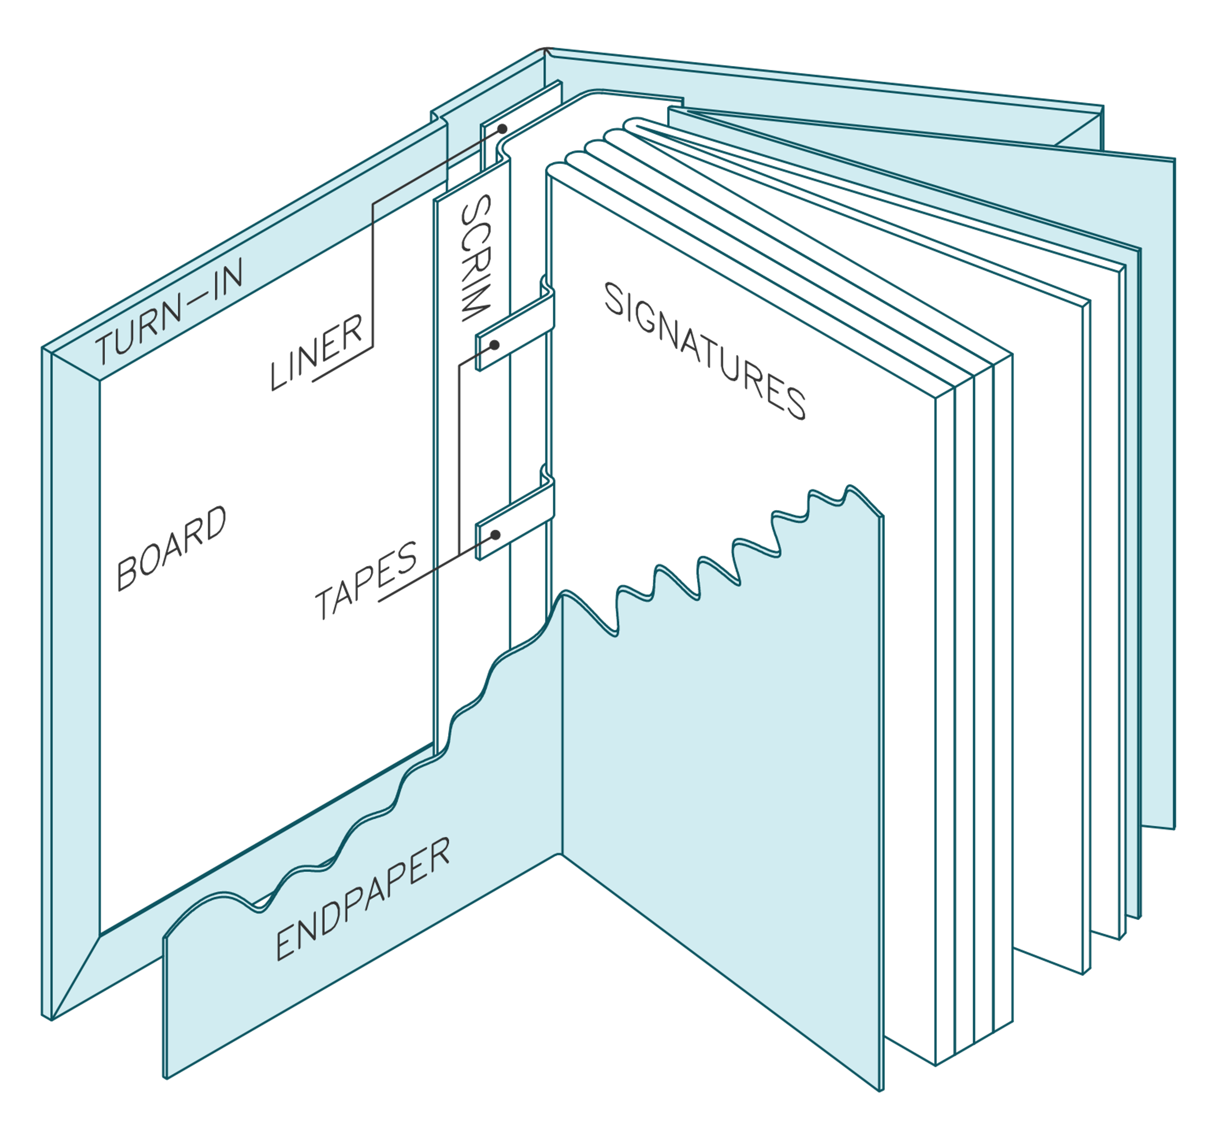
Overview book construction

Slide 40
Sewing our text block

Slide 41
Fold signatures
The amount of sheets per signature is VERY IMPORTANT: 5 else the pages will be out of order.

Slide 42
Folding process
Fold in half, match edges, press down with hand at centre of edge to secure.
Sweep bone folder from your hand to the fold then up and down the fold to crease it.

Slide 44
Keep signatures in page order!
Notes:
As you continue Check that you are keeping the signatures in order. Page numbers between signatures should always match.

Slide 45
Punching Holes
Awl made from 3D printer and tapestry needle
Punching template from laser cutter
Notes:
File link for awl and template
Can buy awl
Can make template from manilla card

Slide 46
Punching Holes
Work over something with some give, thin cardboard good
Hook template at top of signature
Aim for centre of crease

Slide 47
Keep signatures in page order!
Notes:
As you continue, check that you are keeping the signatures in order. Page numbers between signatures should always match.

Slide 48
Sewing
Video of this on wiki to refer to at home!

Slide 49
1st signature
Always pull in the direction you’re sewing (parallel to spine) to prevent tearing
Ensure you are catching all pages in the signature

Slide 50
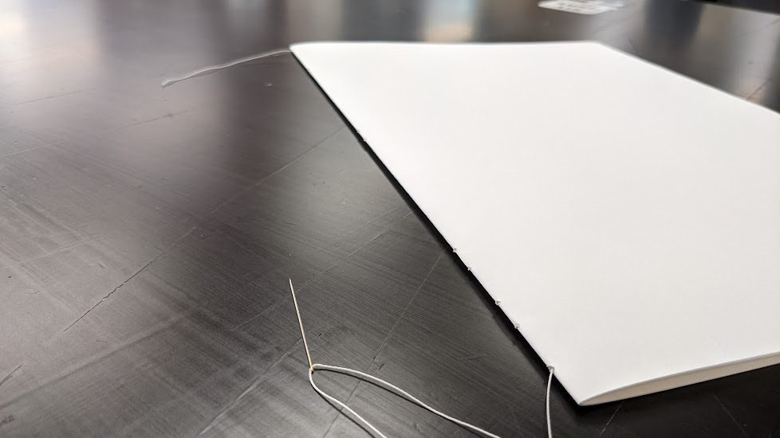
1st Signature
Place first page down on edge of desk
Enter first hole from outside of signature, and weave needle back and forth through the holes until you get to the far end.

Slide 51
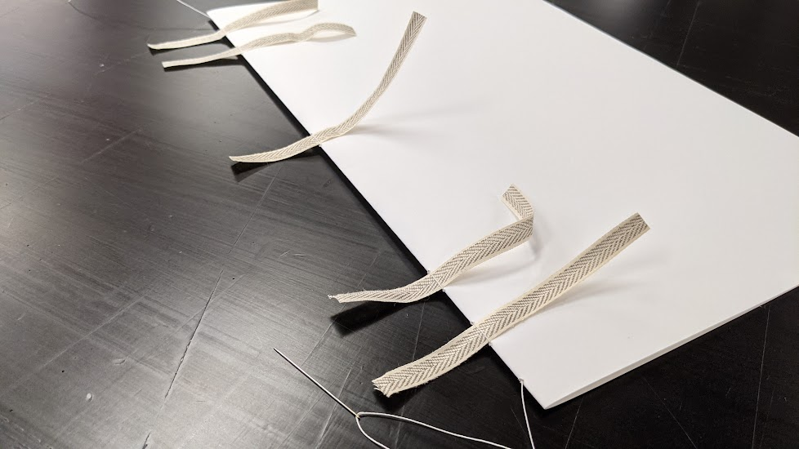
1st Signature
Poke tapes under loops of thread on outside
Firm up thread

Slide 52
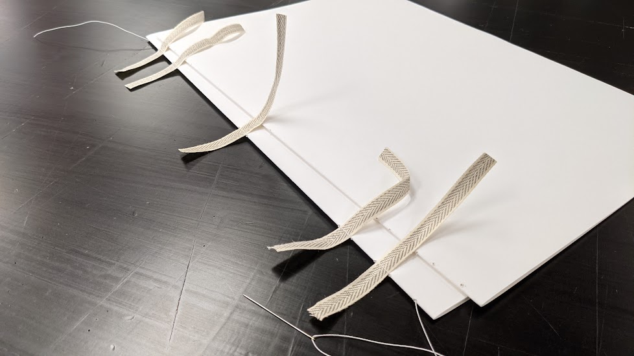
2nd Signature
Place second signature on top of first, matching page numbers

Slide 53
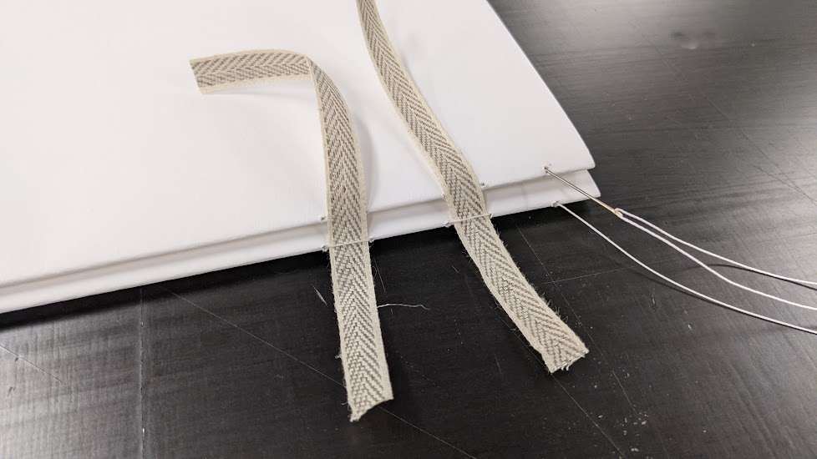
2nd Signature
Enter the first hole directly above where your needle came out of last.
Bring your needle out through the 2nd hole (next to the first tape)

Slide 54
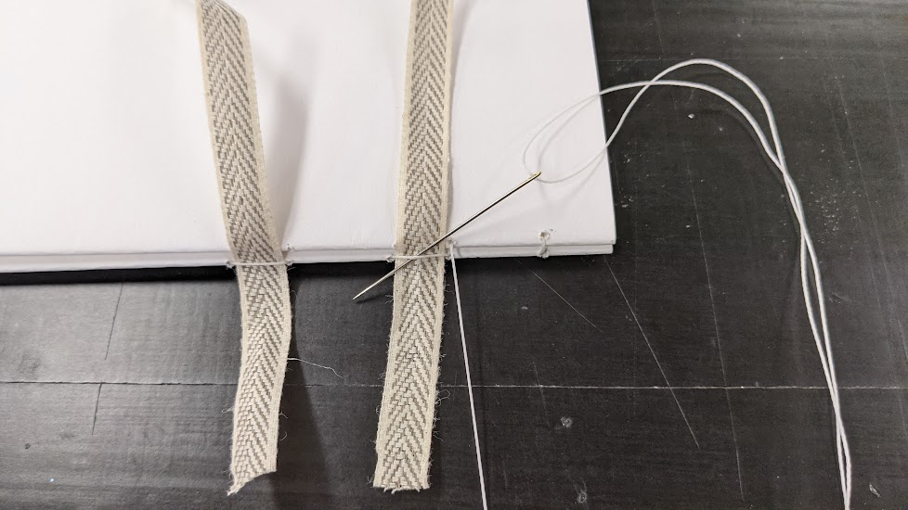
2nd Signature
Loop your needle under that first loop over the tape
This adds a twist between the signatures, helping to keep them together.

Slide 55
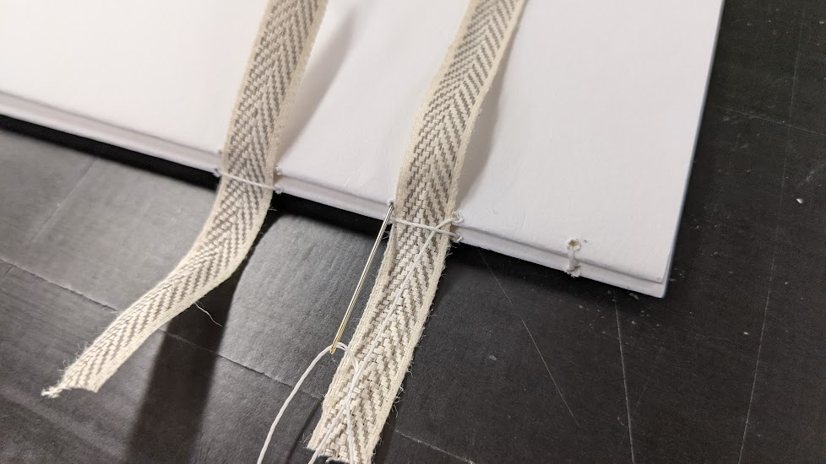
2nd Signature
Poke your needle back into the signature at the other side of the tape
And back out at the next tape.

Slide 56
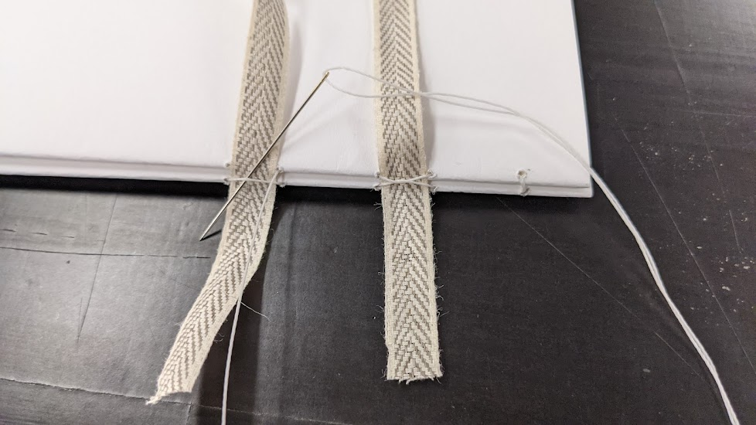
2nd Signature
Repeat the twisting as on the previous tape.

Slide 57
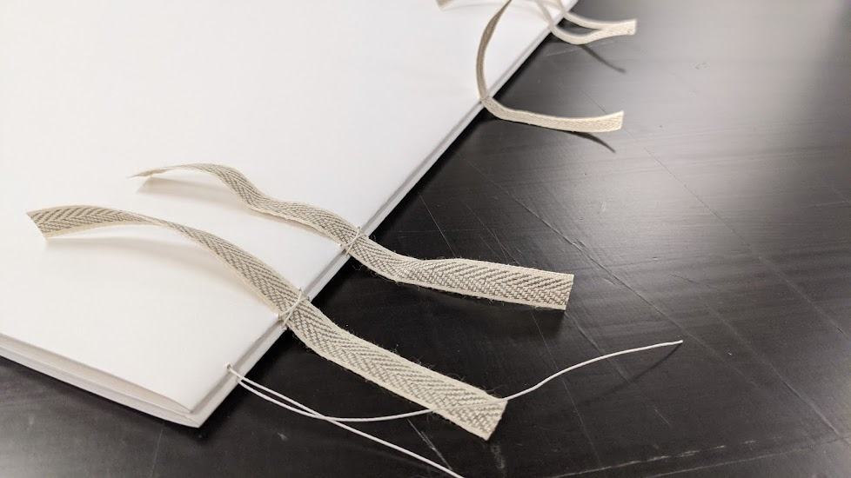
2nd Signature
Do this for all the tapes and bring your thread out at the other end of the signature

Slide 58
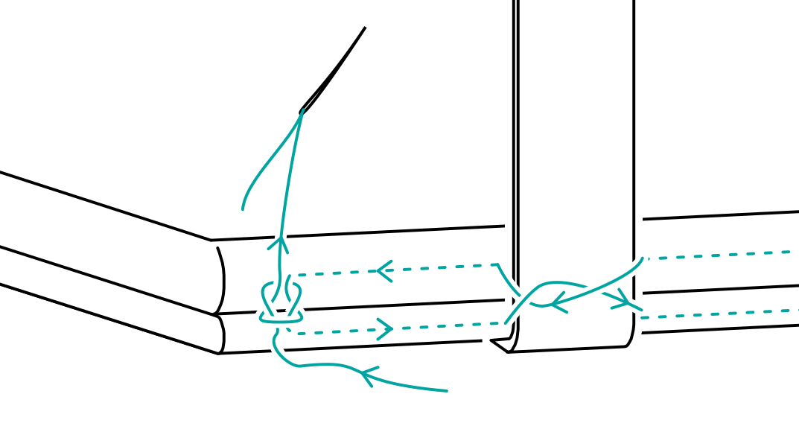
2nd Signature
Tie a square knot between the loose tail (from where you started sewing the first signature) and your working/ needle thread

Slide 59
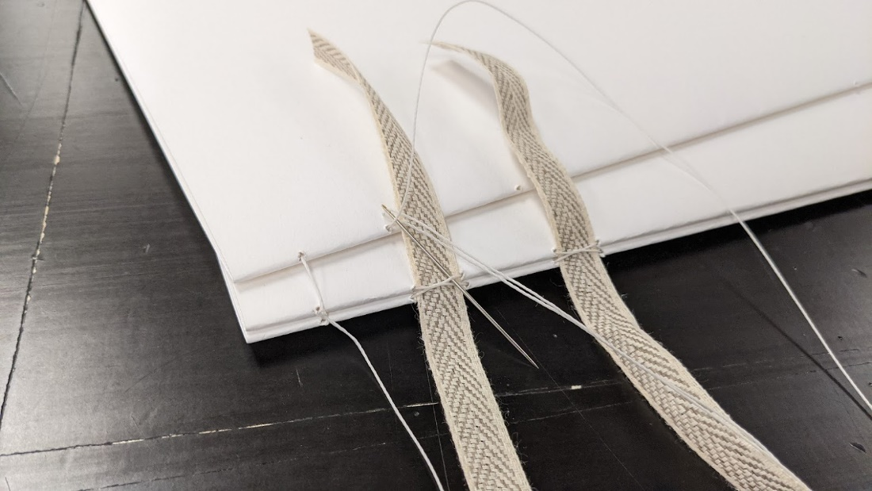
3rd Signature
Place your third signature on top (match page numbers)
Enter the first hole on the third signature and come out before the first tape

Slide 60
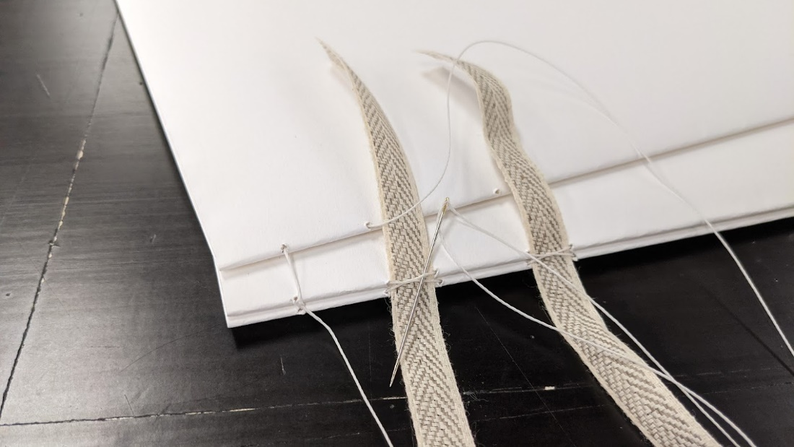
3rd Signature
Slip your needle under the second stitch on the tape (not the first too)
Continue in this manner until you reach the end.

Slide 61
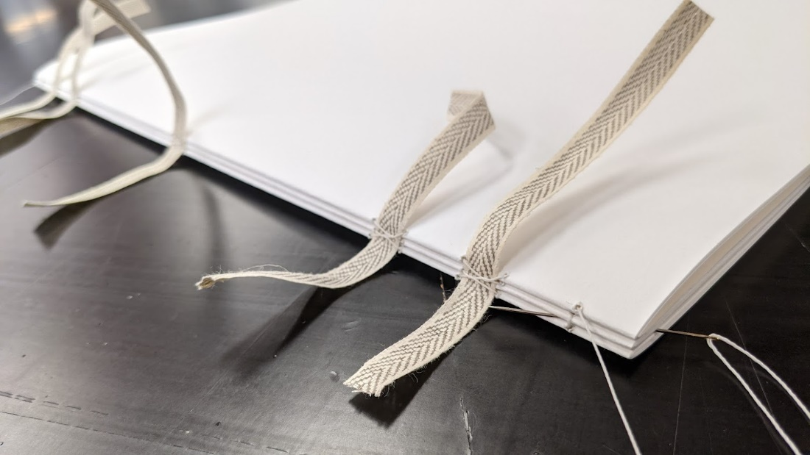
3rd Signature
To secure your third signature to the bundle, slip your needle between the 1st & 2nd signatures

Slide 62
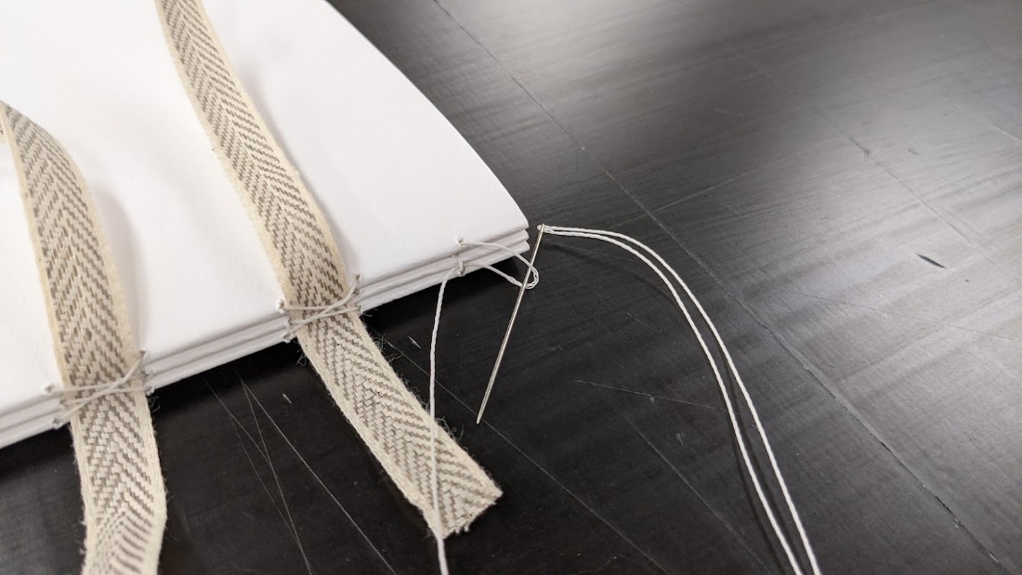
3rd Signature
Pull your thread most of the way through ,leaving a loop.
Then pass your needle through the loop formed.

Slide 63
4th (and rest of) signatures
Place your signature on top
Sew the signature as per the previous, picking up the twists from the previous signature as you pass the tapes.
At the end repeat the looping but now between the 2nd & 3rd signatures (always the two previous ones)

Slide 64
Keep signatures in page order!
Notes:
As you continue Check that you are keeping the signatures in order. Page numbers between signatures should always match.

Slide 65
At the very end
To knot the thread at the end, pass the needle between the two prior signatures, and then through the loop formed
Repeat this process again (forming two knots)
Leave a long tail, to glue down later

Slide 66
Homework
Finish sewing, bring next session!
Final cover art to me by this weekend!!
Marbling session this Thursday from 2-7:30pm!

Slide 67
Help
Sewing video and diagram on wiki
Help times here at lab:
This week:
Wed 22nd 12-6p
Thurs 23rd 12-8p
Sat 25th 12-6p
Next week:
Thurs 30th 6-8p
Sat 2nd 12-6p

Slide 68
Coming up
Cover Design: Inkscape
Making the text block: fold, sew (21st Sep)
Bonus: Water marbling end papers (23rd Sept drop in 2-8pm)
Laser cutting induction, gluing text blocks (5th Oct)
Bonus: Conservation Tour + Guillotine (TBC)
Bonus: Cutting, painting, metal leafing covers (book in open lab 12-6pm wed, 6-8pm thurs, 12-6 sat)
Putting it all together! (19th Oct)
Notes:
Next fortnight we will be sewing and gluing our text together!

Slide 69
CRAFTING THE GRUMPUS’ TREASURED TOMES Session 3
Notes:
Tee up time for tour of preservations
Ensure inductions ipads are charged and sso page logged in
Set up bucket of water with washer for hands.
Set up glue spots (disposable plates?)
Set up water bucket for glue brushes
Cut strips of wax paper x2 per person each longer than the books are tall, and wider than the strips of wood.
Gather masking tape 1 per person
Gather strips of wood (1 per person)
Gather clamps (2 per person)
Make files to cut. Cutting templates for book cloth?
List of who has and hasn’t sent me their covers
Files for cutting (spacers, trim lines, trim shapes)

Slide 70
Grumpus: What has come before
The story thus far

Slide 71
today
Gluing & pressing text block
Laser induction: online & practical
Gluing mull

Slide 72
Protect Pages
Wrap wax paper vertically around book near spine, and tuck into pages to secure, then add tape.
This will protect the pages a bit from glue, and give us somewhere to tape our mull/tapes onto.

Slide 73
Glue signatures
Tape back tapes down onto paper
Lay book so spine running along edge of table
Glue: saturate tapes and work in between signatures a bit
Place wood on top and press down. Notice tapes wrinkle.
Remove wood, pull top tapes taught (can tape down onto wax paper too)
Place wood back on, and use clamps/desk to apply pressure.

Slide 74
Pressing text block
Helps make it neat and firm
Don’t overdo the tightness, else spine will be squished

Slide 75
Laser induction: online

Slide 76
Anyone not done a general Induction?
Notes:
Maybe do online here now

Slide 77
Laser Induction: Practical

Slide 78
Laser: How to book
Anyone want to cut their cover themselves? If so, book in next week, else I will do it by next (final!) session.

Slide 79
Choose your materials
marbled papers
headbands
bookmark
book cloth

Slide 80
Guillotine/tour of conservation

Slide 81
Homework
!!! SEND ME YOUR COVER DESIGN ASAP IF YOU HAVENT YET !!!

Slide 82
Bonus: Tour of Conservation
Shane will take tour through State Library’s Conservation department
See the space and equipment
See how he trims a book on the guillotine

Slide 83
Bonus: extra making
If you want to:
Cut your own book in the laser
Glue on your own scrim/bookmarks etc
Paint or metal leaf your covers
Come in during open lab! Swing me an email so I can prep. Book the laser if you want to cut.
billie.ruben@slq.qld.gov.au

Slide 84
Help: Open Lab Times
This Week:
Wed 6th 12-6
Thur 7th 12-8
Sat 9th 12-6 (Billie not in)
Next Week:
Wed 13th 12-6
Thur 14th 12-8
Sat 16th 12-6 (Billie in)

Slide 85
Coming Up
Photographer next sesh (let me know if you don’t want your picture taken)

Slide 86
Coming Up
Laser cutting induction, gluing text blocks (5th Oct)
Bonus: Conservation Tour + Guillotine (date TBC)
Bonus: Cutting, painting, metal leafing covers (book in open lab 12-6pm wed, 6-8pm thurs, 12-6 sat)
Shane will trim our text blocks to size
I will glue on the mull/scrim
Putting it all together! (19th Oct)
Notes:
Next fortnight we will be sewing and gluing our text together!

Slide 87
Glue on headband
Cut 2pcs to width of text block
Glue to head and tail of spine sticking just out of the text block at each end

Slide 88
Glue on mull
Cut it to fit between the two headbands.
Pre fold it to the right size for your book.
Tape base onto wax paper to secure
Add plenty of glue, dab it to saturate mull
Tape down top onto wax paper
Smooth with finger
Rest wood on top (don’t clamp)

Slide 89
CRAFTING THE GRUMPUS’ TREASURED TOMES Session 4
Notes:
Have photography consent forms printed
Have pens
Glue per pair
Brushes each
Waste paper
Knife
Mat
Steel ruler
Wood
Clamps
Finishing Front Covers
Painting (Acrylic)
Gold leafing:
Brushes
Size: https://artmaterialsupplies.com.au/shop/jo-sonja-tannin-sealer-and-gold-size/
Leaf
making the case (cover)
Why use book cloth (impermeable to glue, protects from water/dirt etc)
Methylcellulose and PVA Mix (PVA glues quick alone)
Thicknesses/ measurements around edges
laser cut spacers and trimming guides (with measure and description e/g for edge)
sharp thin utility knives
steel rulers
cutting mat
need knitting needles 3 per person if doing flippy back bit, 2 else. mounted to boards would be good.
need presses for each person, or heavy things.
non-stick stuff polyester film? Waxed paper?
pressing boards
felt
brayers
More info:
how to make fabric into bookcloth https://www.youtube.com/watch?v=ek2-1VJfskY
Casing in (putting the pages into the cover)
dublu (?spelling)
back then front. methylcelulose/ PVA mix
nipping press
Admiring our work!
Edit
What If/Next
How to replicate with tools at home. e.g heavy items and clamps instead of presses, or come and make a press on our CNC machine! :D
DIY endpapers with paste or marbling really fun and easy
Print a book (how to print into folios, online converters?)
Other methods of sewing and binding: any good books? any diagrams we can make?
What to do with loose-leafs (double fan perfect binding, video on YT)
Where to find out more:
QLD Bookbinders Guild
QLD AICCM Paper conservationists
Youtube: bookbinding channel DAS bookbinding, brissy guy, stellar content.

Slide 90
Photos with books!
Photographer in!
Consent forms

Slide 91
Grumpus: What has come before
The story thus far

Slide 92
What we have done in the break
Glued spine
Trimmed edges on guillotine
Glued on mull
Glued headband and bookmark
Glued spine lining (paper)

Slide 93
Today
Add end papers
Making our covers
Putting book into cover
Celebrating!!

Slide 94
Tip on end papers
Grain line
Fold papers
Glue

Slide 95
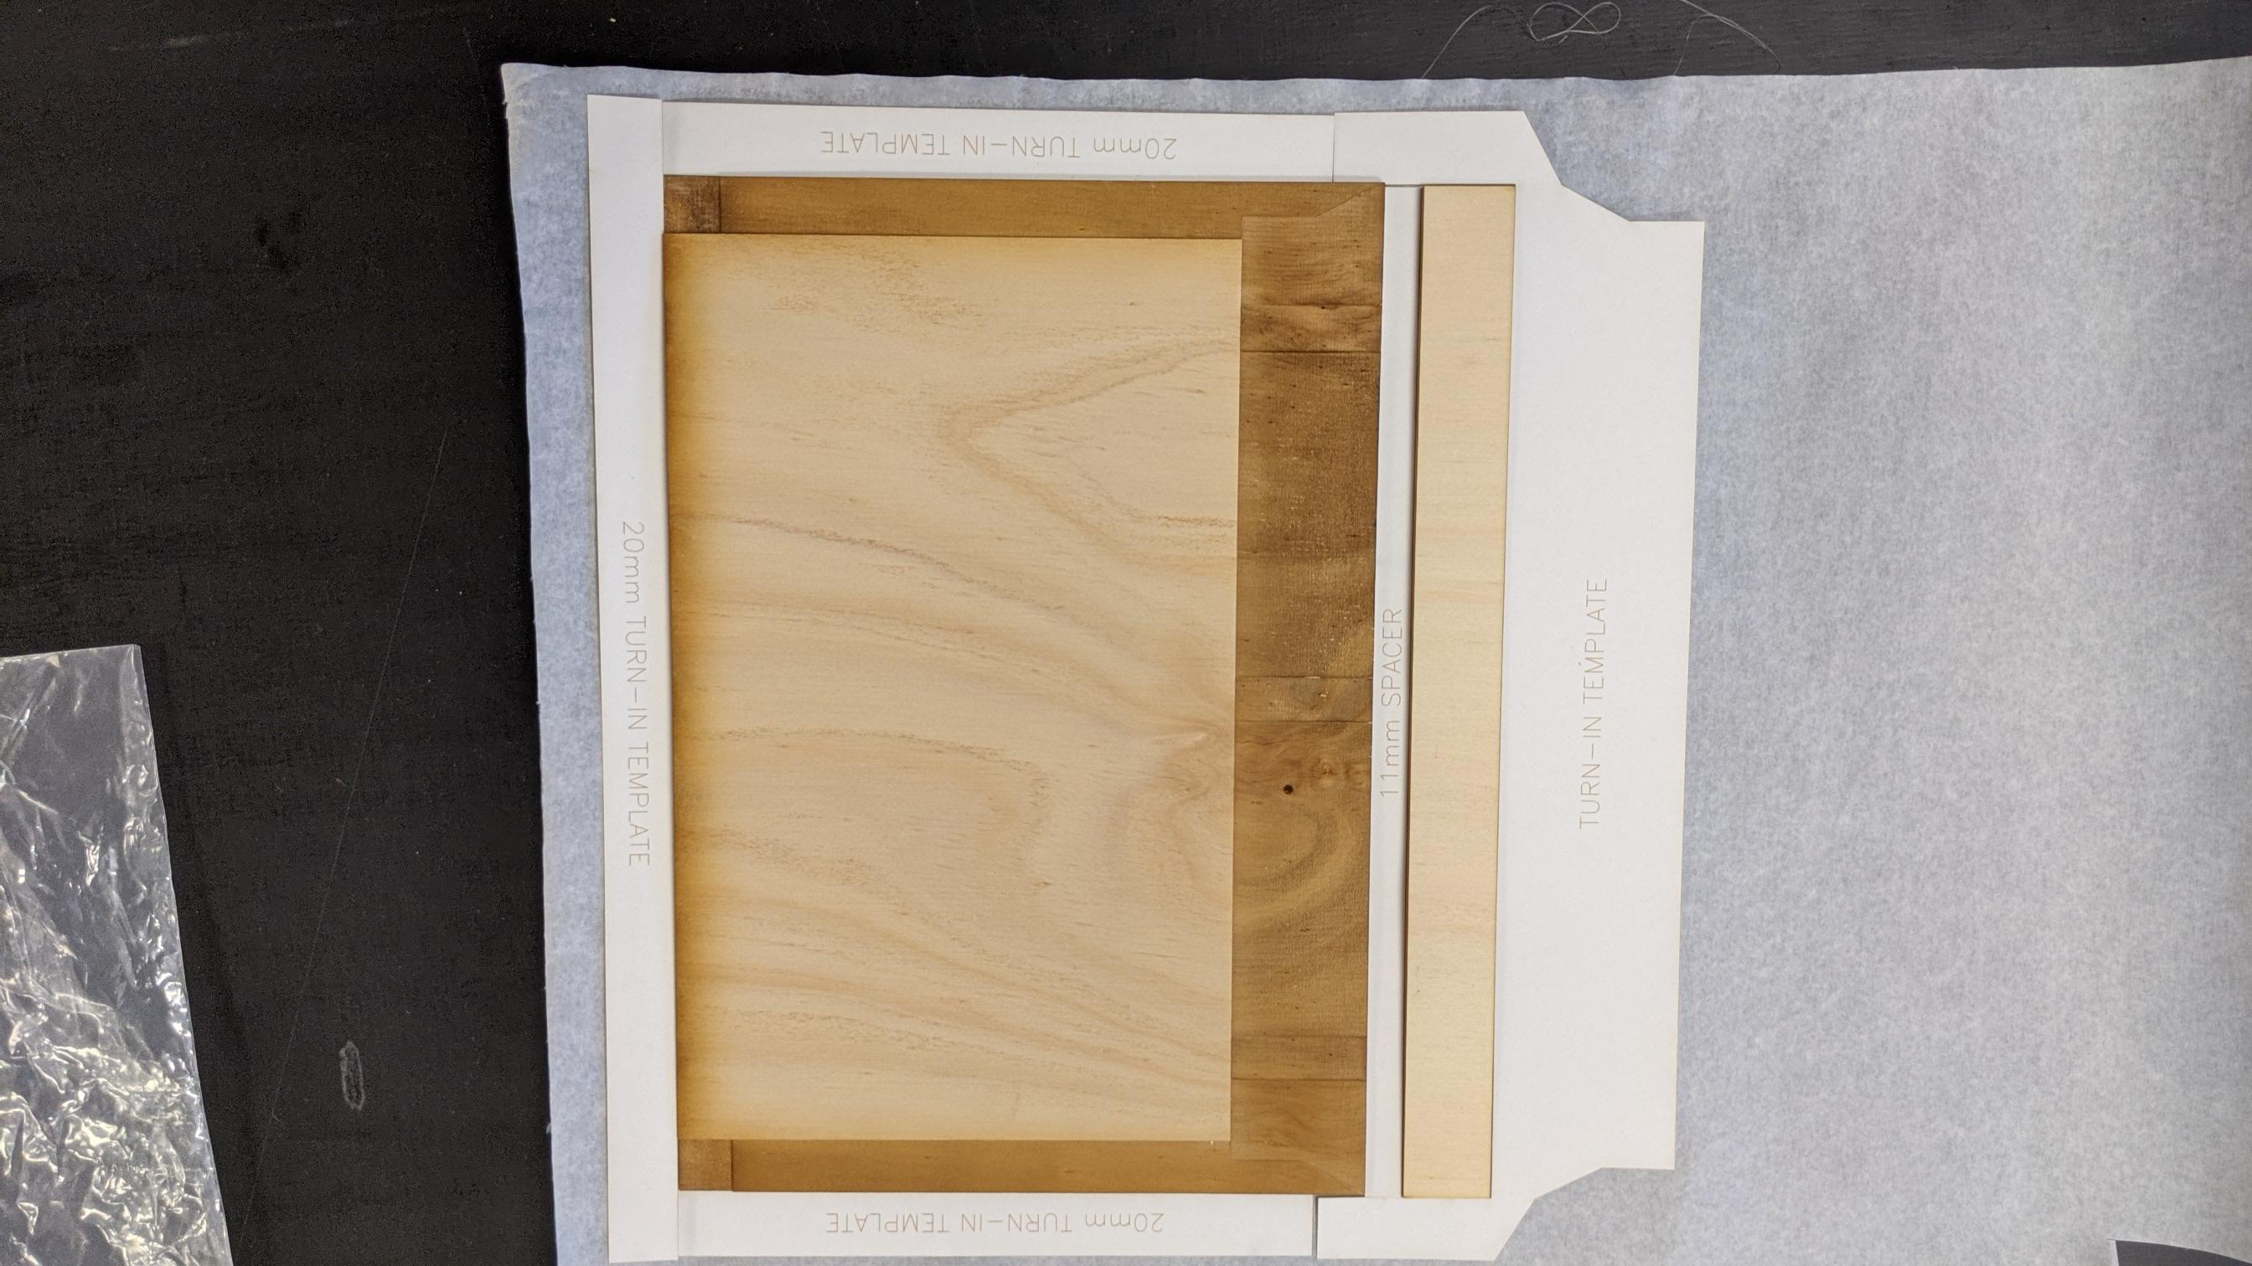
Layout
Check you have enough book cloth by laying out the template and cover like so:

Slide 96
Glue up cover
glue big back piece (plain) down first
Use spacer to place spine
Use spacer to place front cover (glue to inside of cover)
Turn-ins head, tail
Turn in foredge

Slide 97
Cutting end papers to size
Grain line importance
Template?
Cut around
Fold in half

Slide 98
Glue book into cover
Use baking paper to protect pages
Glue tapes to scrim on back glue on cover
Place in cover, close cover to ensure still fits. Note, boarder
Glue up top scrim/tapes/cover
press

Slide 99
Inserting end papers
Glue all one side, and 3mm over edge
Place atop pages
Close cover

Slide 100
Lots of ways to make a book
Types
Laser edges
Laser cut wood blocks for indenting
Laser cut stamps

Slide 101
Where to go from here
QLD Bookbinders Guild
Youtube channels:
Deep dives into various construction methods: DAS Bookbinding (Brissy guy!)
Fun/ lighthearted: Sea Lemon
iBookbinding: Tutorials, guest speakers (also have website)
Wiki
Open Lab & Hack the Evening

Slide 102
Show opening
12th December

Slide 103
What happens after
Keep the works?
Donate to schools?

Slide 104
Help
Wiki page

