Slide 1
Getting Started in Family History
State Library of Queensland
Online collections and resources training

Slide 2
Aims of today’s session
Identify key features and resources of Ancestry Library Edition
Demonstrate how to access information and use key strategies in searching
Demonstrate benefits and problems of Ancestry Library Edition
Explore how Trove is useful in family history research

Slide 3
Ancestry Library Edition
Key features:
Quick name searches
Search across multiple records, countries and time
Access to digitised images
Continually added to and updated
Access previously inaccessible British and Australian records
Notes:
Ancestry is a large database that contains thousands of databases of collections of records from all around the world used by people to research their family history. Public libraries in Queensland have free access to Ancestry Library Edition.

Slide 4
Ancestry databases
Wide variety of records available including:
England, Wales and Scotland censuses 1841-1911
Civil birth, death and marriage indexes for England and Wales
Selections of British parish records

Slide 5
Ancestry databases (cont.)
UK Incoming Passenger Lists 1878-1960
UK Outward Passenger Lists 1890-1960
Australia-wide birth, death and marriage indexes
NSW passenger lists 1826-1922
Victoria passenger lists 1839-1923

Slide 6
Ancestry databases (cont.)
Some 20th Century Australian electoral rolls 1903-1980
NSW – Sands Directories 1861-1933
Various Queensland post office directories and Pugh’s almanacs within “Australia, City Directories, 1845-1948”
Queensland government gazettes 1903-1910

Slide 7
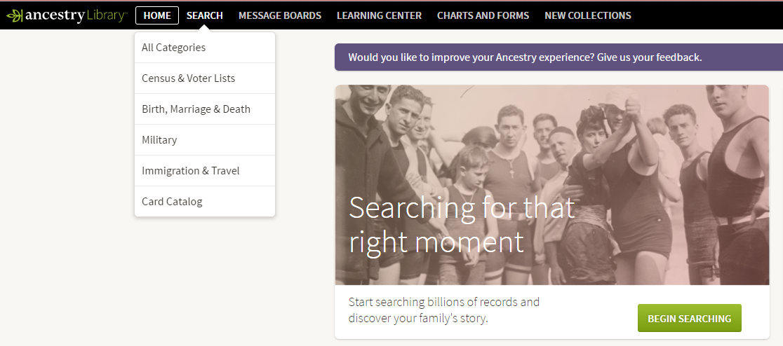
Ancestry – starting to search
Home Screen - Two ways to get to “Search” screen

Slide 8
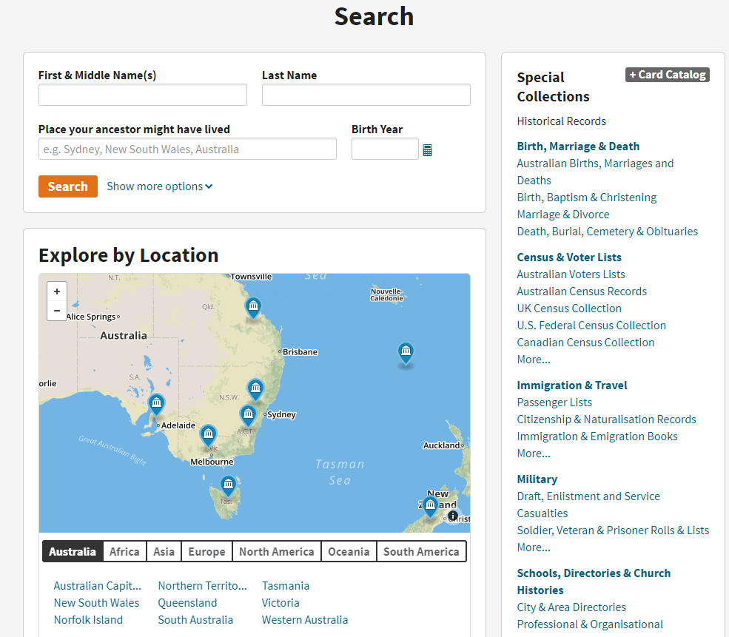
4 ways to search
Special Collections
+ Card Catalog
Basic / Advanced search
Explore by Location

Slide 9
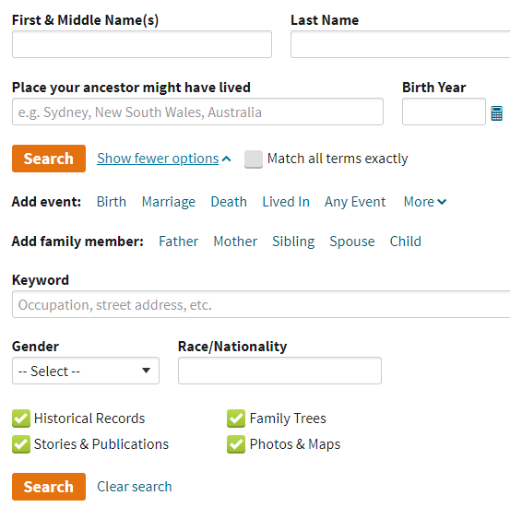
4 ways to search
“Basic” and “Advanced” searching
Notes:
Basic and Advanced searches will search across all Ancestry databases.
Number of results will depend on what information you provide and how much
A Basic search will provide a broad range of results. Using Advanced search and adding additional information such as date of death, parents’ names or a spouse’s name can help narrow the results.

Slide 10
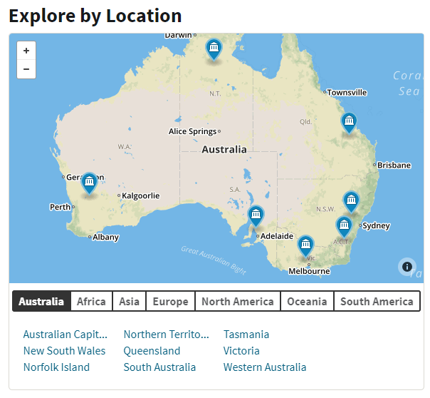
4 ways to search
“Explore by Location”
collections icon
geographical area
specific country or state
Notes:
Provides an opportunity to locate databases and information from a specific geographical location

Slide 11
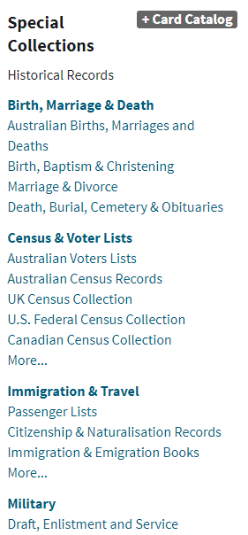
4 ways to search
Special Collections
+ Card Catalog
Notes:
Special Collections - Makes locating and searching specific collections in a subject area easier
Card Catalog - provides the ability to search for records from specific collections, locations or time periods. Explore by Location only goes down as far as England, Wales etc. If you want to see records from a particular county such as Wiltshire the best way is to search through +Card Catalog.

Slide 12
Searching
General search tips
Start with a broad search then slowly add information to narrow results
Try different search terms
Try combinations of search terms
For alternative spelling use wildcards
For unusual spellings try limiting to Exact or Soundex
Notes:
Ancestry automatically searches exact spelling, phonetic and similar variations

Slide 13
Searching (cont.)
Wildcards
Use ? when replacing a single letter within a name
e.g. Sm?th searches Smith & Smyth
* when replacing more than 1 letter in a name
e.g. John* searchs John, Johns, Johnson, Johnsen etc.

Slide 14
Searching (cont.)
Exact
searches for the exact spelling
Sounds Like (or Soundex) and Similar
Alternative spellings of a name
Phonetic
Useful for European names that are spelt different to way pronounced

Slide 15
Hints
Indexing problems
Given names and surnames may be reversed
Spelling may be inconsistent in the original index or document
Informal rather than formal names may be used
Notes:
Documents are transcribed exactly as they appear so abbreviations and mistakes in documents transfer to Ancestry.
Nicknames or Frank instead of Francis

Slide 16
Hints (cont.)
Be wary of making assumptions
Ages may be inconsistent
Be aware that ‘Suggested Records’ may not relate to your particular ancestor or may link to a different document altogether
Notes:
Such as in census records where someone could have been visiting for the night
Ages are often recorded at time of event e.g. census, so often don’t match birthdate

Slide 17
Hints (cont.)
Indexes can be static so check government websites as well
Check original documents for context and crosscheck them with others to see if the error is an indexing one or an inconsistency in the records.
Notes:
Static indexes such as Australian births deaths or marriages - official government websites are more up to date

Slide 18
Hints (cont.)
Search individual databases for more individualised results i.e. Australian Voter Lists
Public Family Trees can be useful but be aware they are often incorrect so be sure to crosscheck any information

Slide 19
Explore Ancestry
Explore what is available but easily missed:
Full Hamburg emigration lists
Dictionary of Biography is available
The Illustrated London News is searchable by name
Check out recently added/updated collections

Slide 20
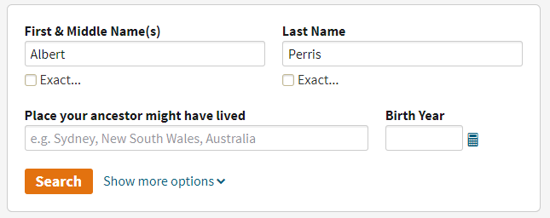
Example 1a
Using Basic /
Advanced search

Slide 21
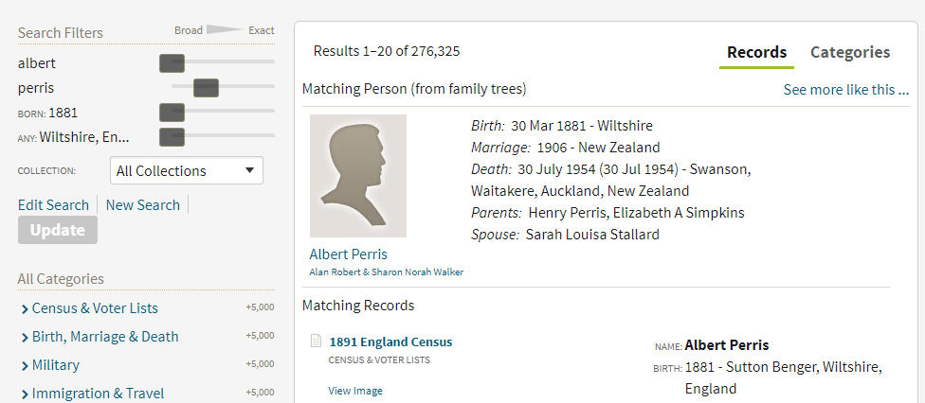
Example 1b

Slide 22
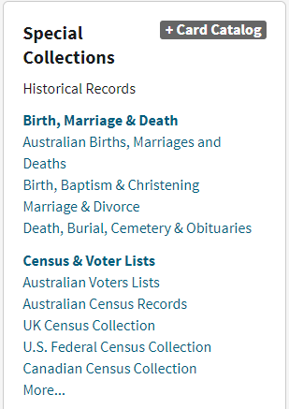
Example 2
Special Collections
Searching for
John William Cooper Drane
1851 UK census

Slide 23
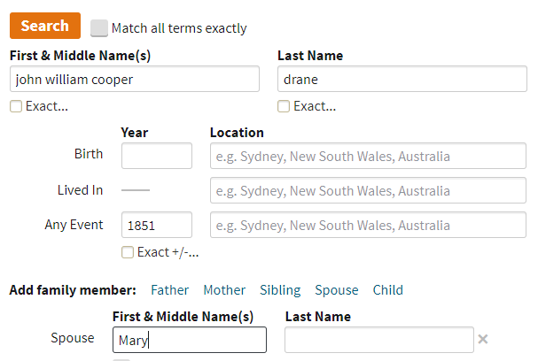
Example 2
Searching for
John William Cooper Drane
1851 UK census

Slide 24
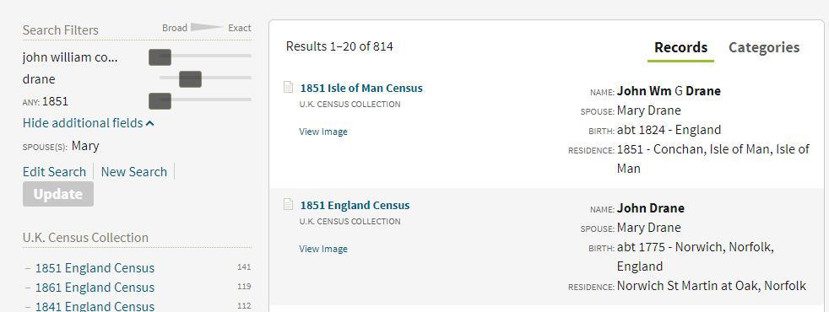
Example 2
Check the unexpected
Notes:
Although has a “G’ instead of a “C” it’s the most likely result.
Notice that the Isle of Man census is separate to the England census

Slide 25
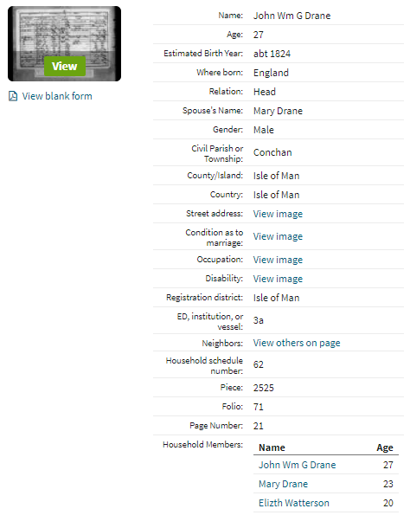
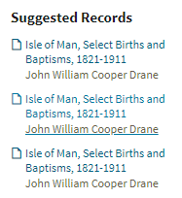
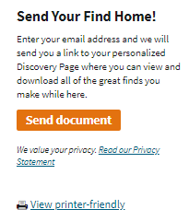
Example 2
Note other suggestions - not always reliable
Printer friendly view
View
original
image
Notes:
Viewing the record enables you to see other household members as well other suggested records
Printer friendly view ensures its prints out in a readable format
View the original image to check for other details

Slide 26
Example 2
Extra detail
Notes:
“G” in the index is actually a “C” on the original document
Occupation provided – Independent Minister

Slide 27
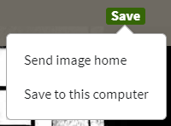
 | View as entire screen |  | To print |  | Change magnification of image
 | View source info about image |  | View next image in collection
Notes:
Viewing an image

Slide 28
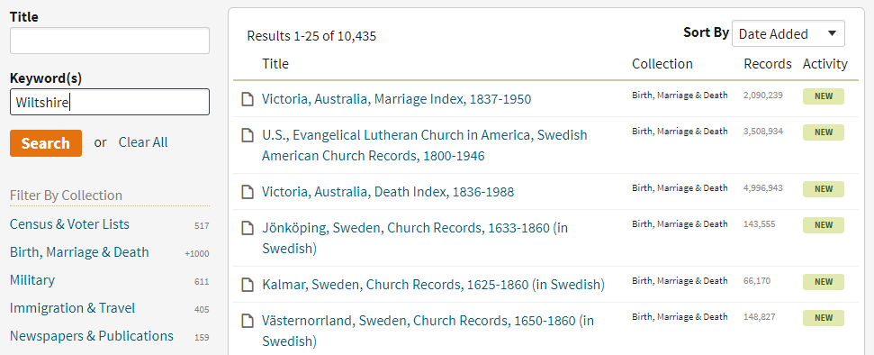
Example 3
+Card Catalog
Wiltshire births, deaths & marriages
Notes:
Type “Wiltshire” in ‘Keyword(s)
Then “Filter by Collection” – ‘Birth, Marriage & Death”

Slide 29
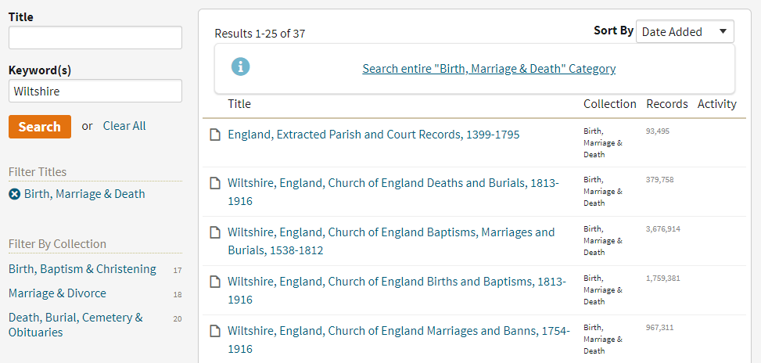
Example 3
Notes:
Filter further as needed

Slide 30
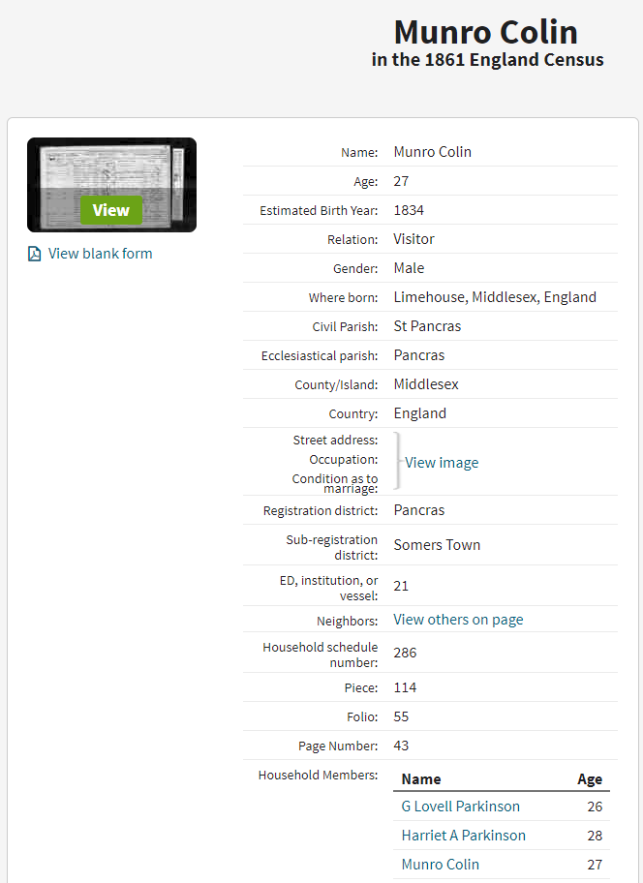
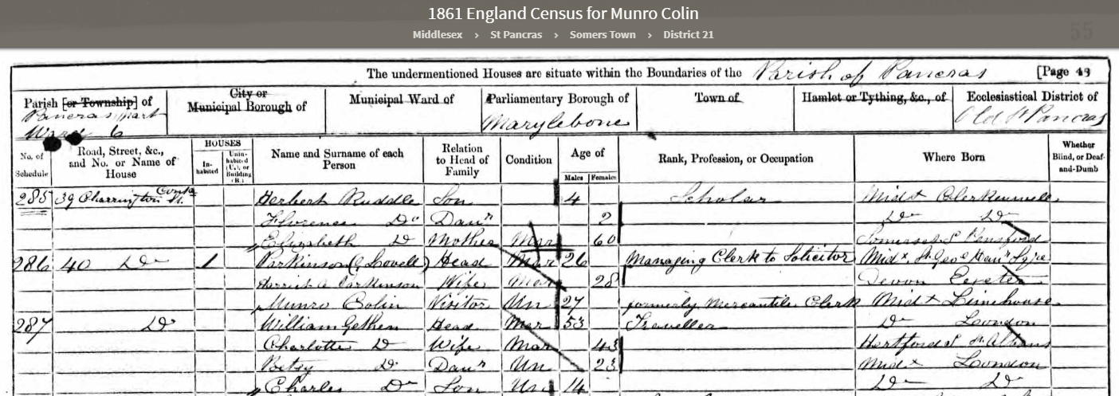
Example 4 – name reversal

Slide 31
Example 4 – name reversal
Original record provides context
Notes:
Name reversal specific to this person
Location different from what was expected: he was visiting
Check other information

Slide 32
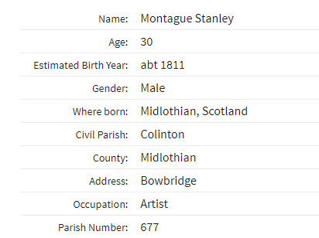
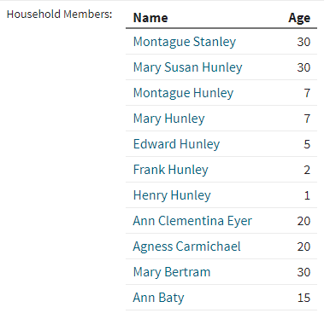
Example 5 – spelling, names
Incorrect spelling: Hunley for Stanley; Eyer for Eyre Informal names: Frank not Francis Drummond Greville
Notes:
Check other information

Slide 33
Example 6
Using other sources to locate material on Ancestry
Problem:
Cannot finding Mrs Lance Rawson on shipping list to England. Her name does not appear on the Ancestry index of Incoming passenger lists 1878-1960

Slide 34
Example 6
Strategy:
Use Australian newspapers online Trove http://trove.nla.gov.au/newspaper
Find her leaving Australia ship, date, port
Find approximate date of ship’s arrival
Use this information, rather than her name to search list

Slide 35
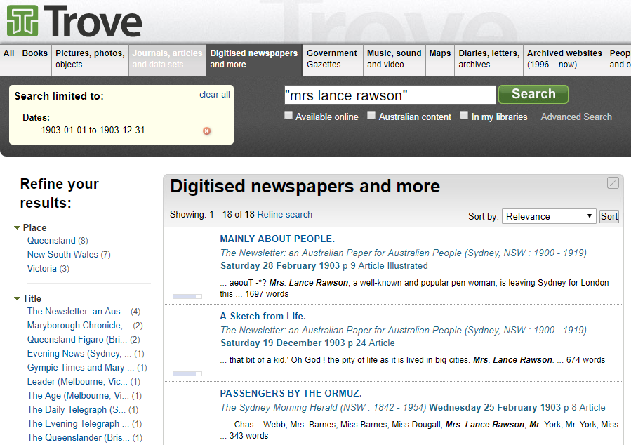
Notes:
Using Advanced search – phrase “Mrs Lance Rawson” + year 1903

Slide 36
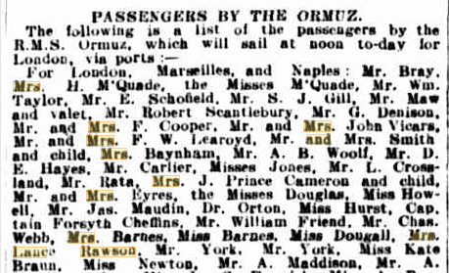
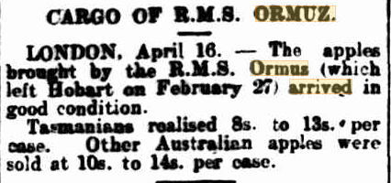
Example 6
Locating ship and time of travel to England
Arrival in London
Sydney Morning Herald
25 February 1903 p.8
The Mercury (Hobart)
17 April 1903 p.5

Slide 37
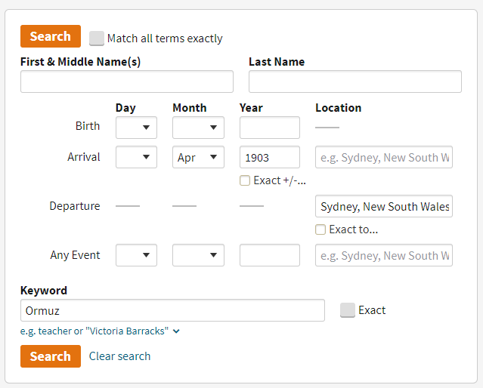
Example 6
Locating passenger arrival by
date
and
ship

Slide 38
Example 6
Ormuz to London 11 April 1903
Search list until find name

Slide 39
Example 6

Slide 40
Summary
Resources: worldwide but with a US bias
Strategies:
Be aware of possible errors in indexing/original records and crosscheck within Ancestry and with other databases
Be aware assumptions may be false
Put in as little detail as possible for a manageable search

Slide 41
Summary (cont.)
Value of Ancestry:
Access to original British and Australian records
Possible to search across records, across countries, as a fluid, easy, quick search but be aware of possible inaccuracies and crosscheck
Be aware of differences between Ancestry library and private subscriptions

Slide 42
Any questions?
State Library of Queensland
Ask Us
07 3840 7810
www.slq.qld.gov.au/services/ask-us

Slide 43
Introduction to Trove digitised newspapers
State Library of Queensland
Online collections and resources training
January 2019

Slide 44
Aims of this session
What is Trove
Why Trove is useful
How to search Trove
How to download and print from Trove

Slide 45
What is Trove?
Searchable collection of information about resources
Discovery service – 11 zones
Digital content repository (limited after 1954 due to copyright)
Community of content partners and users
Notes:
Trove mostly collects information about resources, rather than the resources themselves. It brings together information from libraries, museums, archives and other research organisations catalogues and databases into one place.
This giant “catalogue” is then processed and made available for searching,.
The information is sorted into 11 zones: Digitised newspapers and more; Government Gazettes, Journals, articles and data sets; Books; Pictures, photos, objects; Music, sound and video; Maps; Diaries, letters, archives; Archived websites (1996 – now); People and organisations; Lists.
Trove is also a growing repository of digital content – primarily newspapers, magazines and government gazettes (just NSW at the moment)
Trove is a community – anyone can join and participate

Slide 46
How is Trove useful in family history research?
Helps you find and use resources e.g. newspapers, gazettes, images
Links directly to previously unsuspected or inaccessible details

Slide 47
How is Trove useful in family history research?
Provides clues to areas for further research, e.g. court records
“Fleshes out” our knowledge of individual family members

Slide 48
Newspapers
Newspapers are organised by:
Title
Issue (date)
Page
Article [a single article can contain multiple items, e.g. family notices]
They can be searched or browsed

Slide 49
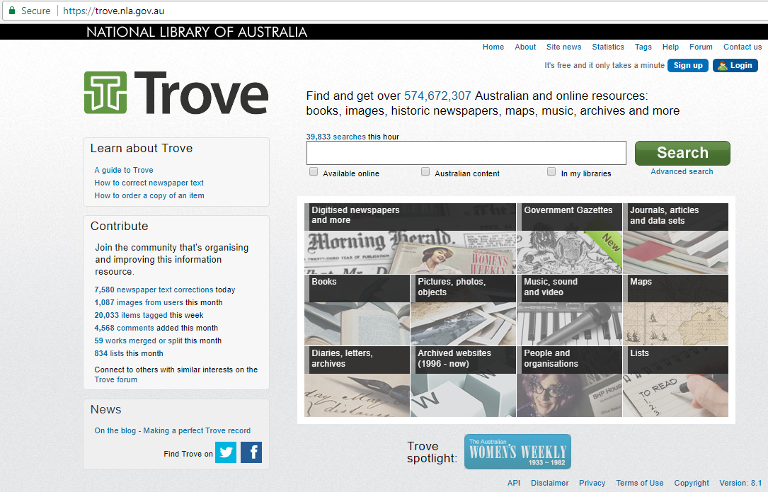

Slide 50
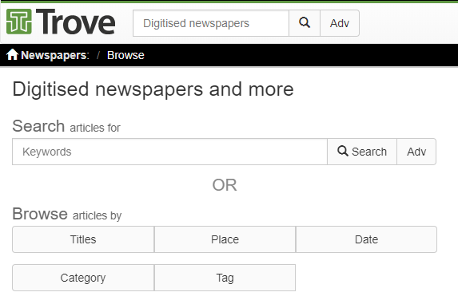
Newspapers

Slide 51
Searching Newspapers
How you search depends on what you are searching for
There are many ways to search Trove and to refine your search
Don’t be afraid to experiment and play

Slide 52
Example – Basic search
Find the report of car accident for George Abraham Fullelove in August 1946. Use search terms “Fullelove car accident”.

Slide 53
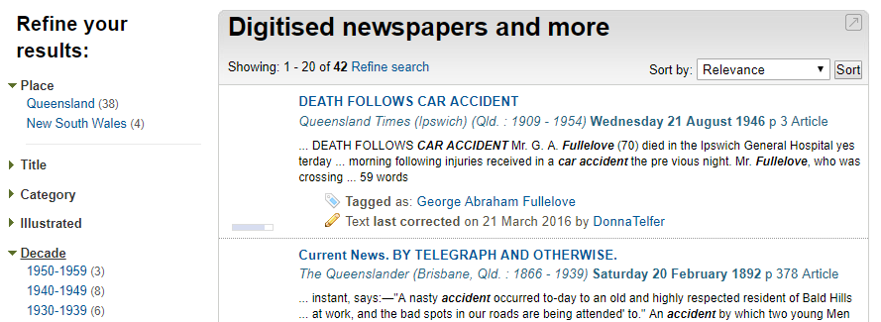
Example – Basic search “refine results
Select “Queensland” and “1940s”

Slide 54
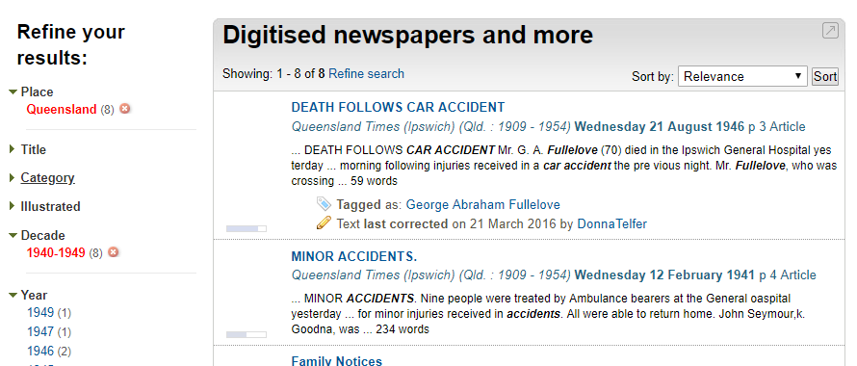
Example – Basic search “refine results

Slide 55
Example – Advanced search
Find a death notice for “George Nicholls Marshall” died Brisbane, 20 December 1951

Slide 56
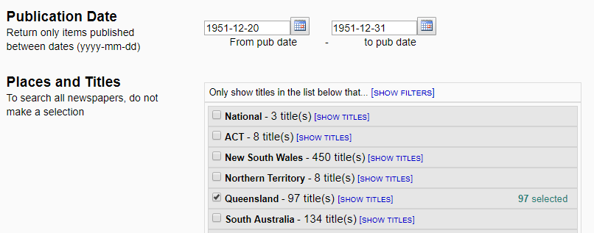
Example – Advanced search
Limit date range and place

Slide 57
Example – Advanced search
Limit category to “Family Notices”

Slide 58
Example – Advanced search
“Refine search” to locate other notices
In “Advanced search”
add further search terms

Slide 59
Example – Advanced search
Find more results by adding further search terms

Slide 60
Newspapers – Power searching
Search for a phrase
Search for name variants, e.g. Kenneth, Ken, Kenny

Slide 61
Newspapers – Power searching
Search for two words near each other, e.g. “wedding” and “Errington” within 20 words of each other.

Slide 62
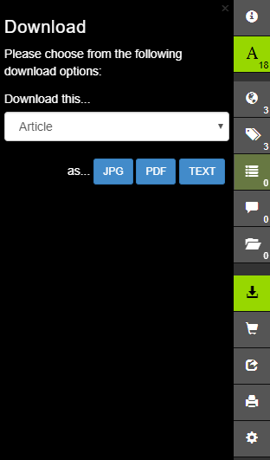
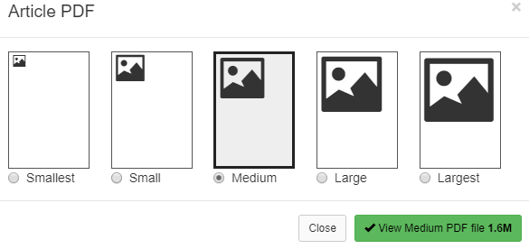
Downloading & printing

Slide 63
Any questions?
State Library of Queensland
Ask Us
07 3840 7810
www.slq.qld.gov.au/services/ask-us

Slide 64
Tags
Keywords or labels that can be added to items in Trove
Can be used as a:
description of topic, place, event, person
way to organise your research
Access all items related to a ‘tag’ by selecting a linked tag
Notes:
What are tags?
Why use tags?
Example - Do a search for “ship artemisia”, demonstrate what happens when you click on a ‘tag’

Slide 65
Lists
Enable you to link different items in Trove together
Can be used to:
Organise your research
Pull together favourite resources
Create lists that might be useful for others
Notes:
Link different items together e.g. family history book, newspaper articles about the same family, photographs, ship picture that family voyaged out to Australia on can all be linked together in a list
Examples available through help page - http://help.nla.gov.au/trove/using-trove/creating-contributing/lists [book club, virtual exhibition, NLA curated lists]

Slide 66
Comments
Added by Trove users
Can help provide relevant information about item such as
Giving additional information
Adding information about events related to item
Provide links to related items in Trove
Are included in a Trove search
Notes:
Set up example in tab in case link doesn’t work: http://nla.gov.au/nla.news-article3166018

Slide 67
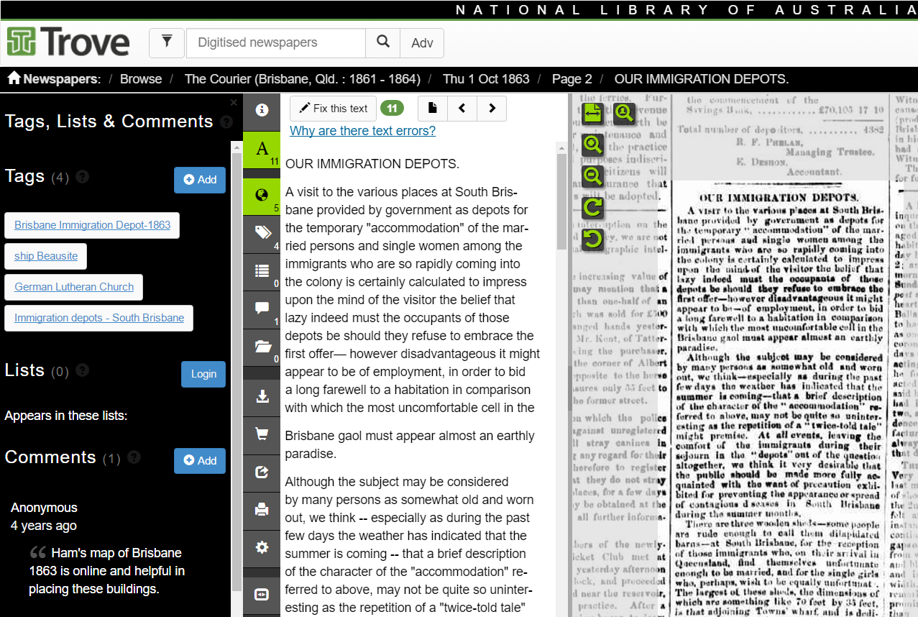
Example
http://nla.gov.au/nla.news-article3166018

Slide 68
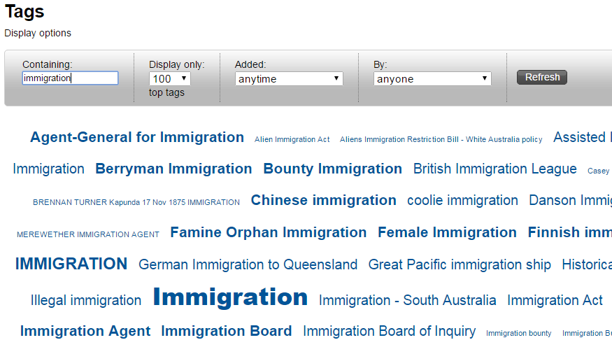
Searching tags
Notes:
Steps:
Click on ‘Tags’ top right hand side of screen
Type in search word
Top 100 tags appear under the search box
Click on any tag you might be interested in.

Slide 69
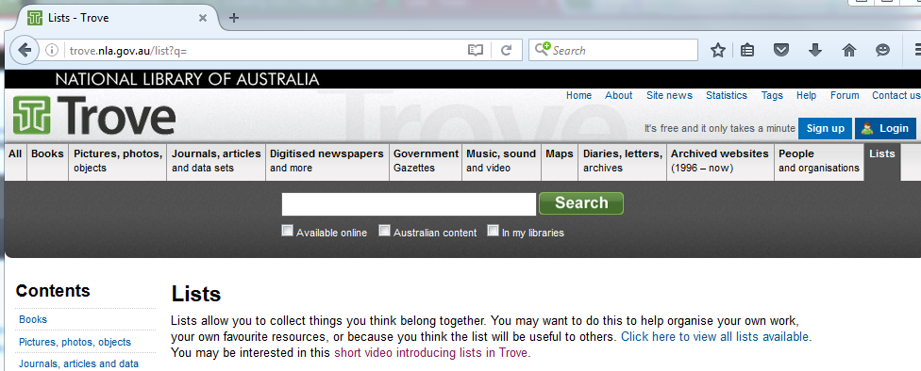
Searching lists
Access from Trove home page [bottom right corner]
Or enter a search and use “Lists” tab
http://trove.nla.gov.au/list/result
Notes:
Demonstrate search then click on ‘Lists’ tab

Slide 70
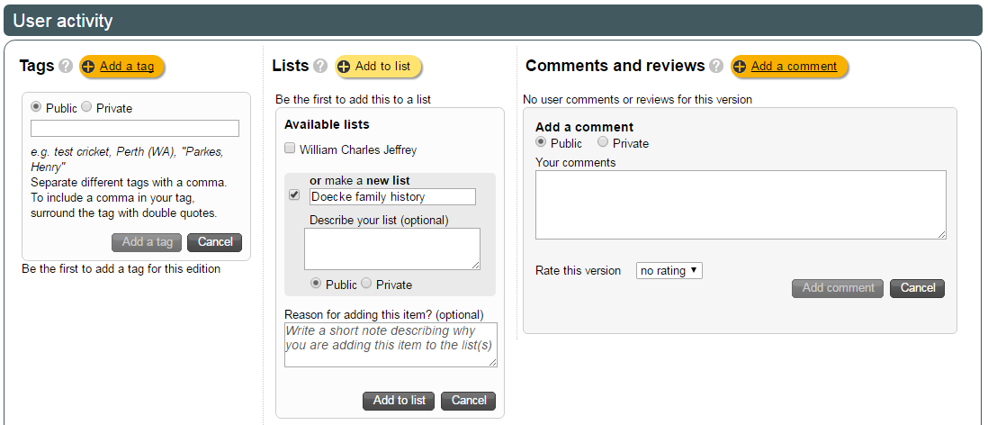
Creating and adding tags, lists & comments
Books / Journals, articles and data sets / Pictures, photos, objects
Notes:
Demonstration
Login to Trove. Search for an item e.g. doecke. Select the item.
Add tags, lists or comments at the bottom of the page under User Activity.
Click on the Add button to open the box to add your text.
If you are using something with a comma such as a surname followed by initials enclose with inverted commas “Doecke, L E”
With lists you can tick in box to add to an already created list or click in the box to make a new list, and name your list.
[Public – anyone can see, Private – only you can see when you’re logged in]

Slide 71
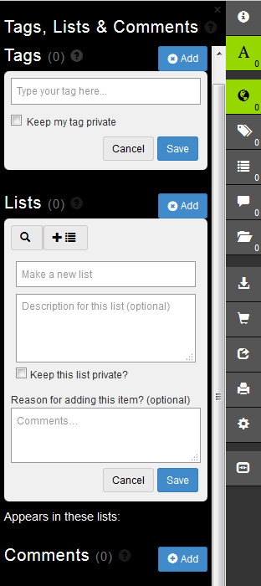
Creating and adding tags, lists & comments
Digitised newspapers
Government gazettes
Shows all Tags, Lists & Comments
Shows Tags only
Shows Lists only
Shows Comments only
Notes:
Click on blue ‘Add’ button.
Type in the word or words you want to use.
Click on ‘Save’.
If you are unsure how to do it there is a ’?’ next to each of the headings, which provides you with the steps.
Hint: Copy your tag text before you save to keep consistency when tagging several items with the same tag.

Slide 72
Text correction
Only available with the Digitised newspapers and Government gazettes sections
Helps improve the accuracy in searches of the newspapers and gazettes.
Provides better transcription printouts of an article’s text.
Notes:
Transcription appears to the left of the original document, and should match the text as originally published.
Some things to take into account:
Where words are misspelt, correct spelling should be added as a comment. This is to ensure that the transcription reflects the spelling of the time.
Exceptions include M’ becoming Mc; obviously missing letters, minor errors where the same word has been spelt correctly elsewhere in the article.
Punctuation and capitalisation as it appears in the original, including hyphens.
Text can be added or removed using the +/- tool.
A selected set of Special Characters can be added using the ‘Insert Symbol’ menu e.g. adding £ symbol
For further information see the Trove help page
http://help.nla.gov.au/trove/digitised-newspapers/text-correction-guidelines

Slide 73
Any questions?
State Library of Queensland
http://www.slq.qld.gov.au/resources/family-history
Ask Us
07 3840 7810
www.slq.qld.gov.au/services/ask-us

