Slide 1
The Vision in Action
SLQ
Case study guide using the Star model
Notes:
Title: The Vision in Action
Case Study guide using the STAR model.

Slide 2
S
Situation

Slide 3
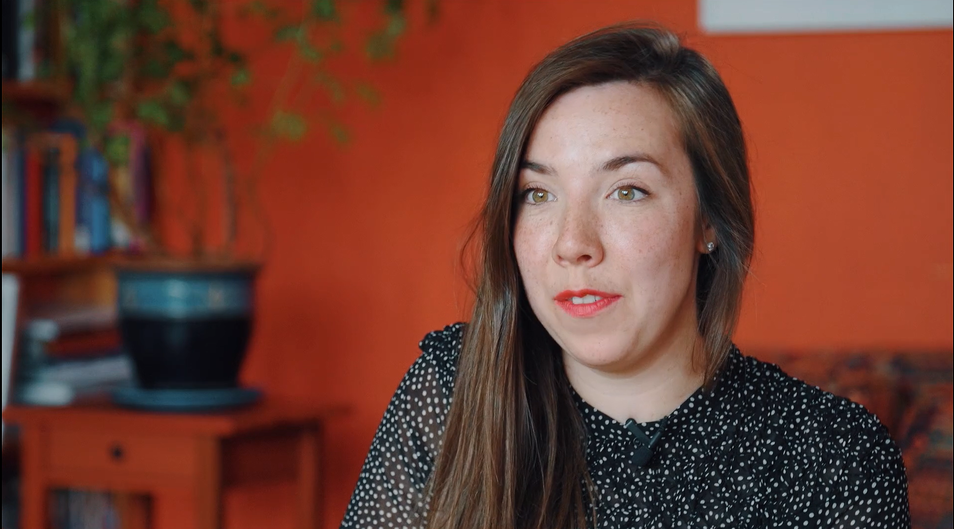
State Library of Queensland recently hosted its annual Fun Palace event. Fun Palace is a full day event celebrating art, science, learning, play, and adventure.
Notes:
(Footage of SLQ representative talking to the camera to explain the situation)

Slide 4
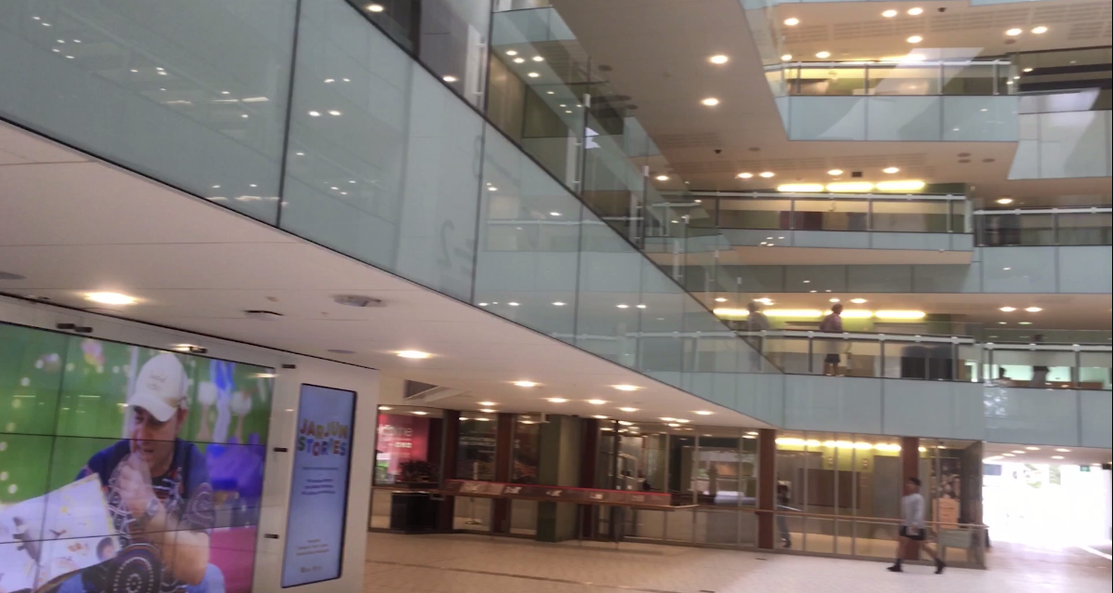
Notes:
(Footage / imagery – State Library of Queensland imagery)

Slide 5
T
TASK

Slide 6
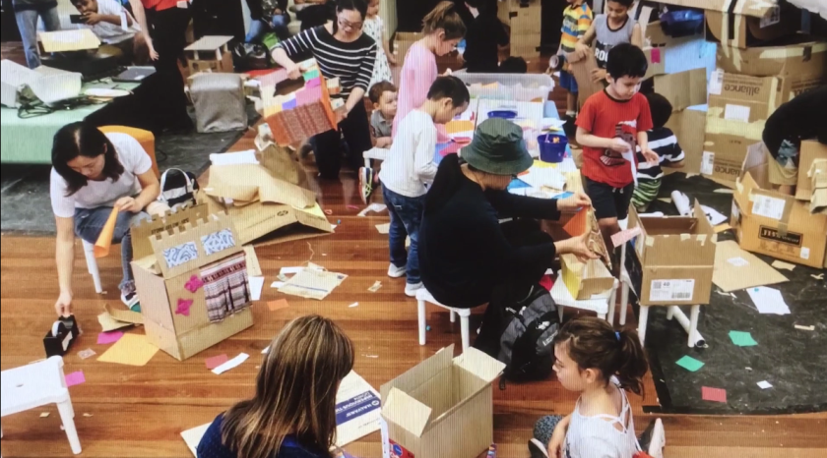
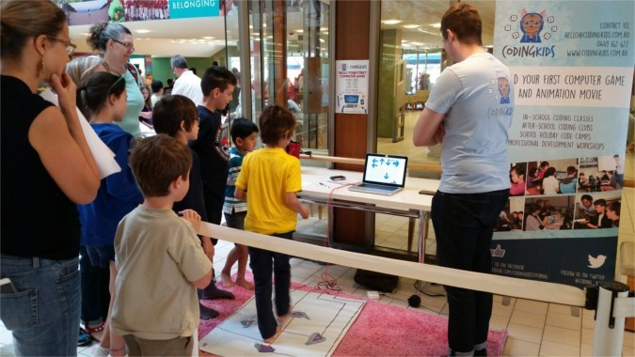
Through Fun Palace, State Library of Queensland sought to increase its engagement and interaction with the community, offering a broad range of activities including science, craft and technology.
Notes:
(Footage / imagery – Various images of the event)

Slide 7
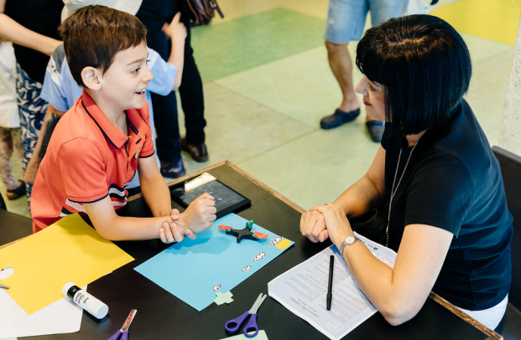
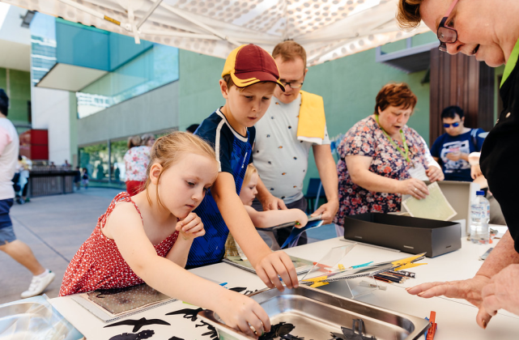
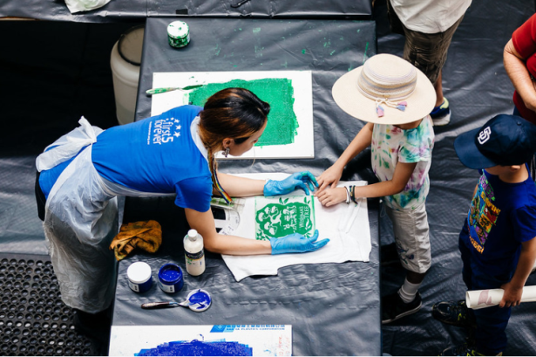
Fun Palace is way of contributing to the Vision Enabler ‘locally connected’ as it helps our library become a vibrant contributor to the community.
Notes:
(Footage / imagery – Various images of the event)

Slide 8
A
Action

Slide 9
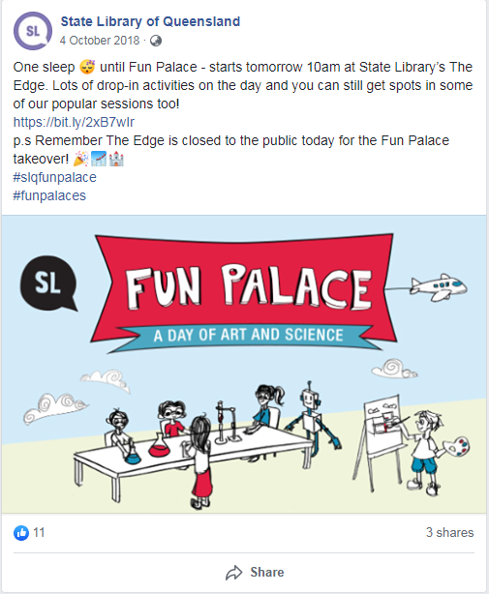
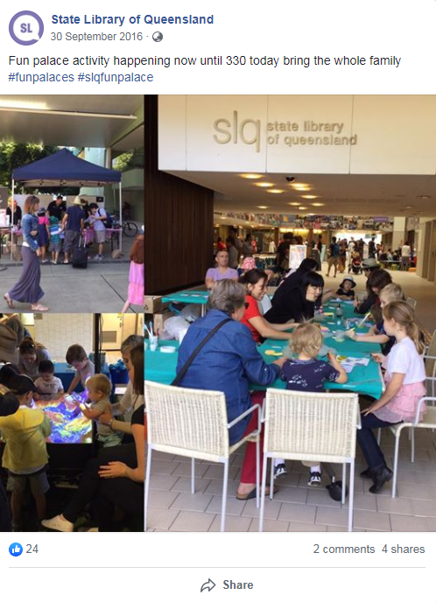
Our team promoted the event through social media channels and developed supporting content including photos and videos with event information.
SLQ - storyboard

Slide 10
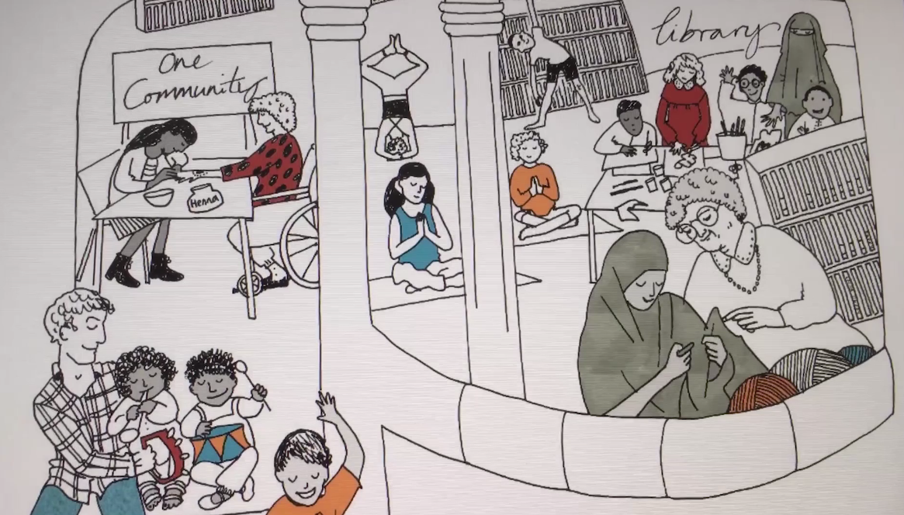
We developed event posters and displayed these throughout the library prior to the event to create interest.

Slide 11
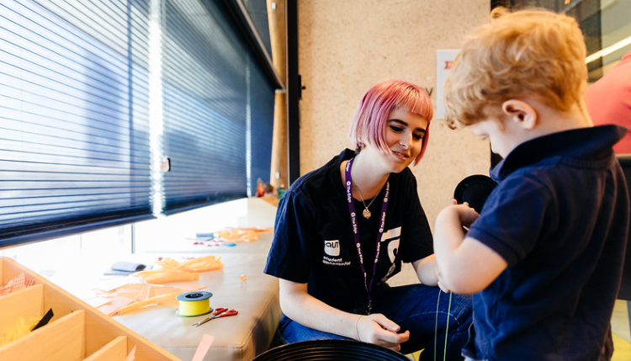
We secured involvement from local subject matter experts and leaders to supervise work stations.
SLQ - storyboard
Notes:
(Footage or photos from the event of local subject matter experts)

Slide 12
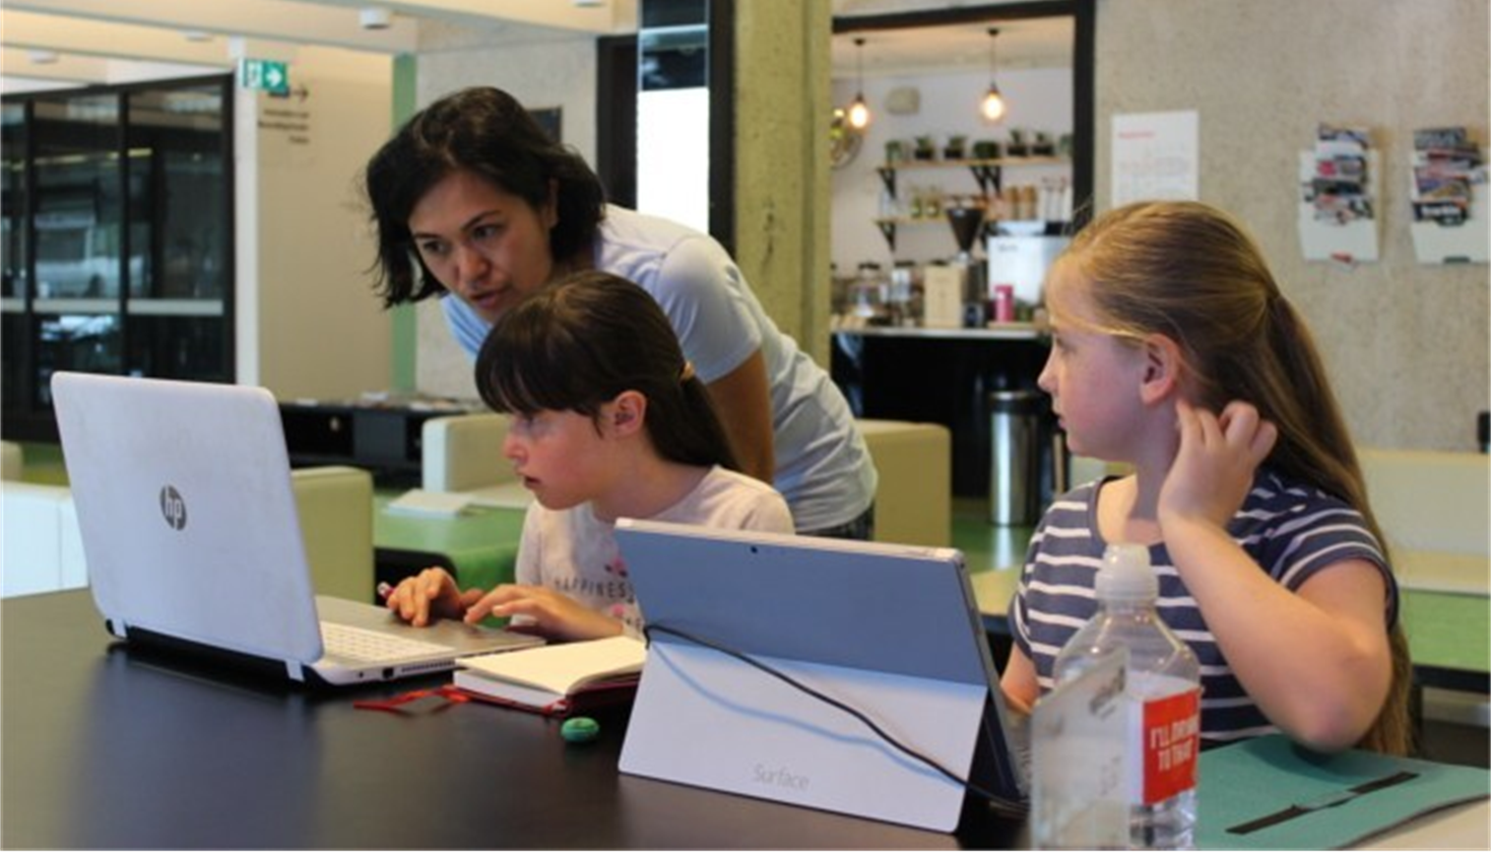
Our team coordinated and managed event logistics including management of all the activity stations. And we documented this with a series of photos and videos.
SLQ - storyboard
Notes:
(Footage of Fun Palace participants engaging in the various activities on offer on the day)

Slide 13
R
result

Slide 14
We had a fantastic turn out at this event. Some of the activities have proved so popular that we’ll be including them as a regular feature in our monthly program here at the library.
For more information on Fun Palace, head to the State Library of Queensland website.
Notes:
(Footage of SLQ representative talking to the camera to explain the situation)

Slide 15
FUN Palace 2019

