Slide 1
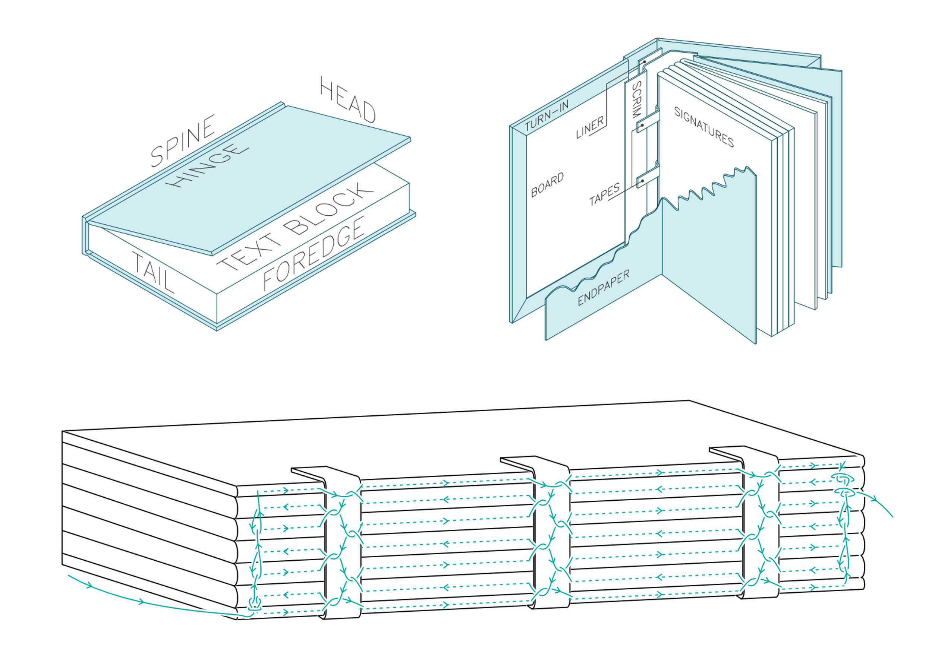
Laser cut covers and hand sewn spines Session 2

Slide 2
Course Overview
Session 2
Recap
Complete our text blocks: Glue mull, headband and book mark.
Laser induction
Clean up and start decorating cover

Slide 3
Course Overview
Session 3
Recap
Trim pages to square
Assemble cover, combine with text block, and add end papers .
Decoration of cover (with gold leaf)
Where to from here

Slide 4
Learnings from last session

Slide 5
How today will work
Today we will have a few tasks on the go in between glue drying. We will alternate between:
Gluing
Getting inducted on the laser (and cutting bijou)
Preparing materials such as ribbons, mull etc
Cleaning and decorating the cover (there will be more time for this next session)

Slide 6
Some terms we’ll use today
Mull (also know as scrim)
‘Tip off’ – to glue the very edge of paper
Headband

Slide 7
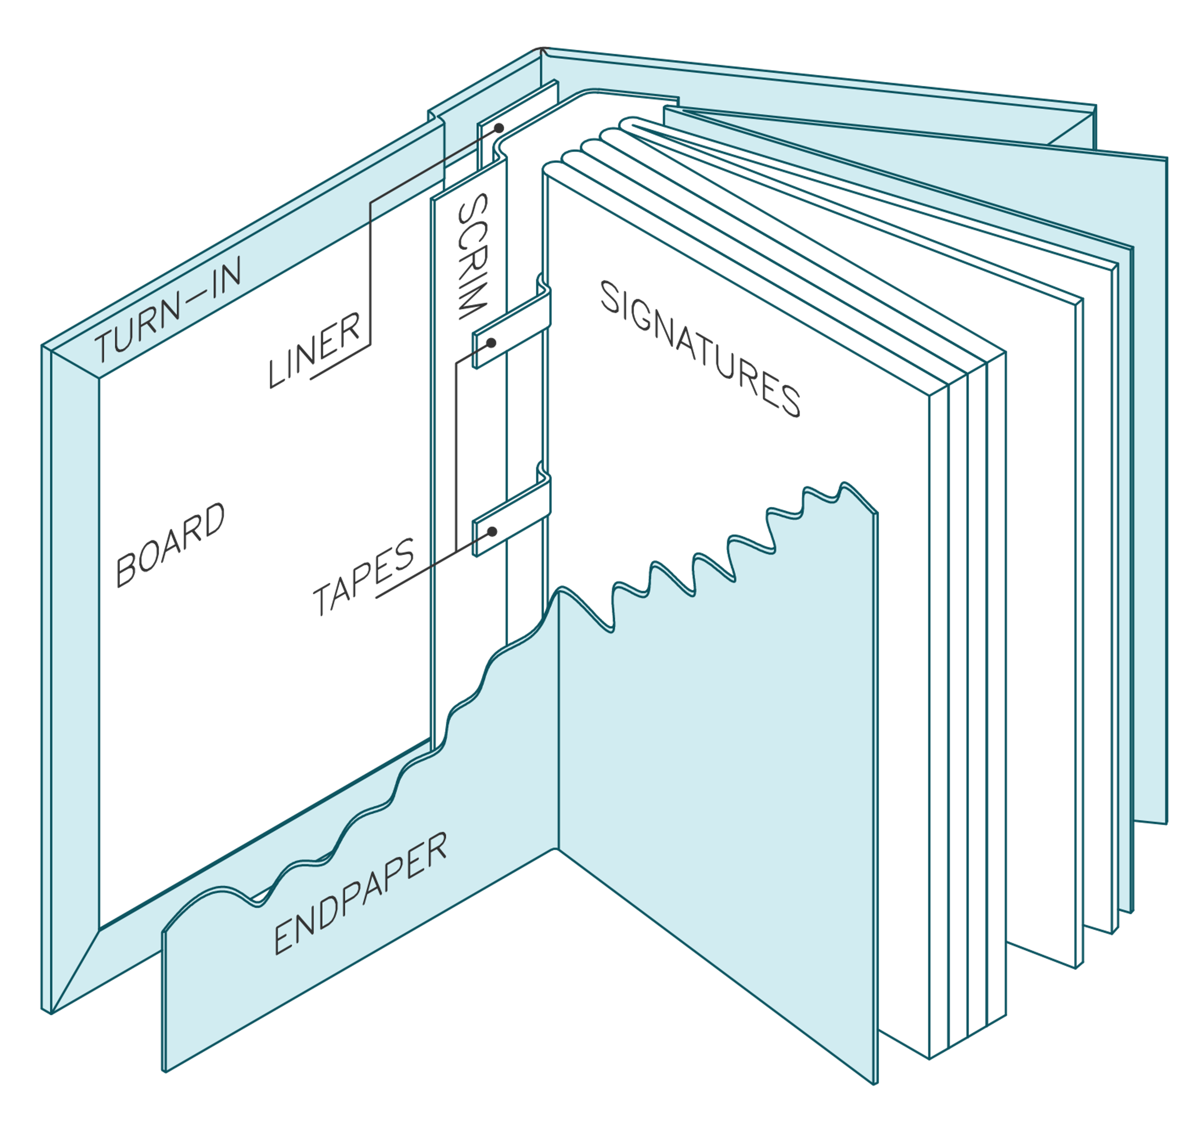
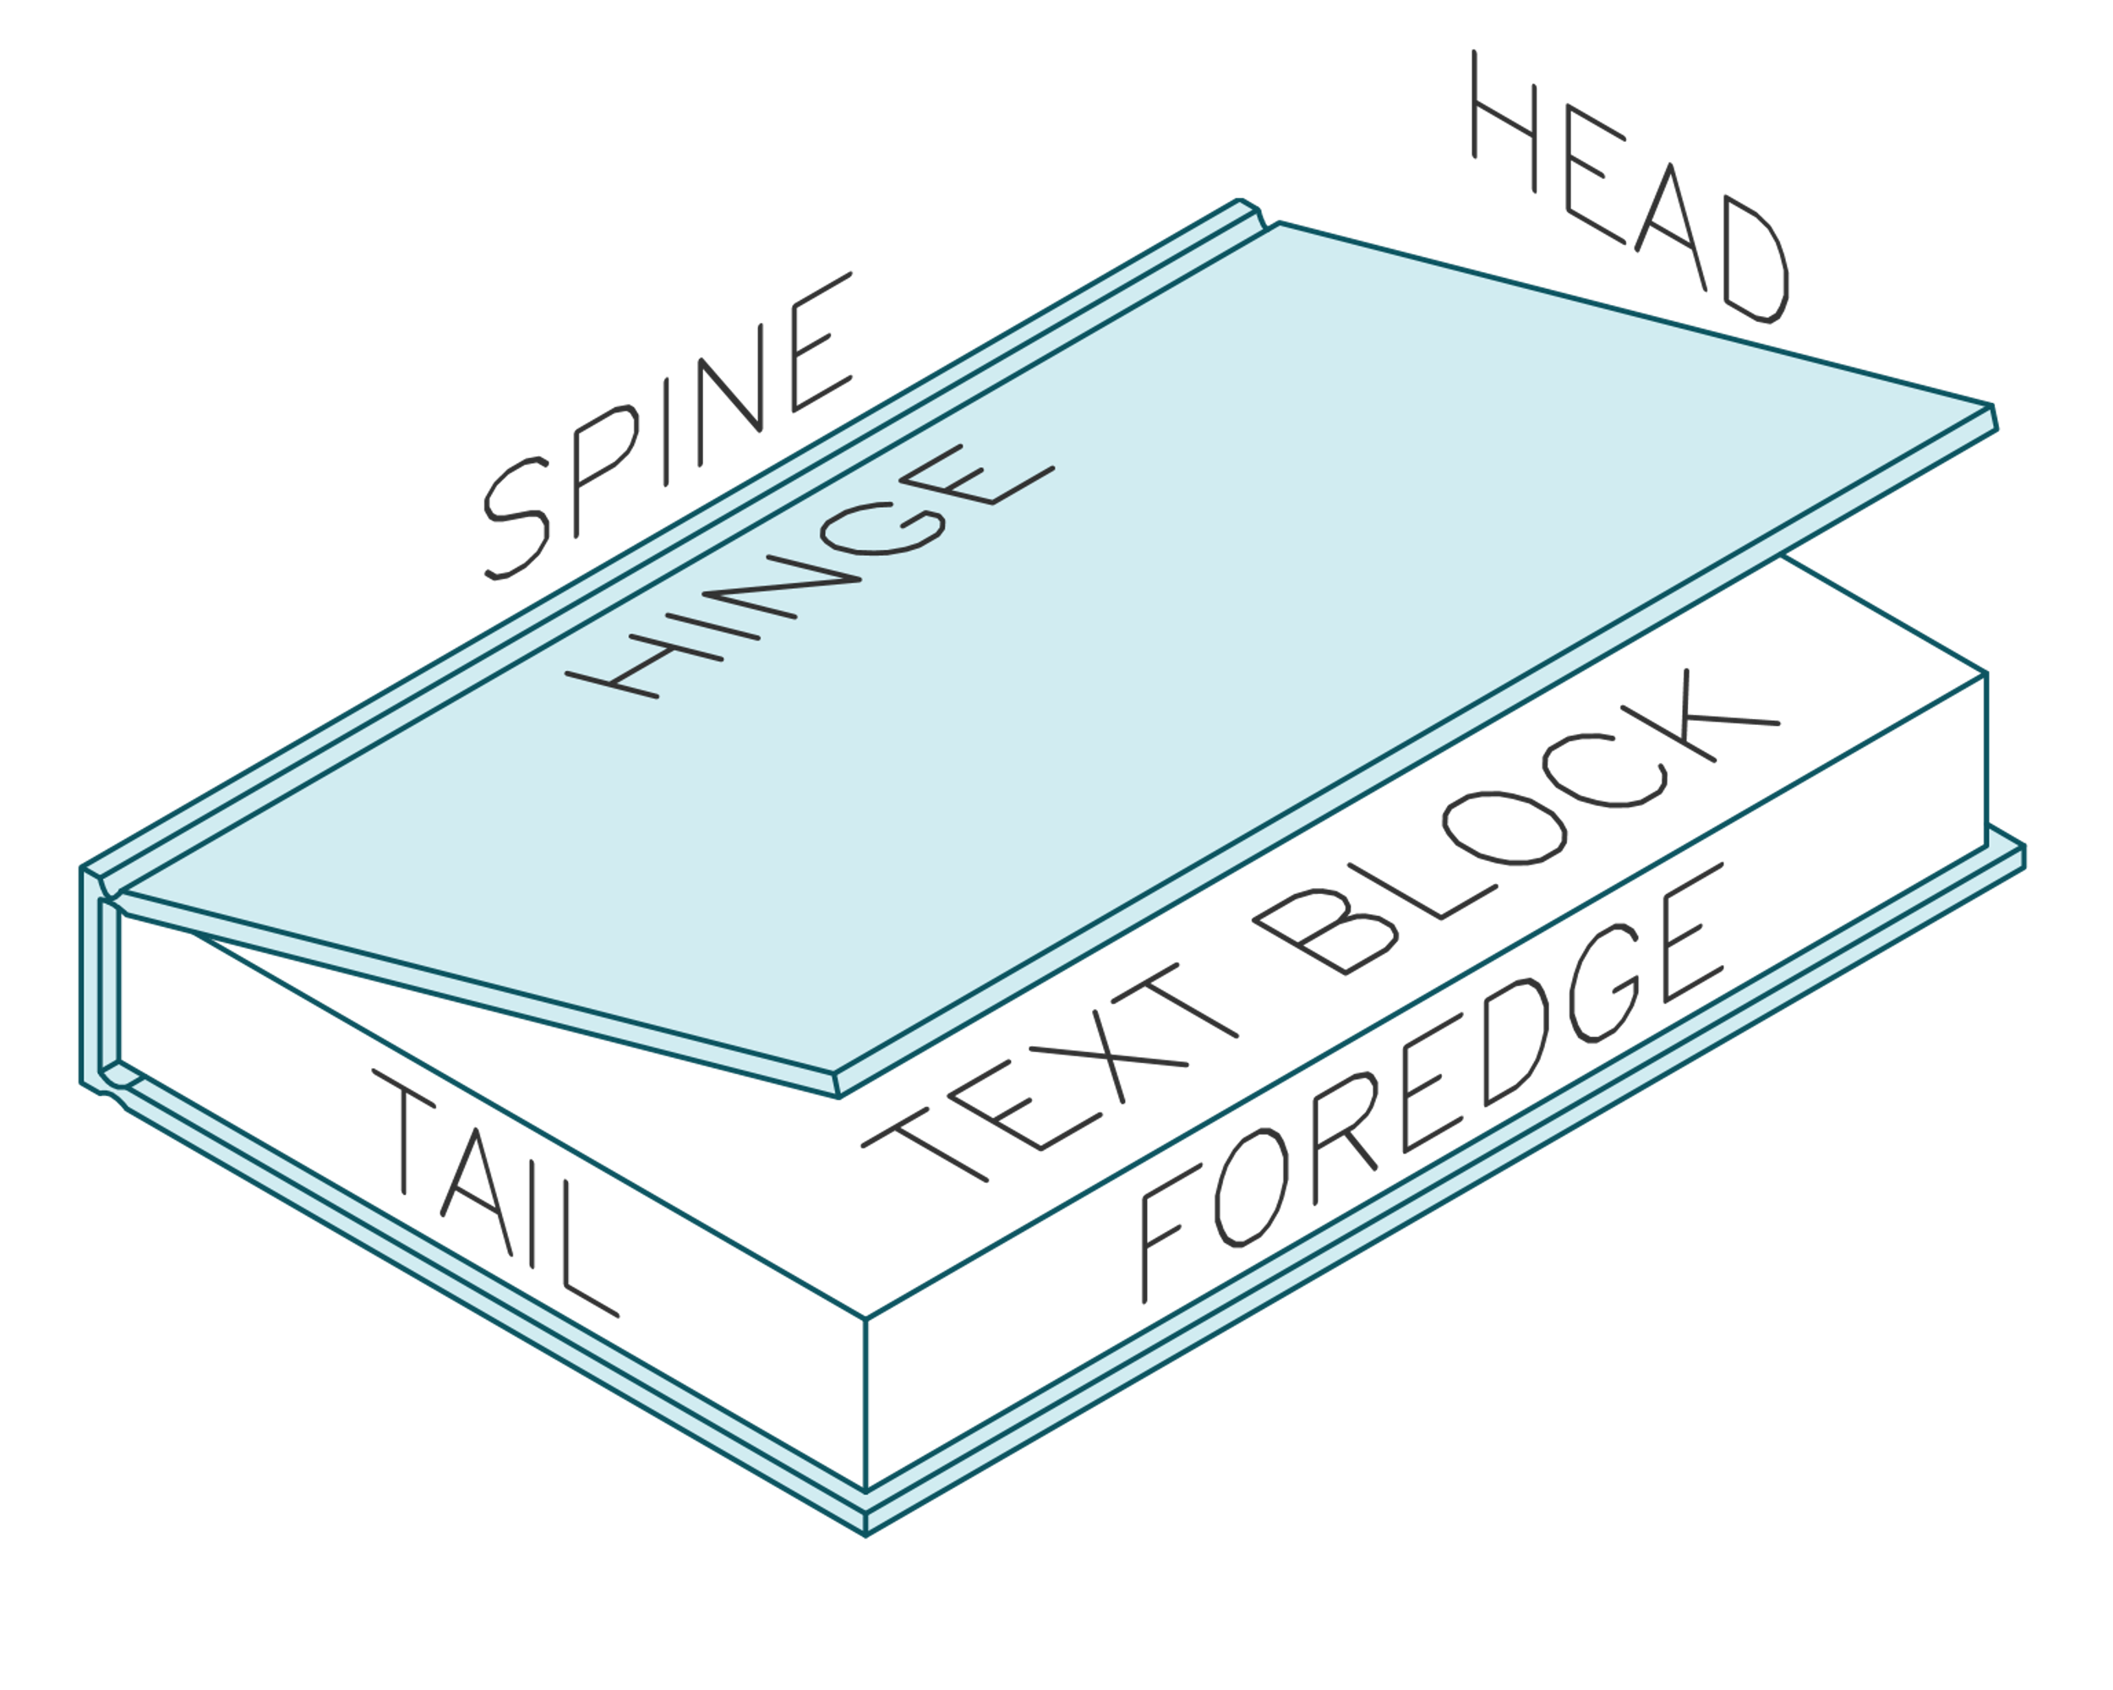
Overview book construction

Slide 8
Gluing the text block
Today you'll be hearing the instructions 'neat and firm​' a lot.

Slide 9
Tip off the first signature
Fold a piece of baking paper and dip small brush into glue and ‘tip off’
Close book and press gently.

Slide 10
Glue signatures
Place your signature between thick card and knock
Tap your signature to make sure it’s all lined up
Place book in clamp (straight but with a little give)
Glue: Just gluing the spine and leaving the tapes glue free at the moment (we’ll glue these when we glue the mull)

Slide 11
Pressing text block
Tighten the clamp
Helps make it neat and firm
Don’t overdo the tightness, else spine will be squished

Slide 12
Choosing our materials and colours

Slide 13
Choose your materials
marbled papers
headbands
Bookmark
Ink colours
book cloth

Slide 14
Laser induction
While our spines dry, let’s get inducted on the laser!
Notes:
Maybe do online here now

Slide 15
Laser Induction: Practical
Today you’ll be getting inducted by making a bijou for your book ribbon. This is essentially a small timber charm at the end of the book ribbon.

Slide 16
Back to our books
Notes:
Maybe do online here now

Slide 17
Glue on headband and ribbon
Cut 2pcs of headband to width of text block
Cut your ribbon the length of your book, with 2 extra inches.
Glue to head and tail of spine sticking just out of the text block at each end

Slide 18
Cutting the mull
The mull needs to be cut so that it fits between the two headbands, and the width of the timber engraving.

Slide 19
Glue on mull
Cut it to fit between the two headbands.
Pre fold it to the right size for your book.
Add plenty of glue, dab it to saturate mull
Smooth with finger
Pull mull to ensure the glue is saturated through.

Slide 20
On to the decoration
Notes:
Maybe do online here now

Slide 21
Cleaning up your cover
Using paper towel and isopropyl we are going to remove some of the charring that happens with the laser.

Slide 22
Testing the ink to understand it
Get a piece of timber offcut
Practice different techniques for applying the colour.
Brush
Colour reduce (with water)
Wiping
Dabbing
Consider where you might want to gold leaf next week
Once your are happy, begin decorating your cover.

Slide 23
Next session
No homework this week!
Next week we will be:
Cutting book cloth
Trimming the pages to square
Gold leafing the cover
Gluing it all together

