Slide 1
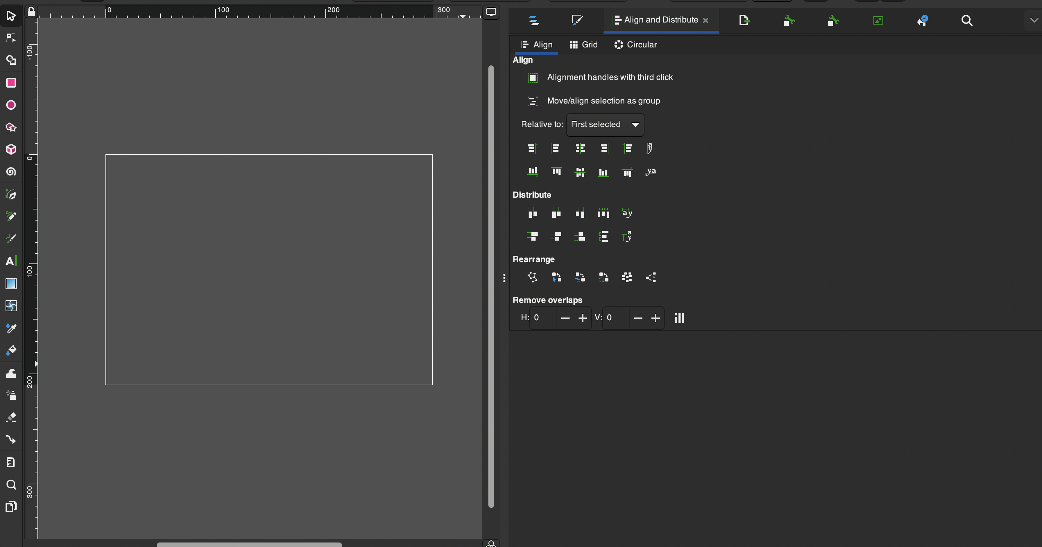
Vector 101 with Inkscape

Slide 2
Acknowledgement of Country
We acknowledge Aboriginal and Torres Strait Islander peoples and their continuing connection to land and as custodians of stories for millennia. We respectfully acknowledge the land on which we all meet today, and pay our respects to elders past, present and emerging.

Slide 3
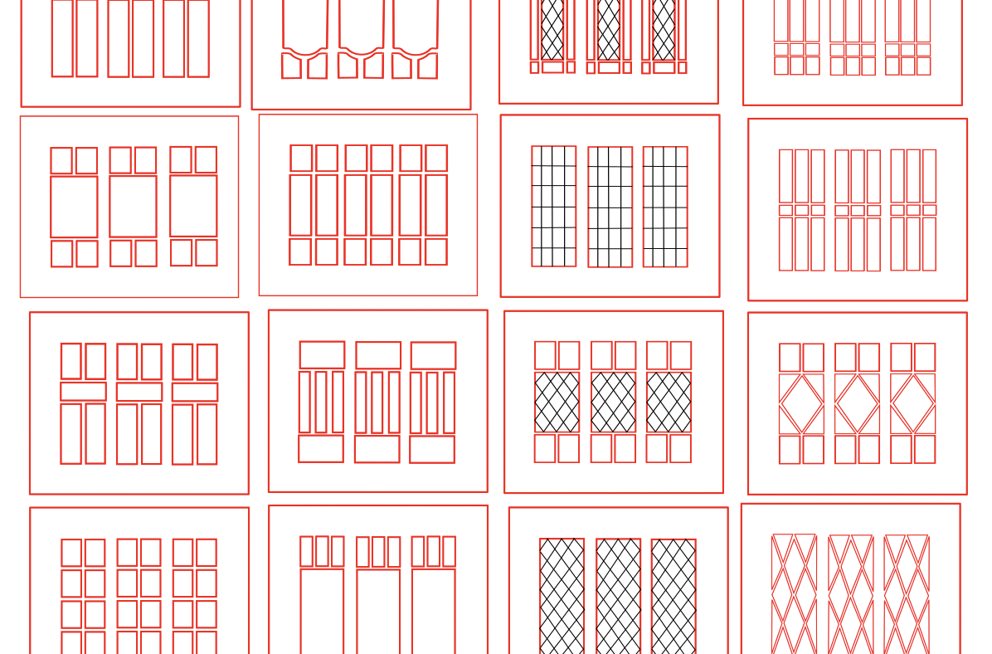
WORKSHOP SUMMARY
Create and edit vector graphics (like illustrations, decals and logos) in this Inkscape course for beginners.
In this 2-hour intro course we’ll start with the fundamentals:
A demonstration of the basic tools and functionality of Inkscape
Navigating around the interface
Setting up your own custom workspace
Key features and tools: layers, paths, the pen tool and trace
Workshop Outline
Understand vector vs raster
Colour
Document settings
Become familiar with the interface
Learn about layers
Grouping and ungrouping
Learn pen tool basics and create shapes
Add and adjust strokes
Add and adjust colours
Add basic text
Learn how to use the Trace Bitmap tool
File types and cross compatibility (SVG, EPS, AI etc)

Slide 4
LET'S GET
STARTED
One Search

Slide 5
THE BASICS OF VECTOR DESIGN
Inkscape 101

Slide 6
Vector vs Raster

Slide 7
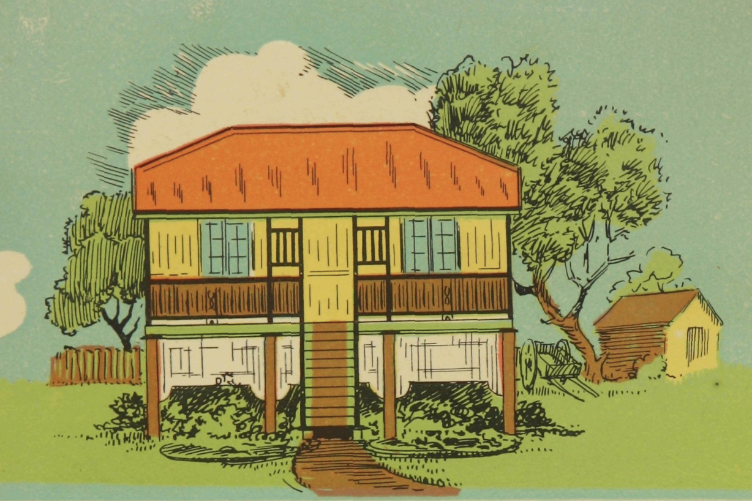
The John Oxley Library holds a vast collection of drawings, manuscripts, design plans, house plans, building designs and related materials with links to built heritage and architecture in Queensland. View a selection of them with digitised drawings, images and digital stories with architects as they talk about their work.
STATE LIBRARY COLLECTIONS
LINK

Slide 8
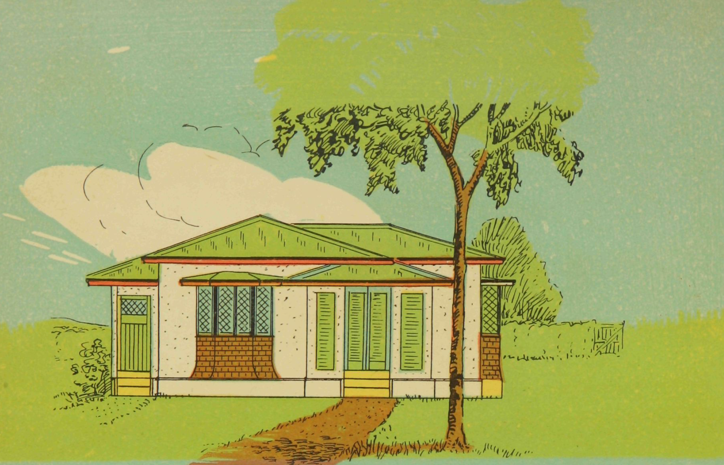
CREATING VECTORS
We're going to screenshot an image of the designs from the 99 Everyday homes catalogue, like these house illustrations, to trace with our pen and shape tools to practice creating vector designs.

Slide 9
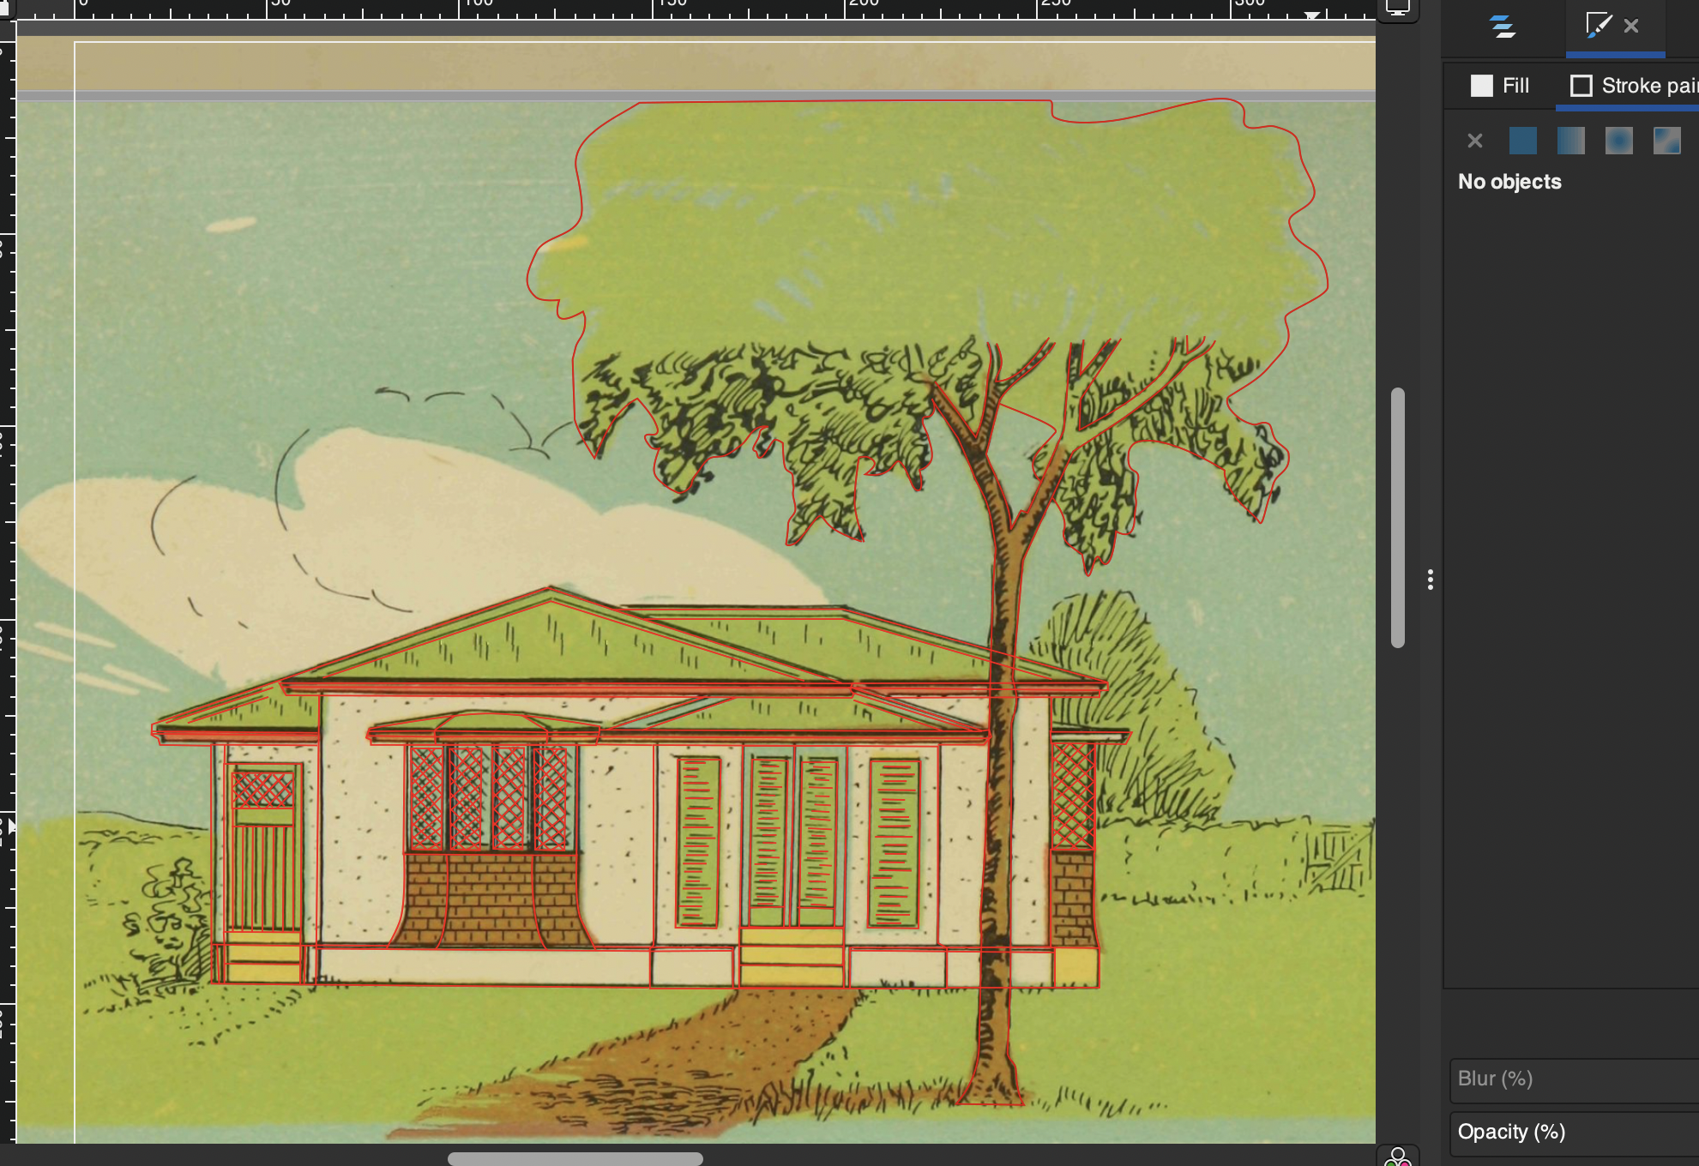
CREATING VECTORS
By breaking down the image into shapes you can see how easy it can be to turn an image or illustration into a vector design.

Slide 10
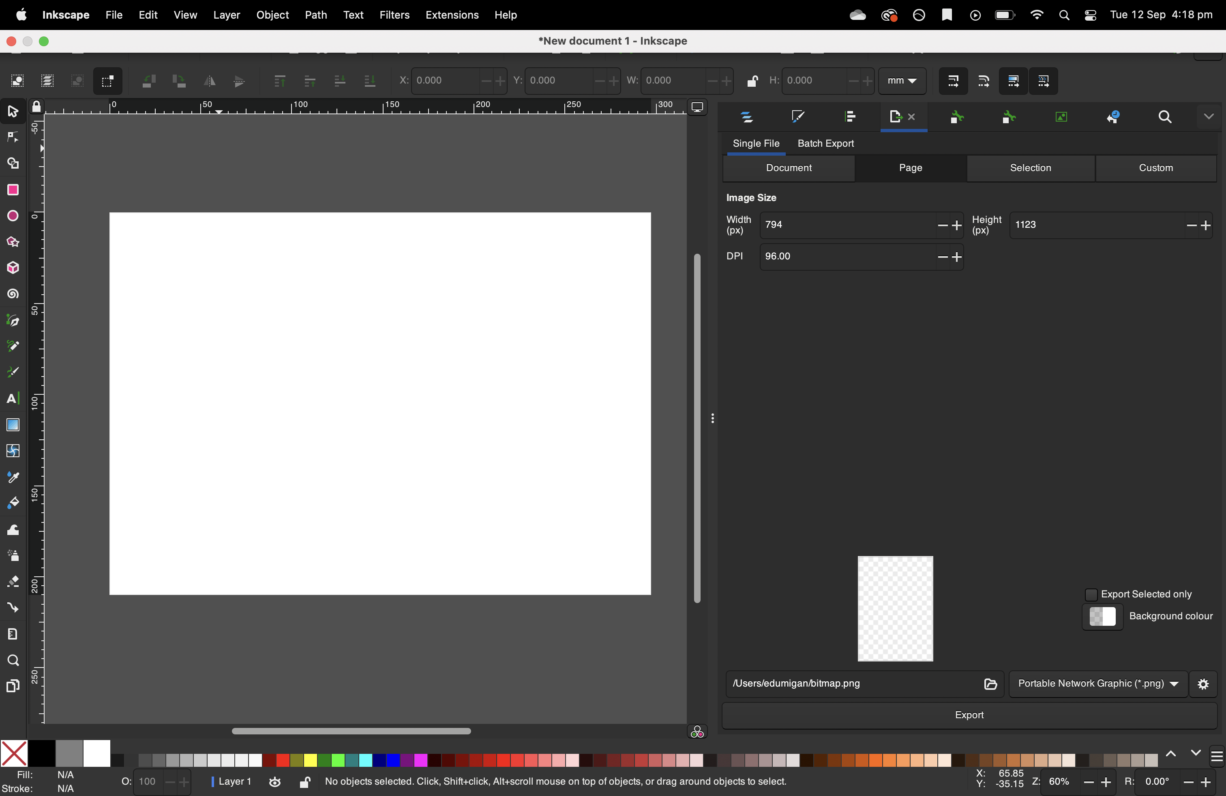
Inkscape
Interface
An Introduction to the Inkscape interface.
Inkscape is a free and open-source vector graphics editor. Great for beginners and has a huge community surrounding it with lots of helpful tutorials and information online.

Slide 11
THANKS FOR ATTENDING
Please complete our survey that will be sent out via Eventbrite.
Contact us on appliedcreativity@slq.qld.gov.au

