Slide 1
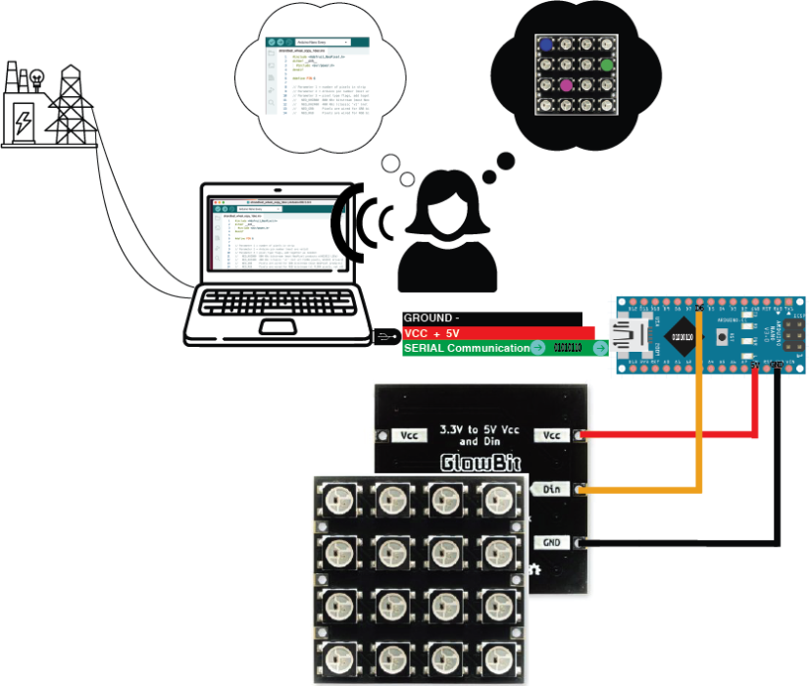
Arduino Microcontroller 101
Mick Byrne Oct 2023

Slide 2
Acknowledgement of Country
We acknowledge Aboriginal and Torres Strait Islander peoples and their continuing connection to land and as custodians of stories for millennia. We respectfully acknowledge the land on which we all meet today, and pay our respects to elders past, present and emerging.

Slide 3
WORKSHOP SUMMARY
This workshop is a basic introduction to Arduino microcontrollers using available code libraries. You will learn how to connect your Arduino to a breadboard and activate an LED light, no soldering just plug-and-play basics.
101 skills development workshops give you the basic skills you need to start your new creative journey.

Slide 4
SESSION OVERVIEW
Part 1
Welcome &
Intro to Microcontrollers
* What’s a Micro controller ?
* Why are we using Arduinos?
Part 2
Hardware and components The hands-on bit
* Anatomy of an Arduino board
* Making a circuit.
* Input /Output - Cause & effect
* Testing
Part 3
Arduino IDE basics
The grammar & syntax bit
* Connect to our board
* Introduction to Sketches
* File setup
* Design
Part 4
Our coding challenge and using Libraries
Lets have a go at coding
* Colour
* Movement
* Design
* Cutting
Notes:
The point of this session familarise ourselves of some of the basics and where we can find more information.
Hopefully you’ll learn enough tonight that you’ll want to go home and learn more.
We’d also love you come back and ask questions.

Slide 5
Apart from the Computer in front of you.
No tools required… just what you brought with you:
Your eyes,
your ears,
your hands
your curiosity and patience.
TOOLS

Slide 6
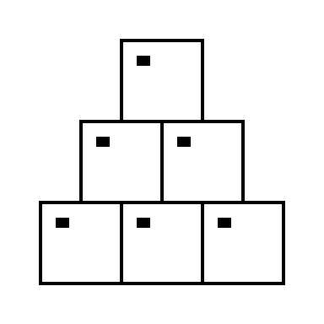
Arduino Nano ($20)
Breadboard ($1.50)
Jumper leads ($1)
Usb Cable ($1.5)
9 gram servo ($6)
NeoPixel ring ($4.5)
LED
We can sell you a kit at the café if you like -
MATERIALS

Slide 7
Health & Safety
Running this workshop at The Edge?.. You should familiarise yourself and your participants with:
DML Risk Assessment
Innovation Lab Risk Assessment

Slide 8
PART ONE
Welcome
What’s a nice person like you doing in a place like this?
Whats an MCU & why Arduino?
Notes:
Welcome
Check in and get set up on a computer
Why did you sign up? what are you hoping to get out of this series?
I can tell you why I’m here…
Overview of workshop
Key points here
End goals of session
Key points here

Slide 9
Notes:
Introduction to Arduino Microcontrollers
What is a micro controller?
A microcontroller (or MCU for microcontroller unit) is a small computer on a single integrated circuit.
They usually have
one or more CPUs (processor cores)
memory
programmable input/output peripherals
can be mixed signal devices interacting with
digital signals
analog signals
The easy way to understand what a Microcontroller is how they differ to microprocessors which is what is used for general purpose applications in personal computers .
Why use an MCU?
Microcontrollers are small, low powered and robust, making them perfect for embedded systems such as: medical devices
remote controls
office machines
appliances
power tools
toys
wearables!
Another way to understand what a Microcontroller is how they differ to microprocessors which is what is used for general purpose applications in personal computers .
What is Arduino?
Arduino is an open source computer hardware and software company, project, and user community (see: https://en.wikipedia.org/wiki/Arduino ).
The hardware is based on the Amtel 8-bit AVR MCU
The software uses the Processing IDE, with a simplified version of the C++ language
Open source has led to the creation of a huge range of
clones
compatible devices
peripherals
A strong community means
“Someone, Somewhere has solved the problem”
we can run this workshop using and adapting existing resources.

Slide 10
PART TWO
Hardware and components
The hands-on bit
Anatomy of an Arduino board
Making a circuit.
Input /Output - Cause & effect
Connect to our our computer to our board
Blink test

Slide 11
Anatomy of the Arduino Nano
USB connector
VIN
2x Ground Pins
+5 Volt Power
3.3V
Analog pins
Digital Pins
Builtin LED

Slide 12
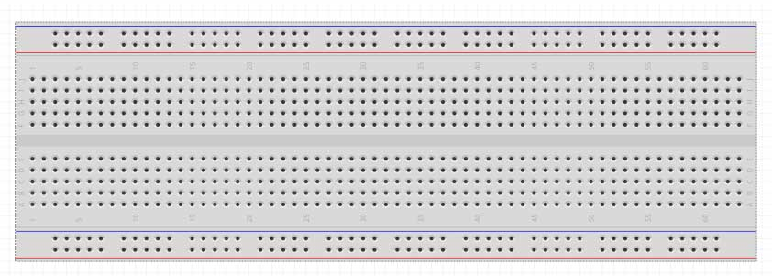
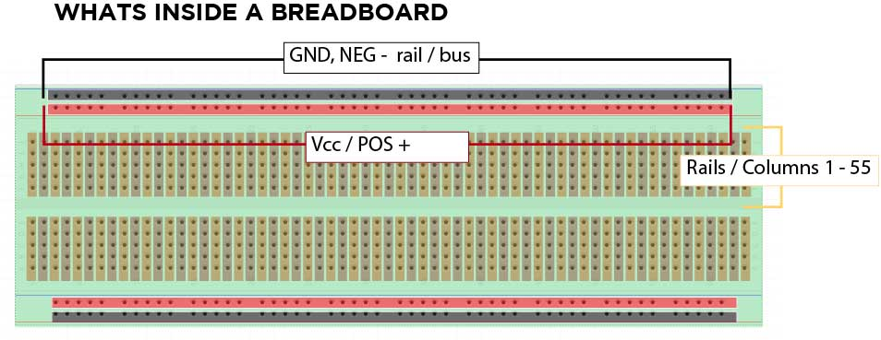
Using a Breadboard
Breadboards a great for learning and prototyping.
Less juggling parts
Easy to keep things tidy
No tools, no solder
Easy connections, less shorts
Can be confusing until you know what is going on inside.

Slide 13
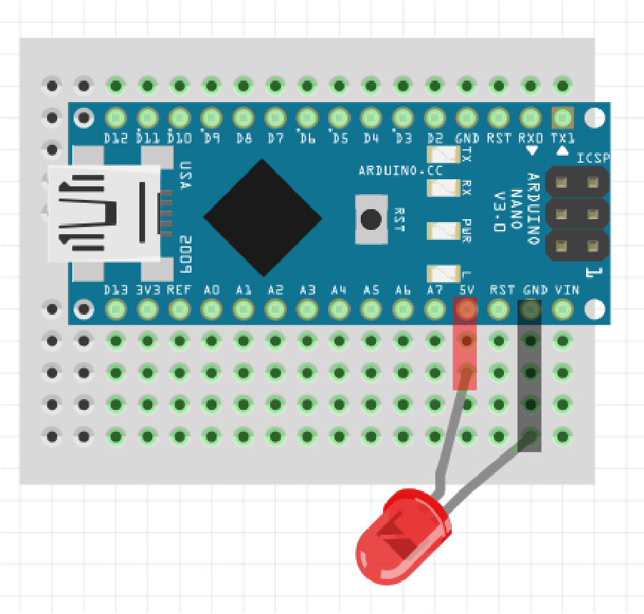
Using a Breadboard
Connect the
Anode (+) side of the LED to the 5V Pin and
Cathode (-) side Ground pin
When there’s power to the board there is always
+3.3V on the 3v3 Pin
+5V on the 5V Pin
You can put an LED across it or measure the potential with a multimeter.

Slide 14
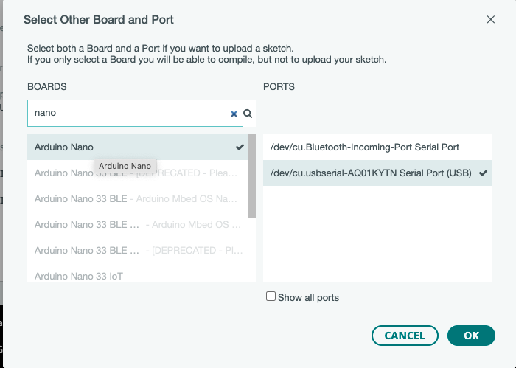
Using a Breadboard
So the Nano is connected to the computer (via usb)…
…but is the computer connecting to the board???
Open up Arduino IDE
Open this dropdown
Use the search bar to look for your Nano
And select the Serial Port (USB) to connect via the cable.
And hit OK
ARDUINO IDE

Slide 15
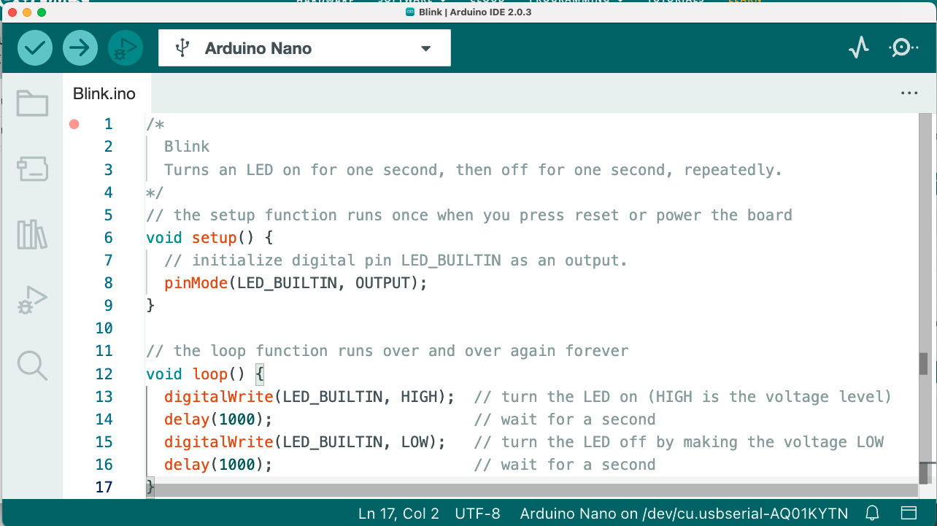
Using a Breadboard
Lets run our first test.
We’ll open an example sketch… Blink
Notes:
This is the simple test first test that everyone runs
If you have the right board selected Arduino Nano and the right port selected Serial Port (USB)
Verify the code
And the Upload it…. The LEDs should flash as the sketch is sent across to the Nano and then your program should run.

Slide 16
PART THREE
Arduino IDE basics
The grammar & syntax bit
Connect to our our computer to our board
Introduction to basics sketches – structure, functions, constants and variables.
Notes:
https://www.arduino.cc/reference/en/

Slide 17
Using a Breadboard
Notes:
Lets have a look whats in this very simple sketch.

Slide 18
https://www.arduino.cc/reference/en/
Open up this web page and grab your cheat sheet and lets go thru the Coding Structures, Functions, Constants, variables and syntax we use to program our Arduinos to monitor and control circuits and components.

Slide 19
PART FOUR
Our coding challenge & using Libraries
Lets have a go at coding
Libraries
Colour
& Movement

Slide 20
Lets combine what we’ve learnt and these sketches to make something new
Remember the point is to familarise ourselves of some of the basics and where we can find more information.
If your sketch doesn’t work its not a failure. It’s a failure if you don’t learn anything

