Slide 1
Simple Circuits - Electronics 101
Notes:
Before session:
Materials:
Per participant:

Slide 2
Acknowledgement of Country
Notes:
We acknowledge Aboriginal and Torres Strait Islander peoples and their continuing connection to land and as custodians of stories for millennia. We respectfully acknowledge the land on which we all meet today, and pay our respects to elders past, present and emerging.

Slide 3
Intros!
Notes:
Intro Activity - Favourite Invention
Whats your name?
Why did you sign up for today?
Whats your Favourite Invention?
The Transistor
experts to estimate that 13 sextillion transistors were manufactured from their invention in 1947 to today (that 13 followed by either 21 or 32 zeros). In 2014, this was 2.9 sextillion. This shows just how quickly we are producing them and putting them into service how many transistors are there in the world?
A transistor is a semiconductor device with at least three terminals for connection to an electric circuit. In the common case, the third terminal controls the flow of current between the other two terminals. wikipedia

Slide 4
What’s your name?

Slide 5
Why do you want to know about electronics?

Slide 6
Whats your Favourite Invention?
What’s your name?
Why do you want to know about electronics?

Slide 7
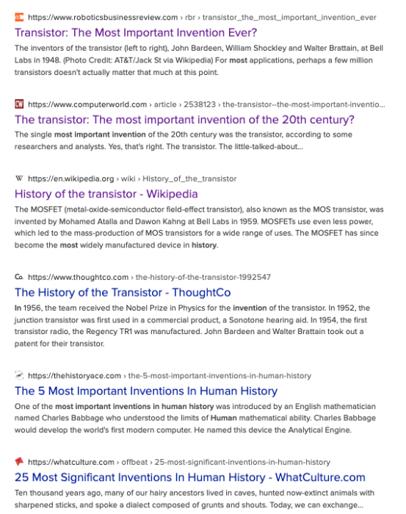
Whats your Favourite Invention?
The Transistor
Notes:
The Transistor
experts to estimate that 13 sextillion transistors were manufactured from their invention in 1947 to today (that 13 followed by either 21 or 32 zeros). In 2014, this was 2.9 sextillion. This shows just how quickly we are producing them and putting them into service how many transistors are there in the world?
A transistor is a semiconductor device with at least three terminals for connection to an electric circuit. In the common case, the third terminal controls the flow of current between the other two terminals. wikipedia

Slide 8
Session Overview
Intro - Why this workshop
Notes:
Session overview only

Slide 9
Session Overview
How does electricity flow in a circuit
Current
Voltage
Resistance
Ohms Law
Common Components & an intro to the multimeter.
Notes:
Session overview only

Slide 10
Session Overview
What’s the difference between the words Electric & Electronics
What are the basic electronics components and the key concepts we need to know to bend current and voltage to our whims.
Notes:
Session overview only

Slide 11
Part 1 Why an electronics 101?
Notes:
How does electricity work??? Its easy you go over and turn it on at the switch on the wall
Intro to electricity
In lots of situations, especially in workshops, you'll get asked if you know how something works, before quickly moving to the next bit.
And electricity is one of these classic things that a hand wavey assumption is made that you'll know how it works and we don't really stop to make sure we all really understand it.
Today we're going to stop and try and make sure that we all have the basic understanding of
how Electricity flows in a circuit,
how some common components work and
how we can make use the effects for our own devilish ends.
IF WE CAN WE’LL WORK OUR WAY THRU THE BASICS AND UP AND INCLUDING TRASNSITORS
First time I delivered some of this content ( a couple of month ago ) I was reflecting on how people get their head around complex concepts and I came across ELI5
We are going to guided by ELI5 concept to make sure we all understand. Explain Like I'm 5 is a bit of a movement on the web, started on reddit (and other message board style social media) and things like youtube where people take commonly asked questions like “How does Electric circuit work?” and answer these questions in a way that a lay person would understand - using a Five year old intelligence as a rough filter of the assumed understanding or experience of the world as a starting point for the explanation.
Often the ELI5 explanation ( or the best ones i think) make use of observations a five year old would use. You'll see what I mean when we get to it.)
Learning styles – learning thru mental models, by seeing relationships and consequences, by measuring
Learning by doing - resourcing our intuitions with experience
Learning together - by discussing, explaining
BECAUSE THIS IS WORKSHOP IS A BIT OF A FIRST REALLY INTERESTED IN HEARING YOUR FEEDBACK – TOO MUCH, NOT ENOUGH

Slide 12
But first a safety message
Electricity can kill.
Never mess with anything that uses mains power – anything you plug into the wall.
If in doubt check before you disassemble any electrical appliance or equipment.
Notes:
If there’s only one thing that you learn today it would be great to think you are confident about what’s safe and legal and what’s not.
A helpful way to look at it electrical safety is IEC (int Electrotechnical Commision) definition of High Voltage, Low Voltage and Extra Low Voltage

Slide 13
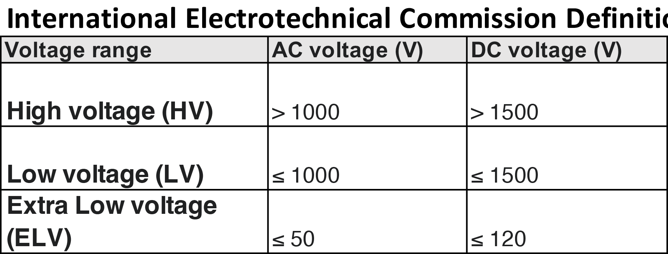
Be confident in your Electrical Safety
In Queensland its illegal for anyone to undertake unlicenced work on any electrical equipment over the ELV threshold.
Questions?
Notes:
High Voltage is over 1000V AC and 1500DC and can arc thru the air
Low voltage is anything under this and can result in an electric shock
Extra Low Voltage is anything under 50VAC or 120VDC and is consider low risk
In Australia you need to be certified to work on anything over Extra Low Voltage.
TODAY WE’LL BE WORKING ON 9 VOLT DC CIRCUITS ☺
References
www.legislation.qld.gov.au/view/html/inforce/current/act-2002-042#sec.14
www.legislation.qld.gov.au/view/html/inforce/current/act-2002-042#sec.55
https://www.legislation.qld.gov.au/view/html/inforce/current/act-2002-042#sch.2

Slide 14
ACDC ???
AC stands for Alternating Current – it’s the type of electricity that we have in our houses.
Instead of just ramping up to 240 V the current reverse 50 time a second from 240 V+ to 240V- and back again.
The symbol for AC is ~
Notes:
But don’t worry about this too much because as I said before… you should be playing Alternating Current

Slide 15
ACDC ???
DC stands for Direct Current – it’s the type of energy used in cars and electronics.
DC gets used in Electronics and while consumer electronics plug into the wall the power pack that that you power these with generally steps this voltage down and flattens it out.
The symbol for AC is

Slide 16
Part 2 How does electricity flow in a circuit

Slide 17
Current
An electric current is a stream of charged particles, such as electrons or ions, moving through a circuit.
This current flows from (+) positive to the (–) negative
Current is measured in Amps (I)
Notes:
*One ampere is equal to 6.241509074×1018 electrons worth of charge moving past a point per second.
Generally we talk about this current flowing from the positively Charged side of the circuit to the negatively charged side*
Current is measured in Amps ( named after Andre Marie Ampere and represented by the letter I)
*nb: theres a big caveat here- electrons “actually” have been discovered flow from negative to positive (only recently actually)… but the convention has remained - Current flows Positive to negative, active to neutral, positive to ground.
Practical activity: Calc batt & LED

Slide 18
Voltage
Voltage, the electric pressure or difference in potential that causes this current to flow (conventionally from positive to negative*).
This potential is measured in Volts (V)
Notes:
This potential is measured in Volts ( named after Alessandro Volta represented by the letter V)
Practical activity: 9v Battery & LED PLUS a resistor

Slide 19
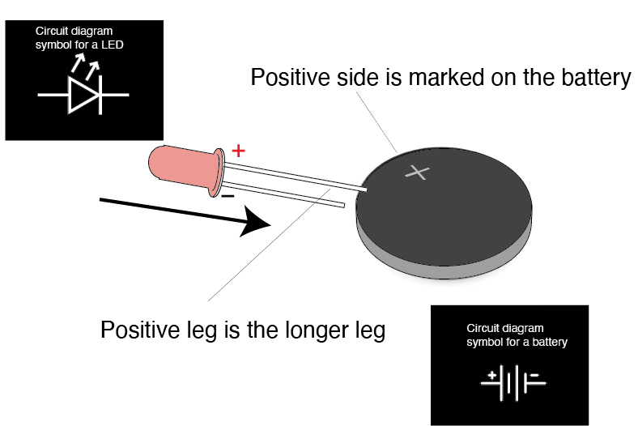
Hands on activity #1 lets get the juice flowing
Notes:
LED and and a calc battery
Battery has a Pos and Neg side
LED is a special Diode – Diode are one way gate has a pos and neg too
When the right way round the Voltage of pushes electrons down the led which tickle the semi conductor which emits photons and then continue around to complete the circuit.
If theres a break in the circuit the electrons – current can flow
If the LED is around the wrong way the elctrons get caught at the led and the circuit wont flow

Slide 20
Current and Voltage analogies
Hydro-Electro Analogy – the drain-pipe theory
Notes:
There are a couple of analogies that commonly get used to describe how this happens that are intuitive to us because we see and in these things in our daily observations. The first one is the “ Hydraulic – Electro analogy” and, the other is the “Earth gravity analogy” (marble run) of electrical potential.
Its good to look at both of these analogies because they both have strengths and limitations.
Practical activity: 9v Battery & LED PLUS a resistor

Slide 21
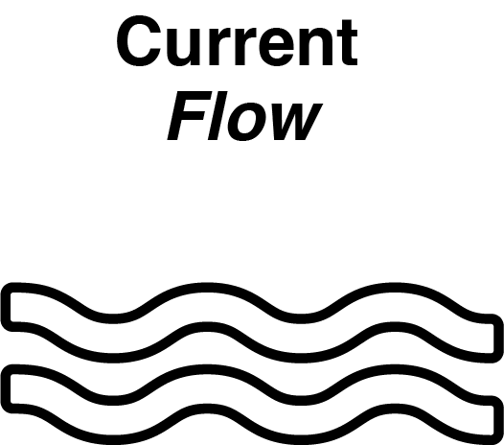
Hydraulic analogy The drain-pipe theory

Slide 22
Hydraulic analogy The drain-pipe theory
Notes:
Valve is off now water getting to the water wheel

Slide 23
Hydraulic analogy The drain-pipe theory
Notes:
Theres no voltage sorce

Slide 24
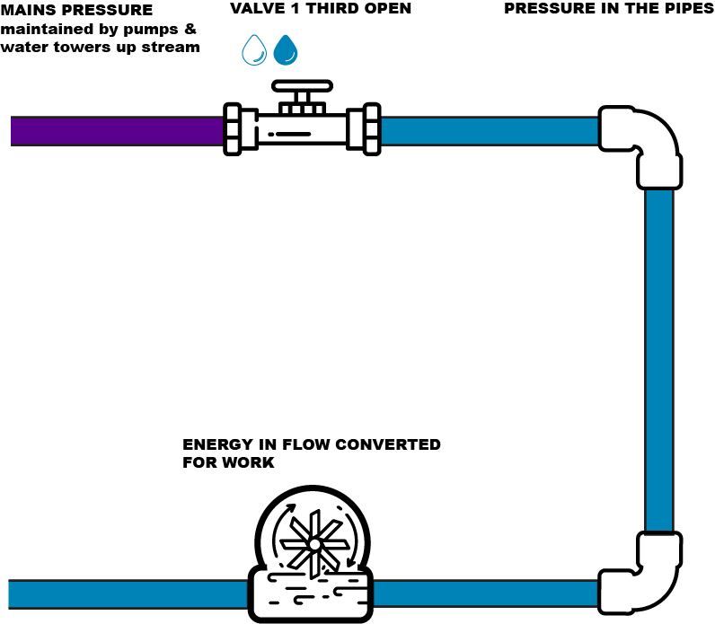
Hydraulic analogy The drain-pipe theory
Notes:
What happens if we turn on the valve

Slide 25
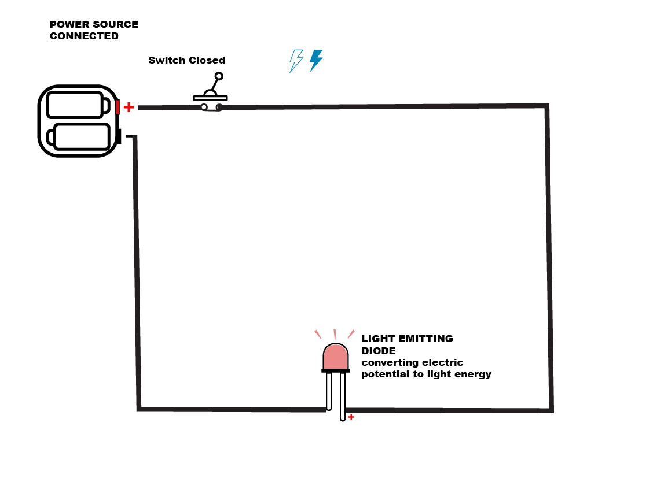
Hydraulic analogy The drain-pipe theory
Notes:
What happens if apply a voltage and close the switch

Slide 26
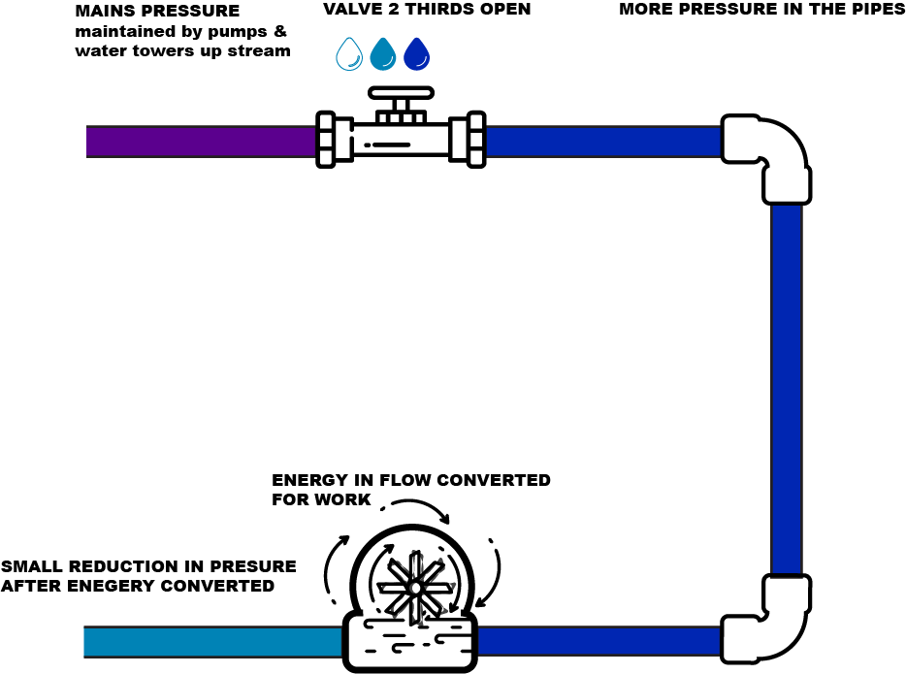
Hydraulic analogy The drain-pipe theory
Notes:
What if we turn the valve on a little more?

Slide 27
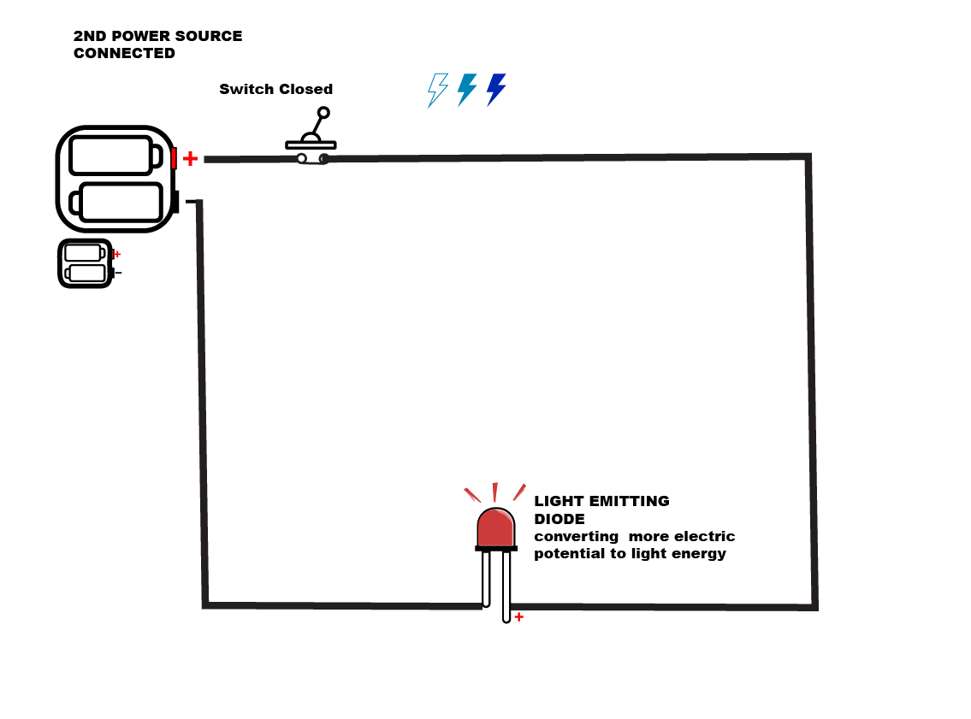
Hydraulic analogy The drain-pipe theory
Notes:
What if we add more voltage

Slide 28
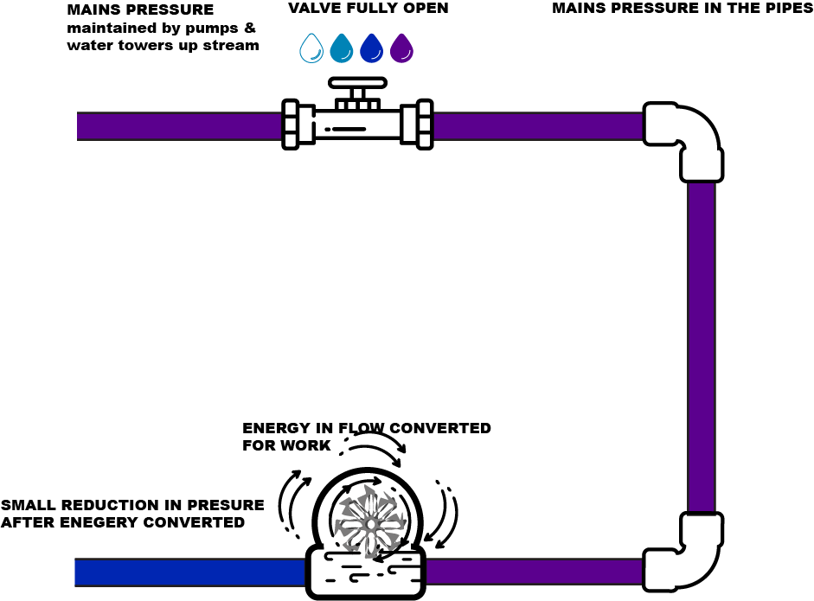
Hydraulic analogy The drain-pipe theory
Notes:
What if we increase the potential even more?

Slide 29
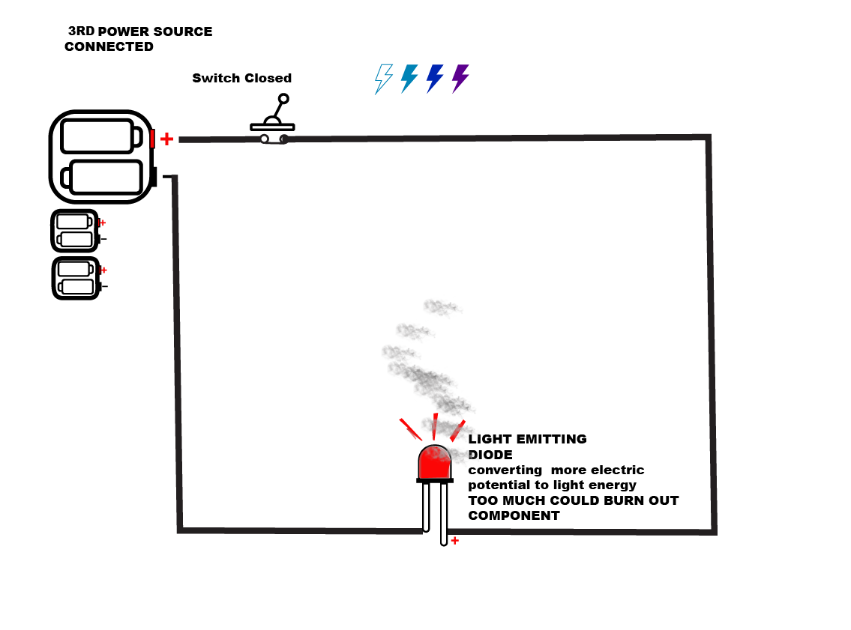
Hydraulic analogy The drain-pipe theory
Notes:
Maybe its too much

Slide 30
Resistance
Resistance is the measure of its opposition to the flow of electric current.
Resistance is measured in Ohms (Ω)
Notes:
Resistance is measured in Ohms (named after Georg Ohm and represented by the last letter of the Greek alphabet, Omega Ω)
9v Battery & LED PLUS a potentiometer

Slide 31
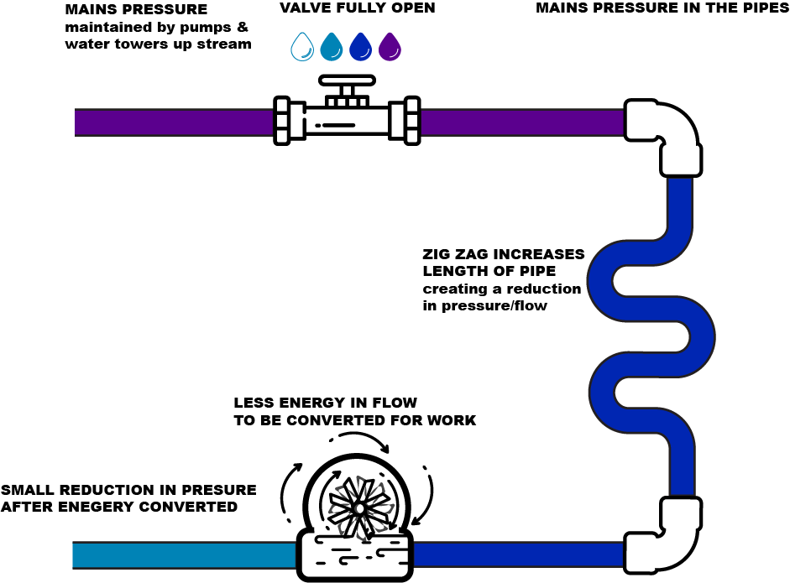
Hydraulic analogy The drain-pipe theory
Notes:
What if we add a longer length of pipe to the system

Slide 32
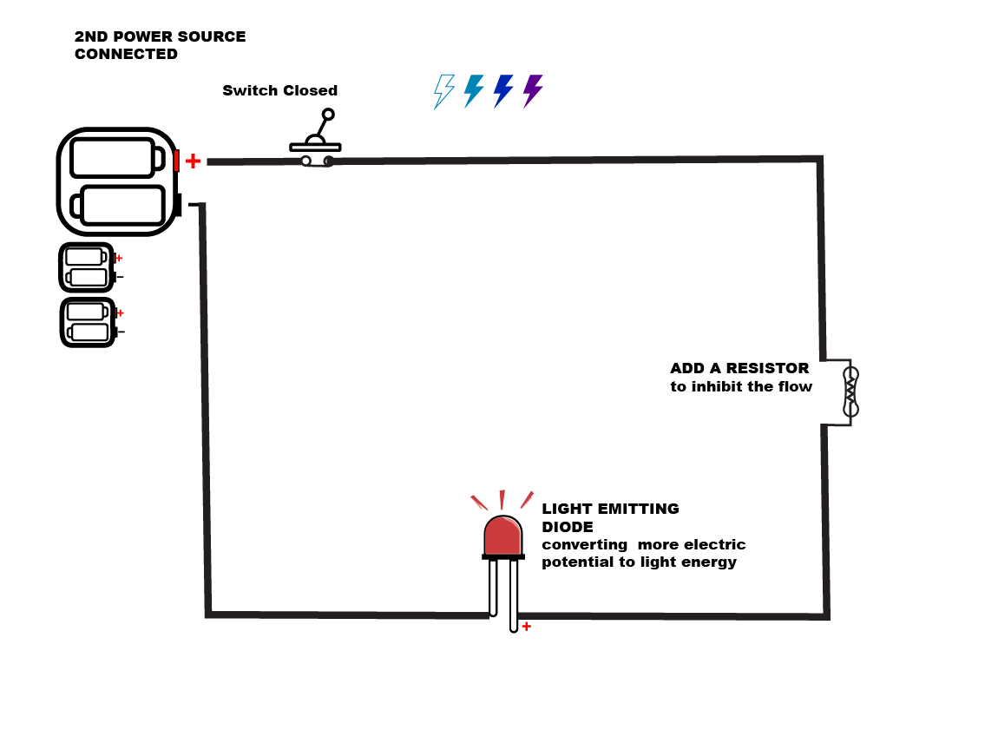
Hydraulic analogy The drain-pipe theory
Notes:
What happens if we turn on the valve

Slide 33
Resistor

Slide 34
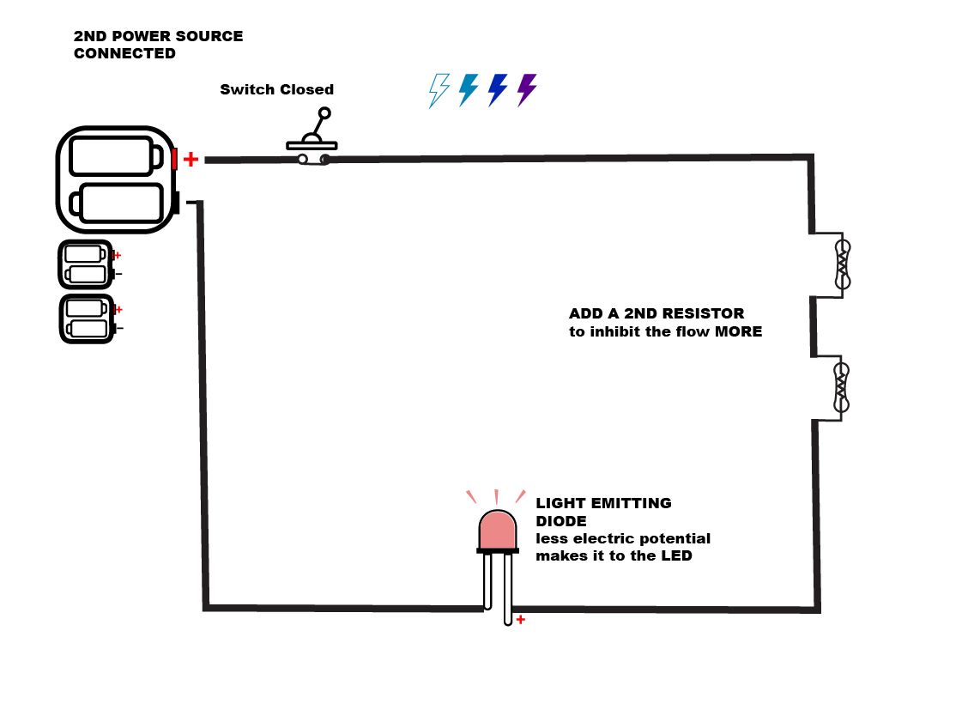
Hydraulic analogy The drain-pipe theory

Slide 35
Current and Voltage analogies
Earth gravity analogy – Marble race
Physics Videos by Eugene Khutoryansky
Notes:
analogy” (marble run) of electrical potential.
Its good to look at both of these analogies because they both have strengths and limitations.
Practical activity: 9v Battery & LED PLUS a resistor

Slide 36
Hands on activity # 2 resistance is futile
Notes:
LED and and a calc battery
Battery has a Pos and Neg side
LED is a Diode – one way gate has a pos and neg too
When the right way round the Voltage of pushes electrons down the led which tickle the semi conductor which emits photons and then continue around to complete the circuit.
If theres a break in the circuit the electrons – current can flow
If the LED is around the wrong way the elctrons get caught at the led and the circuit wont flow

Slide 37
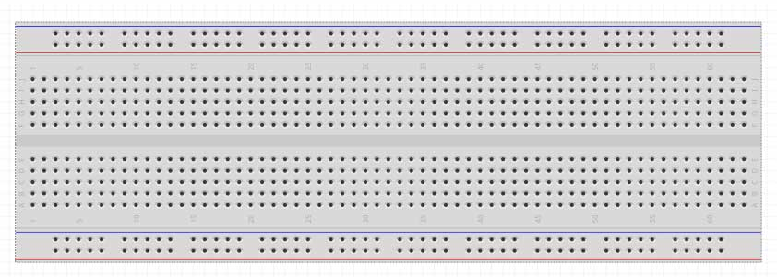
Using a breadboard

Slide 38
Using a Multimeter
Notes:
Another way of getting you head around this stuff is to use a measuring tool.
Multimeters are tool we use for fault finding and checking stuff is working as we go
There’s 2 main types Digital and analogue but these are pretty rare these days
Theres a whole variety of digital ones too.
The main thing to know is whether its manual or auto ranging.,
The ones we’ll be using today are auto ranging
So that’s where we’ll start
Although these measure all sort of things the three things we’ll be looking at are what we’ve cover so far
Voltage, Resitance and Current

Slide 39
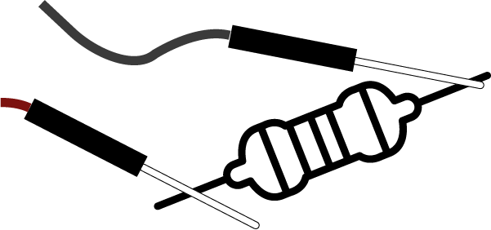
Using a Multimeter
Resistance (Ohms - Ω)
Lets try the multimeter
Out on a couple of resistors.
We can also use the multimeter to work out
which holes are connected on the breadboard.
Notes:
Place red cable in the V Ω -|)- Hz terminal and the black in the common
Select for Ω Resistance
Connect the the leads leads to either side of the component or section of circuit you would like to measure.
NB
When taking a resistance reading we are actually applying a small current to the component (section of a circuit) and measuring the voltage drop. So it needs to be isolated to get an accurate reading. (if its not isolate the current can travel back thru a parallel circuit and give a false reading.
Continuity
Continuity is a little like the resistance setting only it doesn’t give you a value just a yes no to let you know theres path or complete circuit for current to flow.
The meter will read OL. Meaning loop or open circuit or a reading and will beep.
To test for continuity only
Set up you leads and selector the same as above and hit the blue button to select the alternate mode

Slide 40
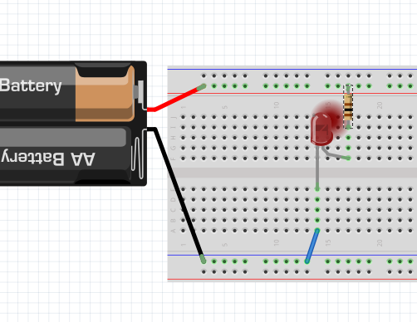
Hands on activity # 2 resistance is futile
It should look something like this
Notes:
LED and a pair of batteries that produce 3V
Battery has a Pos and Neg side
LED is a Diode – one way gate has a pos and neg too
When the right way round the Voltage of pushes electrons down the led which tickle the semi conductor which emits photons and then continue around to complete the circuit.
If theres a break in the circuit the electrons – current can flow
If the LED is around the wrong way the elctrons get caught at the led and the circuit wont flow

Slide 41
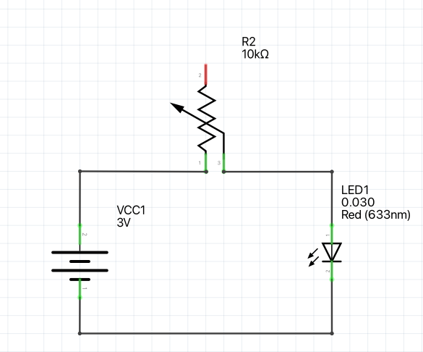
Hands on activity # 2 resistance is futile
Notes:
Ok lets swap the normal resistor out for a potentiometer

Slide 42
Potentiomenter
Notes:
Whats a Potentiometer?

Slide 43
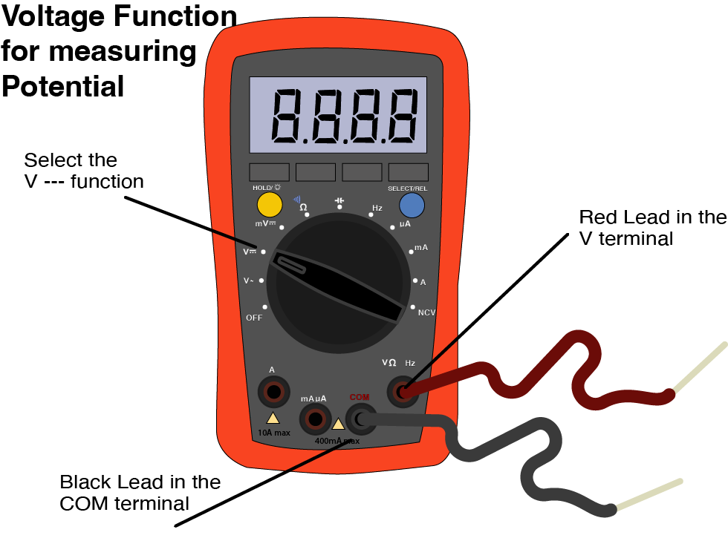
Using a Multimeter
Notes:
First thing to workout before you can measure anything is whether your dealing with a Direct Current (DC) or Alternating Current (AC)
Should be DC cause we genrerally should not be playing with AC.
We’re luck cause these meters default to DC
Place red cable in the V Ω -|)- Hz terminal and the black in the common
Select V--- for DC Voltage
Connect the red lead to the positive (+) and back lead to the negative (-) component or section of circuit you would like to measure.
NB
Remember you are measuring the difference in voltage (potential , pressure… so measuring at the same point you get zero ( no difference in voltage)
If you get a negative Voltage – you have the leads around the wrong way

Slide 44
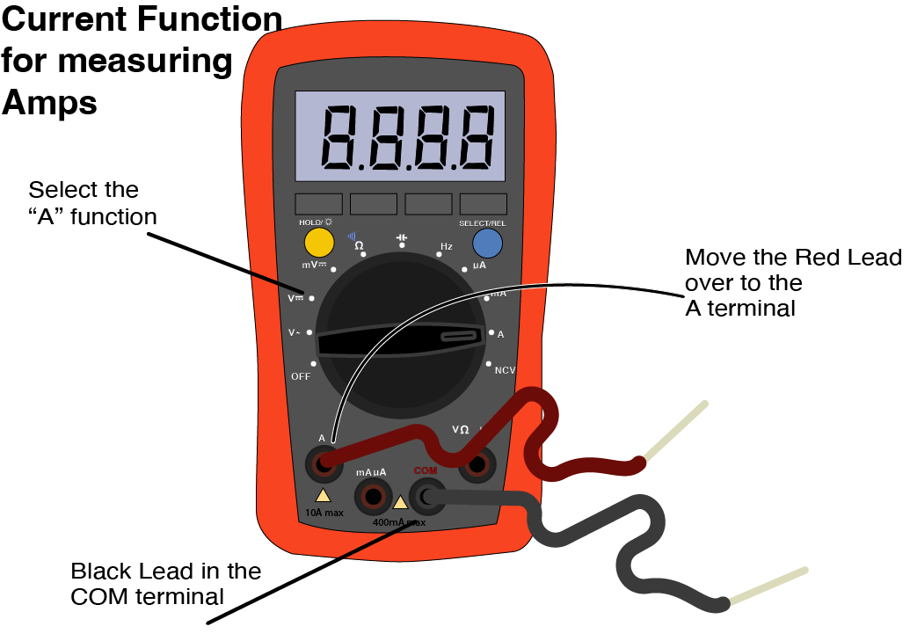
Using a Multimeter
Notes:
!!CURRENT CAN DAMAGE YOUR METER!!
The mA (milliAmp) µA (microamp) terminal is only designed to measure up to a maximum value of 400mA Try to measure anything over this and you’ll blow the fuse.
If you don’t know what reading you are likely to get select the A and work your way back if need be.
If you don’t know the
Place the black in the common and the red cable in the A or mA µA terminal.
Select for A---, mA---, or µA---
Amperage readings need to always taken in series. Taking a reading in parallel to the load provides a shorter path for the current to to flow and will giveyou a false reading and could damage your meter.
Remember you are measuring the difference in voltage (potential , pressure… so measuring at the same point you get zero ( no difference in voltage

Slide 45
Electric Charge
Ohms Law Explained, youtube.com/@EngineeringMindset
Notes:
Copper is a favourite material for making conductors
Its relatively cheap, easy to find and produce and it got great conductivity characteristics.
If this is what a conductor does… whats a semiconductor do?

Slide 46
Ohms Law
Notes:
Ohms Law is the interlinked relationship of Voltage, Current and Resistance.
It’s a powerful tool and while it looks like maths when you play with it enough you come to unstand it on a intuitive level …. Im told ;)

Slide 47
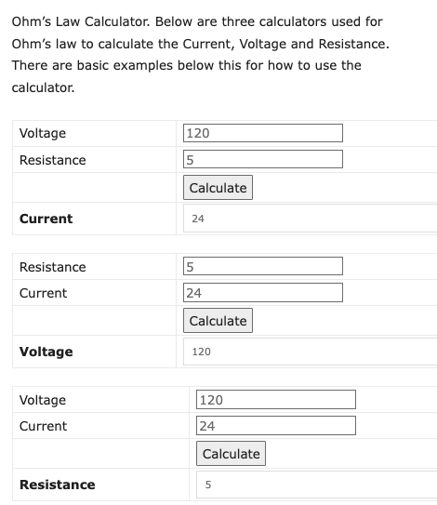
Ohms Law
theengineeringmindset.com/ohms-law-calculator
Notes:
Befor we go any further with this remember you never have to worry about doing maths
Cause theres an app for that

Slide 48
Ohms Law

Slide 49
Ohms Law

Slide 50
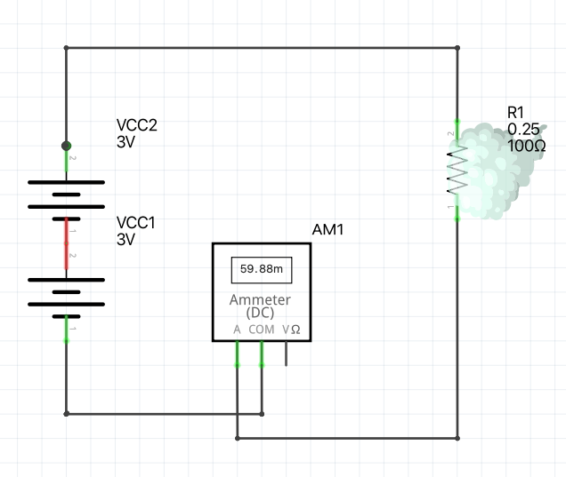
Ohms Law
Notes:
Now that we have this in hand “or kinda” we can do some experiments
What if we double the voltage by adding double the batteries we double the amps

Slide 51
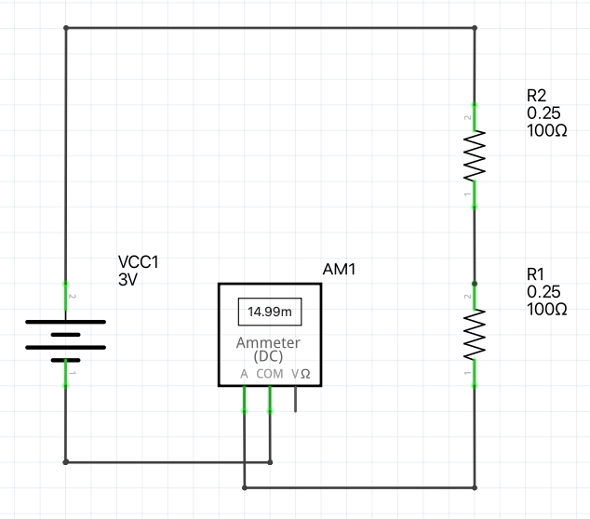
Ohms Law
Notes:
What if we double the resistance by adding doubling the 100 Ohm resistors
we halve the amps

Slide 52
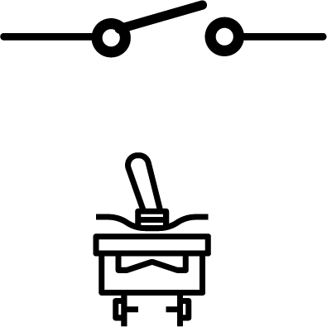
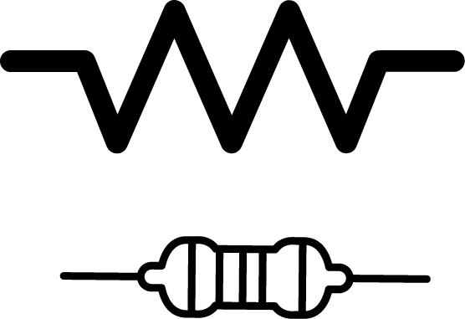
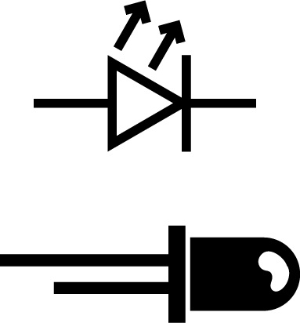
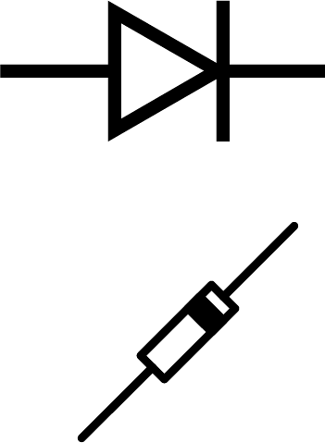
Common components summarised
Switch
mechanical break in a circuit that stops the flow of current.
Resistors
Inhibits the flow of current
Diodes (LED)
One-way gate

Slide 53
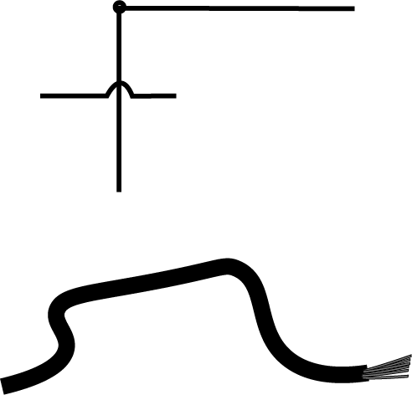
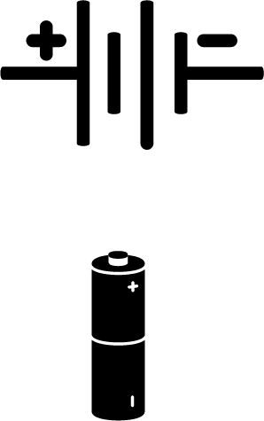
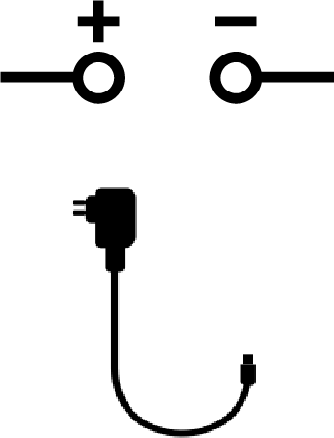
Common components summarised
Conductors (wires)
These are wires or other strips of metal designed to carry
current and are often surrounded by insulation
Supply Voltage
Usually a battery
or
power supplies designed
for powering DC circuits
Notes:
Bread board

Slide 54
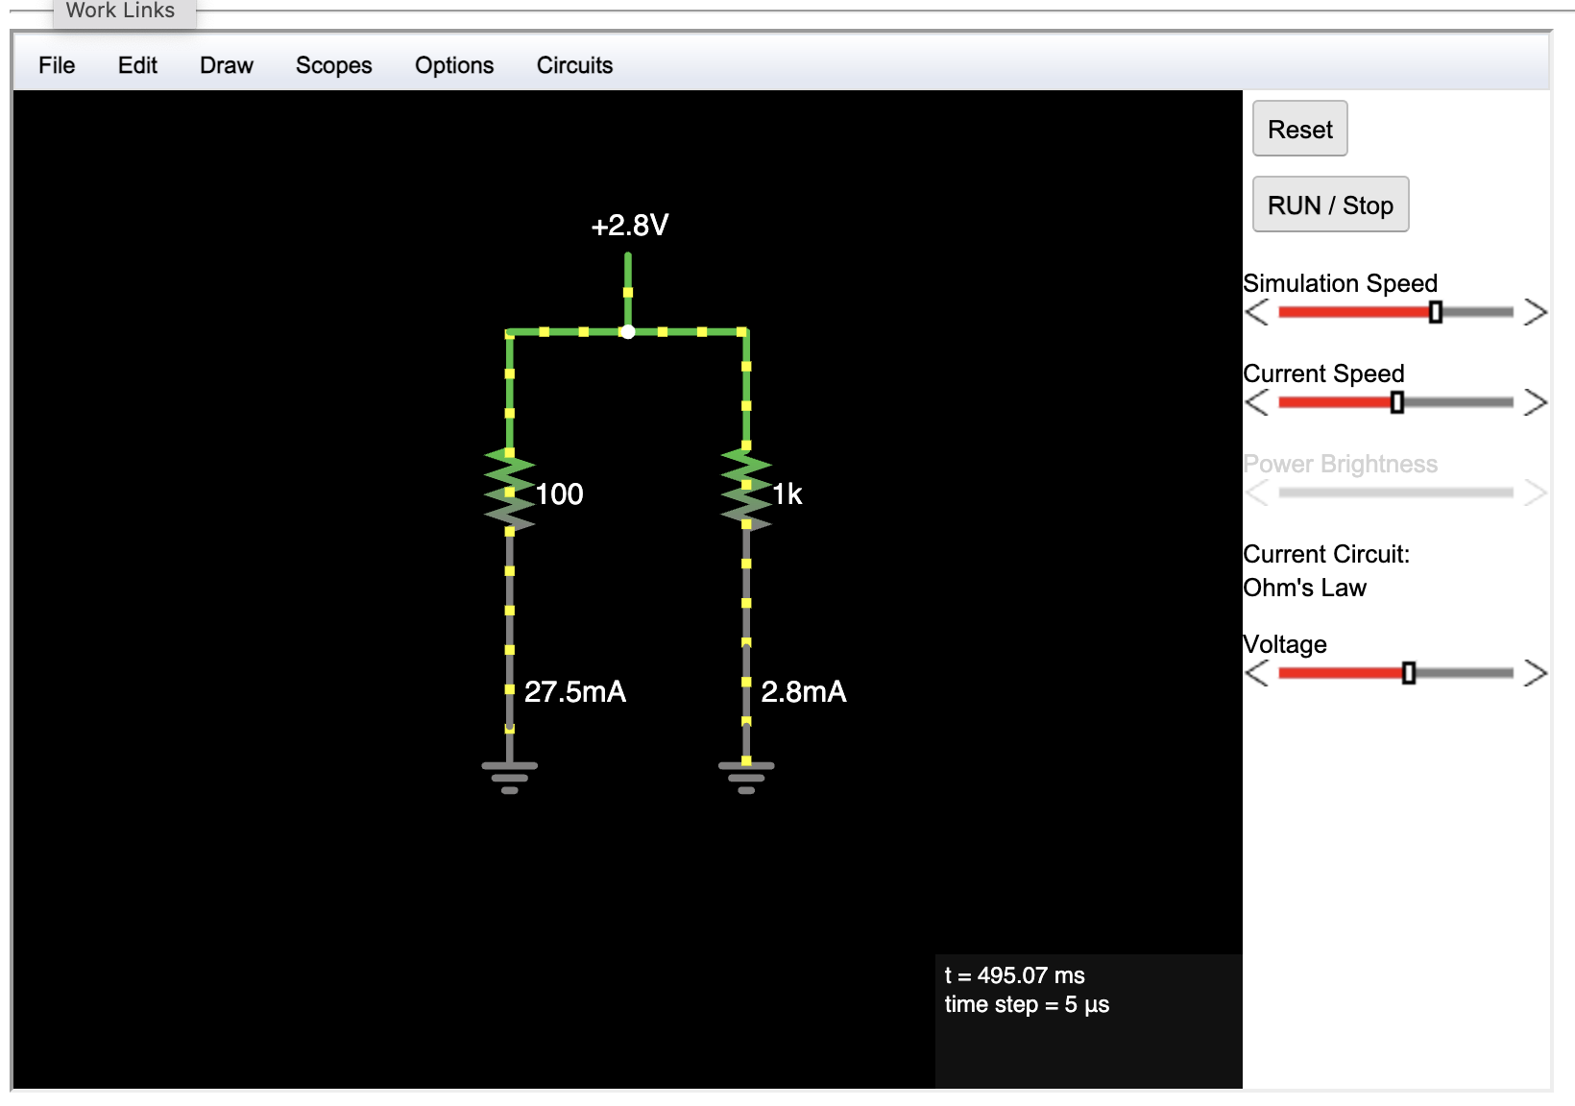
Falstad simulator

Slide 55
What’s the difference between the words Electric & Electronics
Notes:
Electrical installations use the above and of course some more advanced concepts like AC, transdformers, induction to do grunt work
Where as Electronics use semiconductors another electromagnetic effects to sense and respond according to our designs.

Slide 56
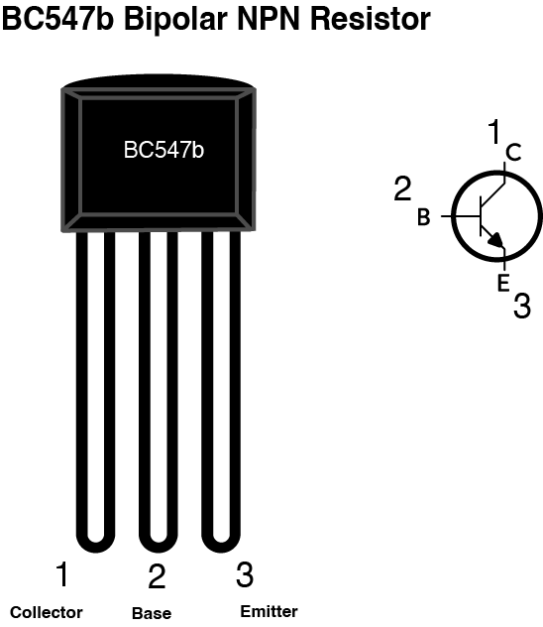
One more component
Transistor
Notes:
A Transistor is a semiconductor that can be used as a switch (turn on or off) or vary the current in one subcircuit in response to the inputs of a parallel sub circuit.
It allows us to design circuits that will automatic and remotely change their output based on a voltage inducing input somewhere else.
Today we are going to be using a fairly common sort of Transistor its a Bipolar
Bipolar Transistors are current regulating devices that control the amount of current flowing through them from the Emitter to the Collector terminals in proportion to the amount of biasing voltage applied to their base terminal, thus acting like a current-controlled switch. As a small current flowing into the base terminal controls a much larger collector current forming the basis of transistor action.

Slide 57
One more component
Transistor
Notes:
The Transistor sits at the centre of 2 sub-circuits,
the input or base circuit side and
The output or emitter side of the circuit
At the minimum base voltage threshold or “Cutoff” the semiconductor begins to allow current to flow from the collector out of the emitter. Below this threshold the transistor is “Fully-Off”
At the maximum base voltage threshold or “Saturation” the semiconductor is “Fully-On”
The spectrum between these thresholds is the “Active Region”.
Amplify
Gain

Slide 58
Lets put this together

Slide 59
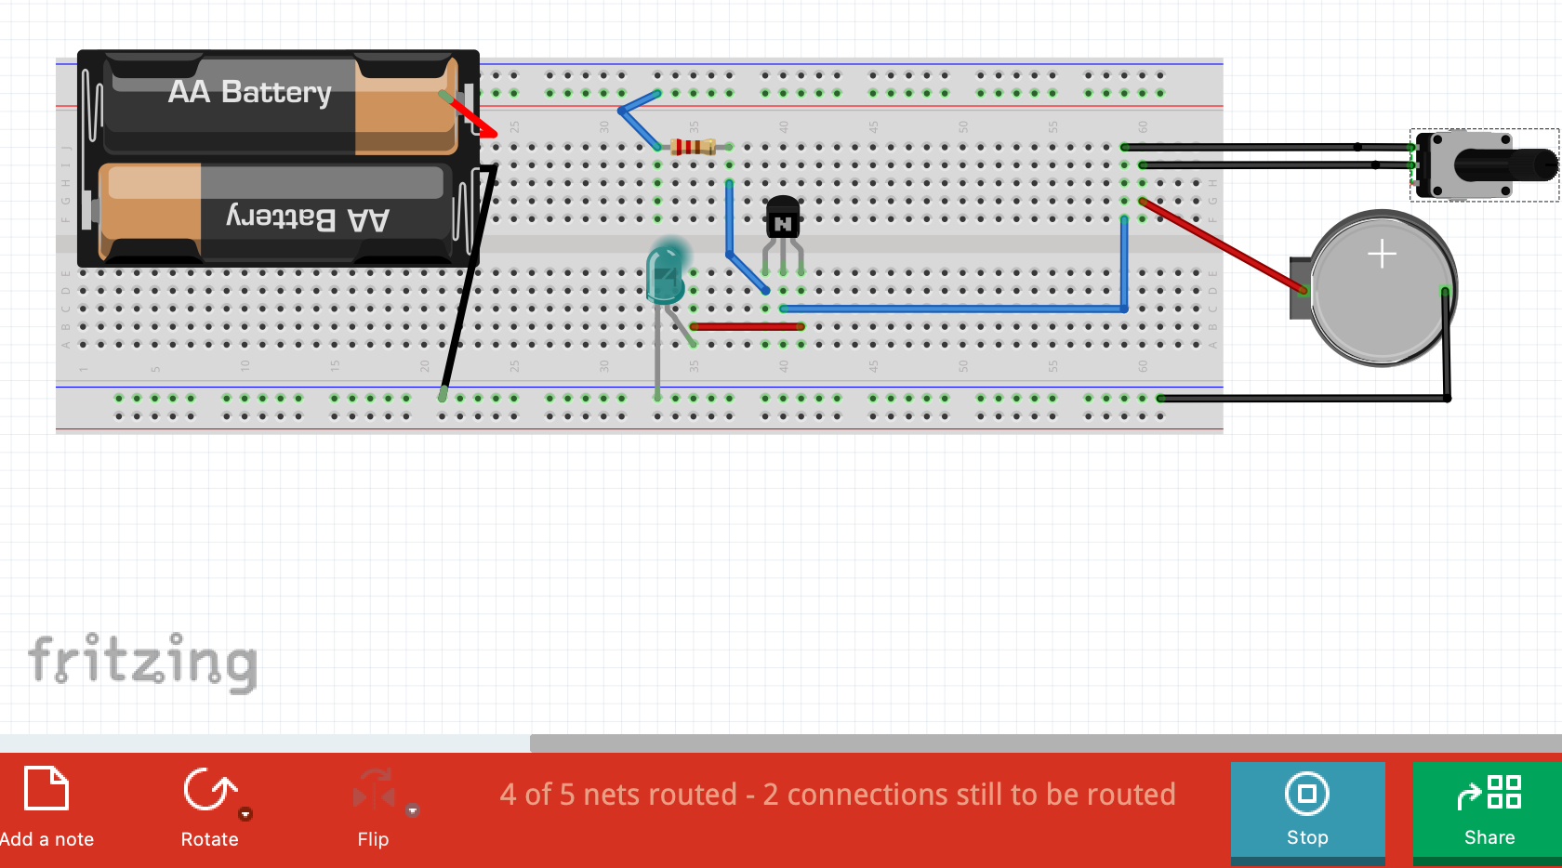
Fritzing

Slide 60
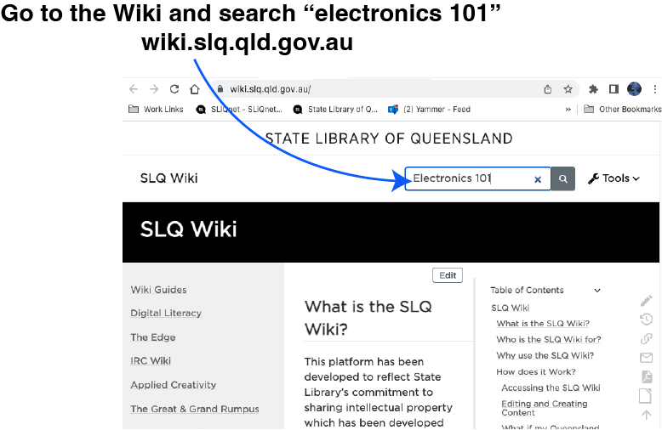
Where to go from here?
SLQwiki –
This presentation and a pile of other useful info is on the wiki
Hack the Evening
Come back and work on your own designs,
Get signed off on theElectronics bench induction.
Talk to people about their projects.

Slide 61
Where to go from here?
Arduino Workshops –
We run Arduino based project workshops and coding workshops 2 or 3 times a year. Keep an eye on the enews for bookings
Instructables projects–
https://www.instructables.com/circuits/projects

Slide 62
Where to go from here?
Videos –
Electricity videos by Eugene Khutoryansky
Great visual explanations for key concepts
ElectroBOOM
Entertaining experiments demonstrating key concepts for you…
so you don’t have to blow anything up at home.
Please don’t try at home

Slide 63
Where to go from here?
Videos –
Electricity Basics The Engineering Mindset
More excellent visual explanations for key concepts

