Slide 1
Laser cut covers and hand sewn spines Session 1
Notes:
Before session:
Email participants:
Can bring own laptop, install inkscape (link to), bring mouse with scroll wheel that can be clicked in!!! (else have laptops here)
Bring USB to transfer files home
Divvy up books between participants, give them links
Finalise webpage including videos of inkscape
Set up laser with demo cut
Materials:
Per participant:
Sample inkscape file + cut demo from laser for reference
Template for covers file (outline on base layer, include good image for live trace) on laptops have layer 2 active.
Laptop +power supply
Inkscape installed (all on same version)
Internet connection

Slide 2
Acknowledgement of Country
Notes:
We acknowledge Aboriginal and Torres Strait Islander peoples and their continuing connection to land and as custodians of stories for millennia. We respectfully acknowledge the land on which we all meet today, and pay our respects to elders past, present and emerging.

Slide 3
Intros!
Notes:
Billie = Not a bookbinder, just an overly enthusiastic maker, background in theatrical costume making and 3D printing, facilitator here at Fabrication Lab
Shane = Conservation Tea
m = real book binder! ☺

Slide 4
Why did you sign up?
Why do you want to make a book?
What do you hope to get out of these sessions?

Slide 5
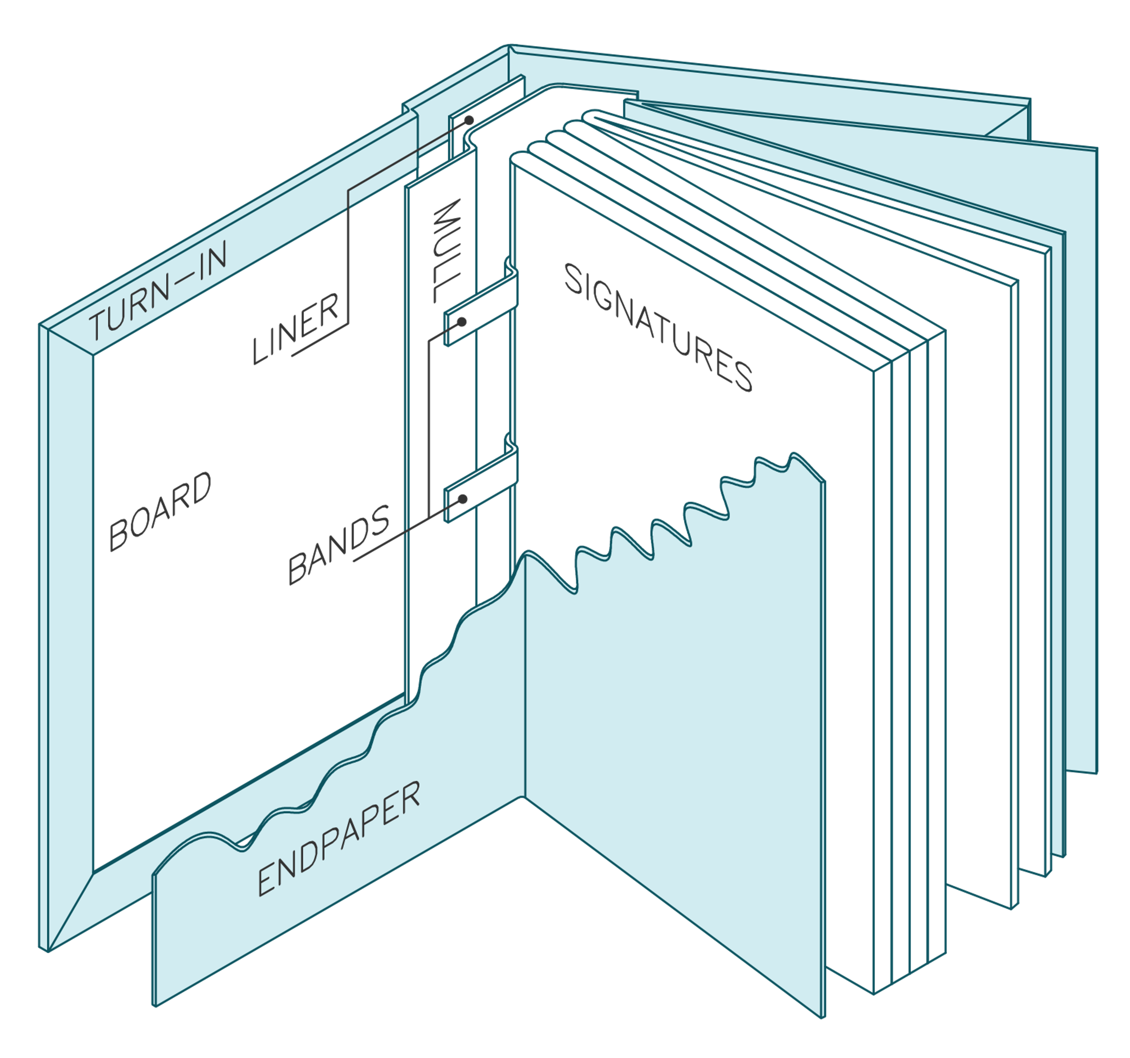
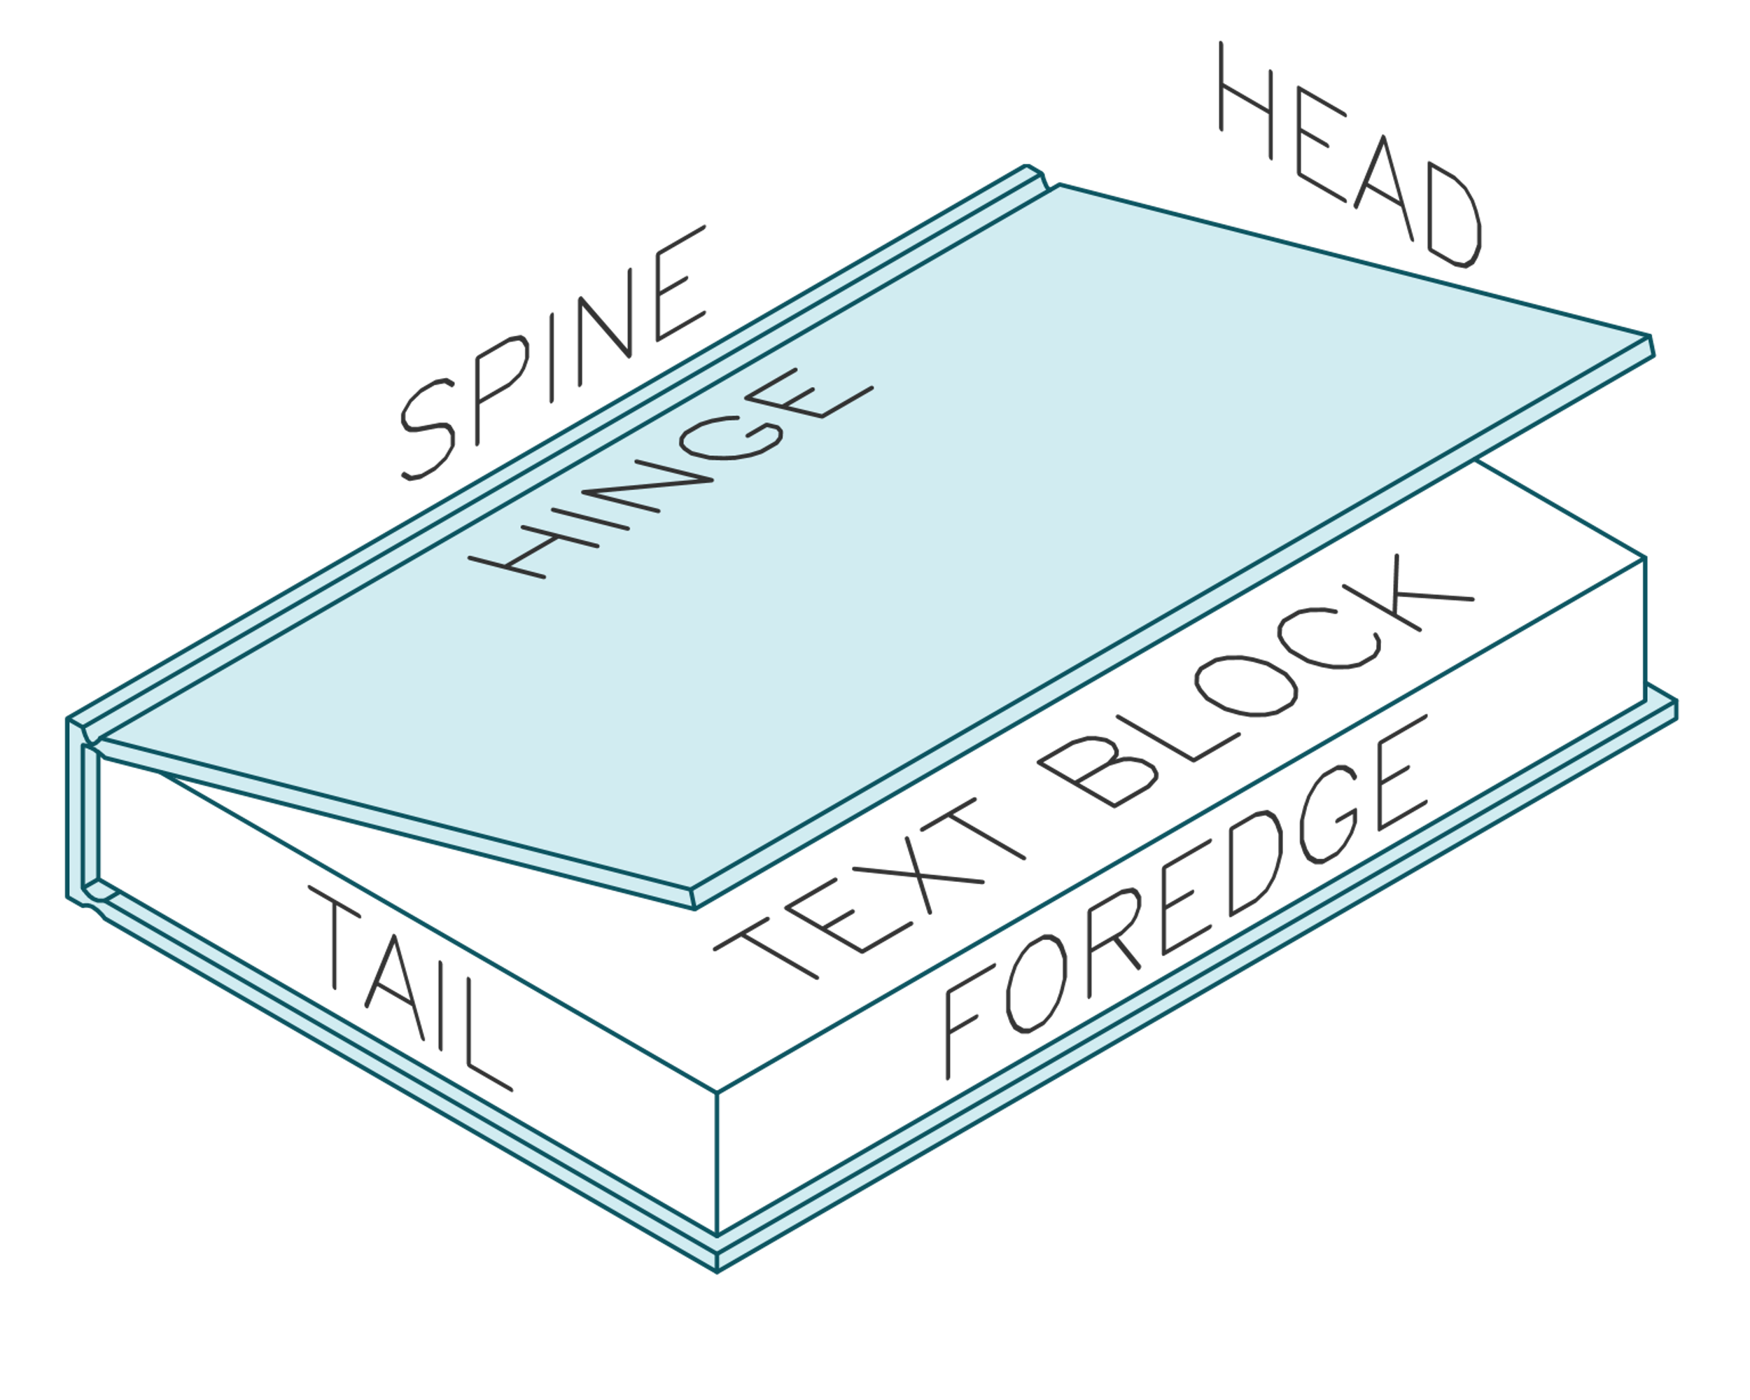
Our books
Notes:
Demo pieces
Laser cut plywood cover, painted and metal leafed,
traditionally bound rest
Headband & ribbon
Show inner workings at back page, talk about gluing
We’re starting on covers today
This workshop is all about learning the process and skills. We’re sure you are going to make beautiful things, but it really is about the skills so don’t be worried if your design is perfect – cause you can make another one once you know the skills

Slide 6
Course Overview
Session 1
Using Inkscape to create a cover design and starting binding. Laser cutter demo
Bookmaking: fold and sew

Slide 7
Course Overview
Session 2
Recap
Complete our text blocks: Glue mull, headband and book mark.
Laser induction
Start decorating cover

Slide 8
Course Overview
Session 3
Recap
Assemble cover, combine with text block, and add end papers .
Decoration of cover
Where to from here

Slide 9
Why laser cut a book cover?
Notes:
Allows us to make intricate things once more, as a lot of the fine work in many handcrafts have been pushed out by mass manufacturing due to time/labour costs involved in hand making something like this.
Very customisable, don’t need to make a big brass stamp for each book cover, or lots of little ones, manually carve something like this.
Also very repeatable! Can expect the same results from the same file.
Opens it up to people who haven’t got the dexterity or practice, as this is very accurate, and being able to design it first digitally is a lot more forgiving than hand carving something!

Slide 10
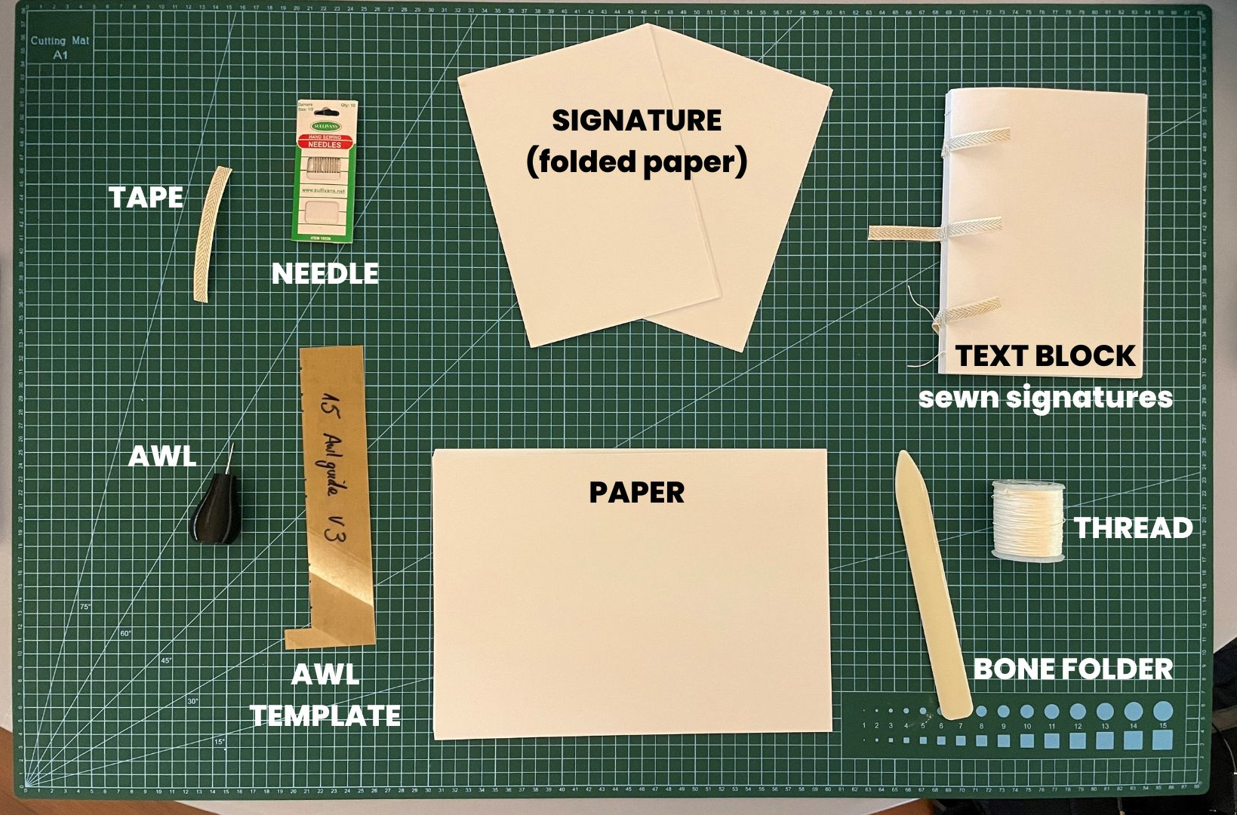

Slide 11
Starting your text block

Slide 12
Sewing our text block

Slide 13
Fold signatures
We'll be using 6 sheets of paper to make a signature.

Slide 14
Folding process
Fold in half, match edges, press down with hand at centre of edge to secure.
Sweep bone folder from your hand to the fold then up and down the fold to crease it.
Fold three signatures

Slide 15
Punching Holes
Awl made from 3D printer and tapestry needle
Punching template from laser cutter
Notes:
File link for awl and template
Can buy awl
Can make template from manilla card

Slide 16
Punching Holes
Work over something with some give
Hook template at top of signature
Aim for centre of crease
Punch it at a 45 degree angle

Slide 17
Sewing
We're going to refer to the video on the wiki.
We'll do this step by step together
This is going to be our practice text block
A note about… Tension

Slide 18
Designing the cover

Slide 19
Laser cutting demo & overview
Demo
Induction in session 2

Slide 20
Bitmap vs Vector Graphics
BITMAP
(pixels)
VECTOR
(math lines)
Notes:
bitmap = pixels (like photo) = bad
vector = lines made of maths infinitely zoom in and will always be crisp
Because they are just maths, they are very easily read by laser cutter
We don’t need to know maths! Special software allows us to make it. Inkscape is one such example.
Most digital images we use day to day (such as JPEGs, GIFs and PNGs) are called bitmaps, they are made up of thousands of little blocks of colour called pixels. These are great for photos but they don't provide enough information for a lot of digital fabrication technologies (such as CNC routers and laser cutters).They also can't be made larger without the image “pixelising” and looking ugly, so bitmaps are not well suited to various graphic design applications like logos.
This is where vector images excel. Vectors are essentially lines made of maths, so you can zoom in and out infinitely without the image blurring, and they are much easier for machine software to interpret. Thankfully, we don't need to program the maths these lines are made of, we have software that will work all that out for us, and they are able to save the images out in various vector formats, some of the most common being SVG and DFX, though PDFs can also contiain vectors (but it gets confusing because they can also contain other things like bitmaps!).

Slide 21
Inkscape (vector software)
Free & Open source
Download online for free inkscape.org
Let’s get started!
Notes:
Because open source, plugins for all kinds of things.
Download Inkscape at home here for free: https://inkscape.org/

Slide 22
Open Inkscape
From taskbar at bottom of screen
Looks like a little snow-capped mountain

Slide 23
Open Template
File > open
Navigate to template on desktop
Click [Open]
Notes:
Open Template
File > open
Navigate to template on desktop
Click Open

Slide 24
Adding shapes
THERE’S A VIDEO OF THIS ON THE WIKI!
Adding rectangles
Adding squares
Ellipses
Circles

Slide 25
Navigation
Moving around
Click in mouse wheel + move mouse
Zooming in and out
Ctrl + scroll wheel
Setting up the interface
Go into preferences in the Edit menu
Notes:
Navigation
Moving around
Click in mouse wheel + move mouse
Zooming in and out
Ctrl + scroll wheel
Set up the interface to suit your needs
Find preferences in the Edit menu and go to interface

Slide 26
Selecting things
Click black mouse icon on tool bar at left
Then click on the thing you want to move
The little black arrows show you’ve selected it.
Click the white space to de-select

Slide 27
Moving things
THERE’S A VIDEO OF THIS ON THE WIKI!
Click black mouse icon on tool bar at left
Then click and drag the thing you want to move.
Let go when it’s in the right place.
Click the white space to de-select it.

Slide 28
Rotating Things
THERE’S A VIDEO OF THIS ON THE WIKI!
Click black mouse icon on tool bar at left
Click on the thing you want to rotate.
Wait a second.
Click again on the thing you want to rotate and the arrows on the outside of the object will change.
Click and drag one of the corner arrows to rotate the object.
Notes:
Rotating Things
Click black mouse icon on tool bar at left
Click on the thing you want to rotate.
Wait a second.
Click again on the thing you want to rotate and the arrows on the outside of the object will change.
Click and drag one of the corner arrows to rotate the object.

Slide 29
Adding text
Text tool
Resizing:
Overall
Text box

Slide 30
Custom Shapes: Pen Tool
THERE’S A VIDEO OF THIS ON THE WIKI!
Adding points
Dragging points
Dragging lines
Corners vs smooth
Adding points
Deleting points
Practice makes perfect!
Notes:
Don’t worry if it’s a bit uncomfy now! You will get the hang of it in no time.

Slide 31
Cover Designs
Three options for coming up with a design
Option 1 - Draw something and vectorize it.
Notes:
Three options

Slide 32
Cover Designs
Three options for coming up with a design
Option 2 - Find one or two reference images that inspire you and compose a design.
Notes:
Three options

Slide 33
Cover Designs
Three options for coming up with a design
Option 3 – some thing different Dream something up in collaboration with an AI.
https://creator.nightcafe.studio/
Notes:
Three options

Slide 34
Inspiration
Also: Old book covers/ illustrations via pinterest, Archive.org, PublicDomainReview.org, googling, etc
It’s about the concept, not a literal interpretation
Notes:
The Well: https://wiki.slq.qld.gov.au/doku.php?id=engagement:grumpus:grumpuslandonline:rrldev:thewellhome
The aim isn’t to reproduce the children’s art in laser form, but to make something inspired by it.

Slide 35
Copyright
The SLQ Collection
Your own drawings
Good sources of free images on wiki like archive.org (just check licences)
Fonts: check the licenses
Notes:
https://archive.org/details/StencilCatalogsCutStencilsForTheUseOfPracticalMen/page/n51/mode/2up?view=theater
https://archive.org/details/ExcelsiorFrescoStencils/page/n43/mode/2up
https://archive.org/details/250stencildesign00kpra/page/30/mode/2up
https://www.pinterest.com.au/billieruben8695/book-covers/
https://publicdomainreview.org/

Slide 36
Cover Designs
Three options for coming up with a design
Option 3 – or something new Dream something up in collaboration with an AI text to image generator.
Check what the machine made from my prompt.

Slide 37
Check what the machine made from my prompt.

Slide 38
Cover Designs

Slide 39
Cover Designs
We’ll even prep it so that Inkscape can have a reasonable hope of producing a decent vector image to be etched on the Laser prep it
Notes:
We’ll even prep it so that Inkscape can have a reasonable hope of producing a decent vector image to be etched on the Laser prep it

Slide 40
Cover Designs
Notes:
We’ll even prep it so that Inkscape can have a reasonable hope of producing a decent vector image to be etched on the Laser prep it

Slide 41
Back to Inscape Trace
Again we can use the pen tool to trace the images
Notes:
Lock your artwork
create a new layer
Start tracing with the pen tool. The pencil tool, the path finder tool
or you can try the auto trace

Slide 42
Live Trace
Choosing (or making!) a good image:
“Stencil-like”
No thin lines
High contrast

Slide 43
Bitmap Trace
THERE’S A VIDEO OF THIS ON THE WIKI!
Inkscape will have a go at tracing your image for you.
Notes:
Inserting image
Video on wiki

Slide 44
Saving
Inkscape SVG –for editing
PDF – for cutting on laser
!!! SAVE TO YOUR USB !!!

Slide 45
Back to sewing

Slide 46
Back to sewing signatures
We want to end up with 6 signatures of 6 sheets.
Sewn together and ready for next week we'll be gluing the
bookmark and mull.

Slide 47
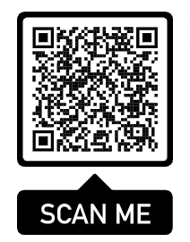
Here is the video if you want to refer to it as you work

Slide 48
Homework
Finish sewing, bring next session!
Final cover art to me by Friday next week 4 Nov!!
We’ll cut it out for you and have it ready for the next session.

Slide 49
Help
Sewing video and diagram on wiki
Inkscape tutorial on the wiki.
Drop us an email or
Come in on Thursday for Hack the Evening 5-8pm.

Slide 50
End of Session 1

