Slide 1
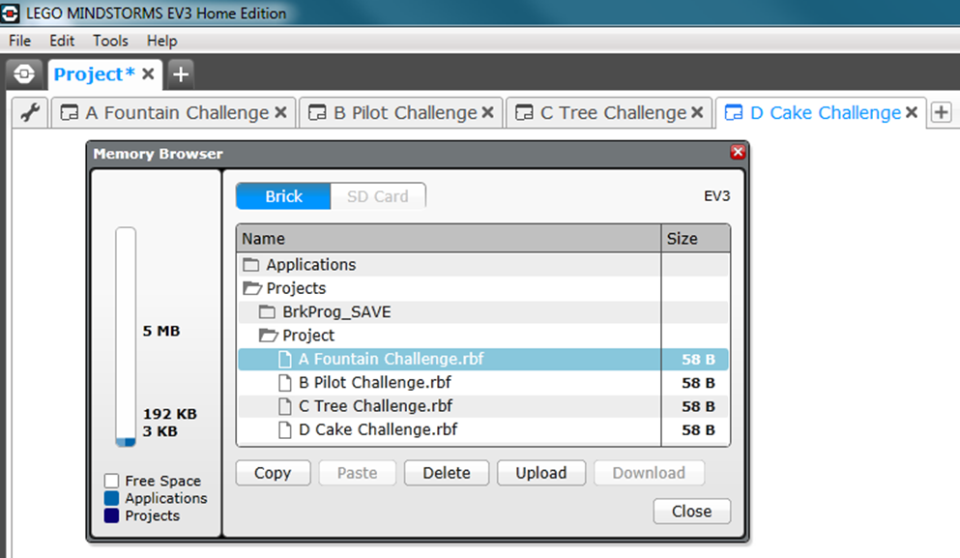
Naming Conventions and Folder Structure
Folder Structure
Make sure you have one folder and all your programs underneath
Change individual program names by double left click into the program name field and alphabetise in order
EV3 Brick View
Your folder will appear under PROJECTS and your programs will be alphabetised within
TIP: name your programs after the missions they are solving to ensure that you can easily identify code on your EV3
To transfer code from one file to another highlight your code, copy and then past it where you want it. This is also helpful to create copies for further adjustments and trialling – with a safety copy saved at the beginning of every session, please see an example below:

